Slide 1



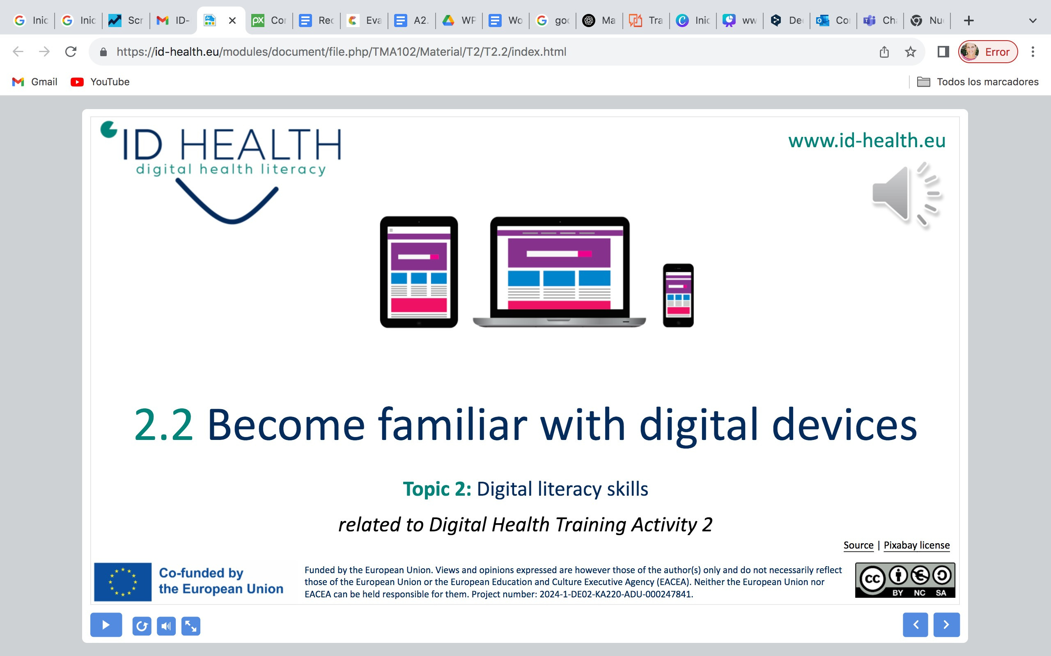
www.id-health.eu
5. Using health information from the internet
5.1
Recognize good health information on the internet

Slide 2








www.id-health.eu
Partners

Slide 3
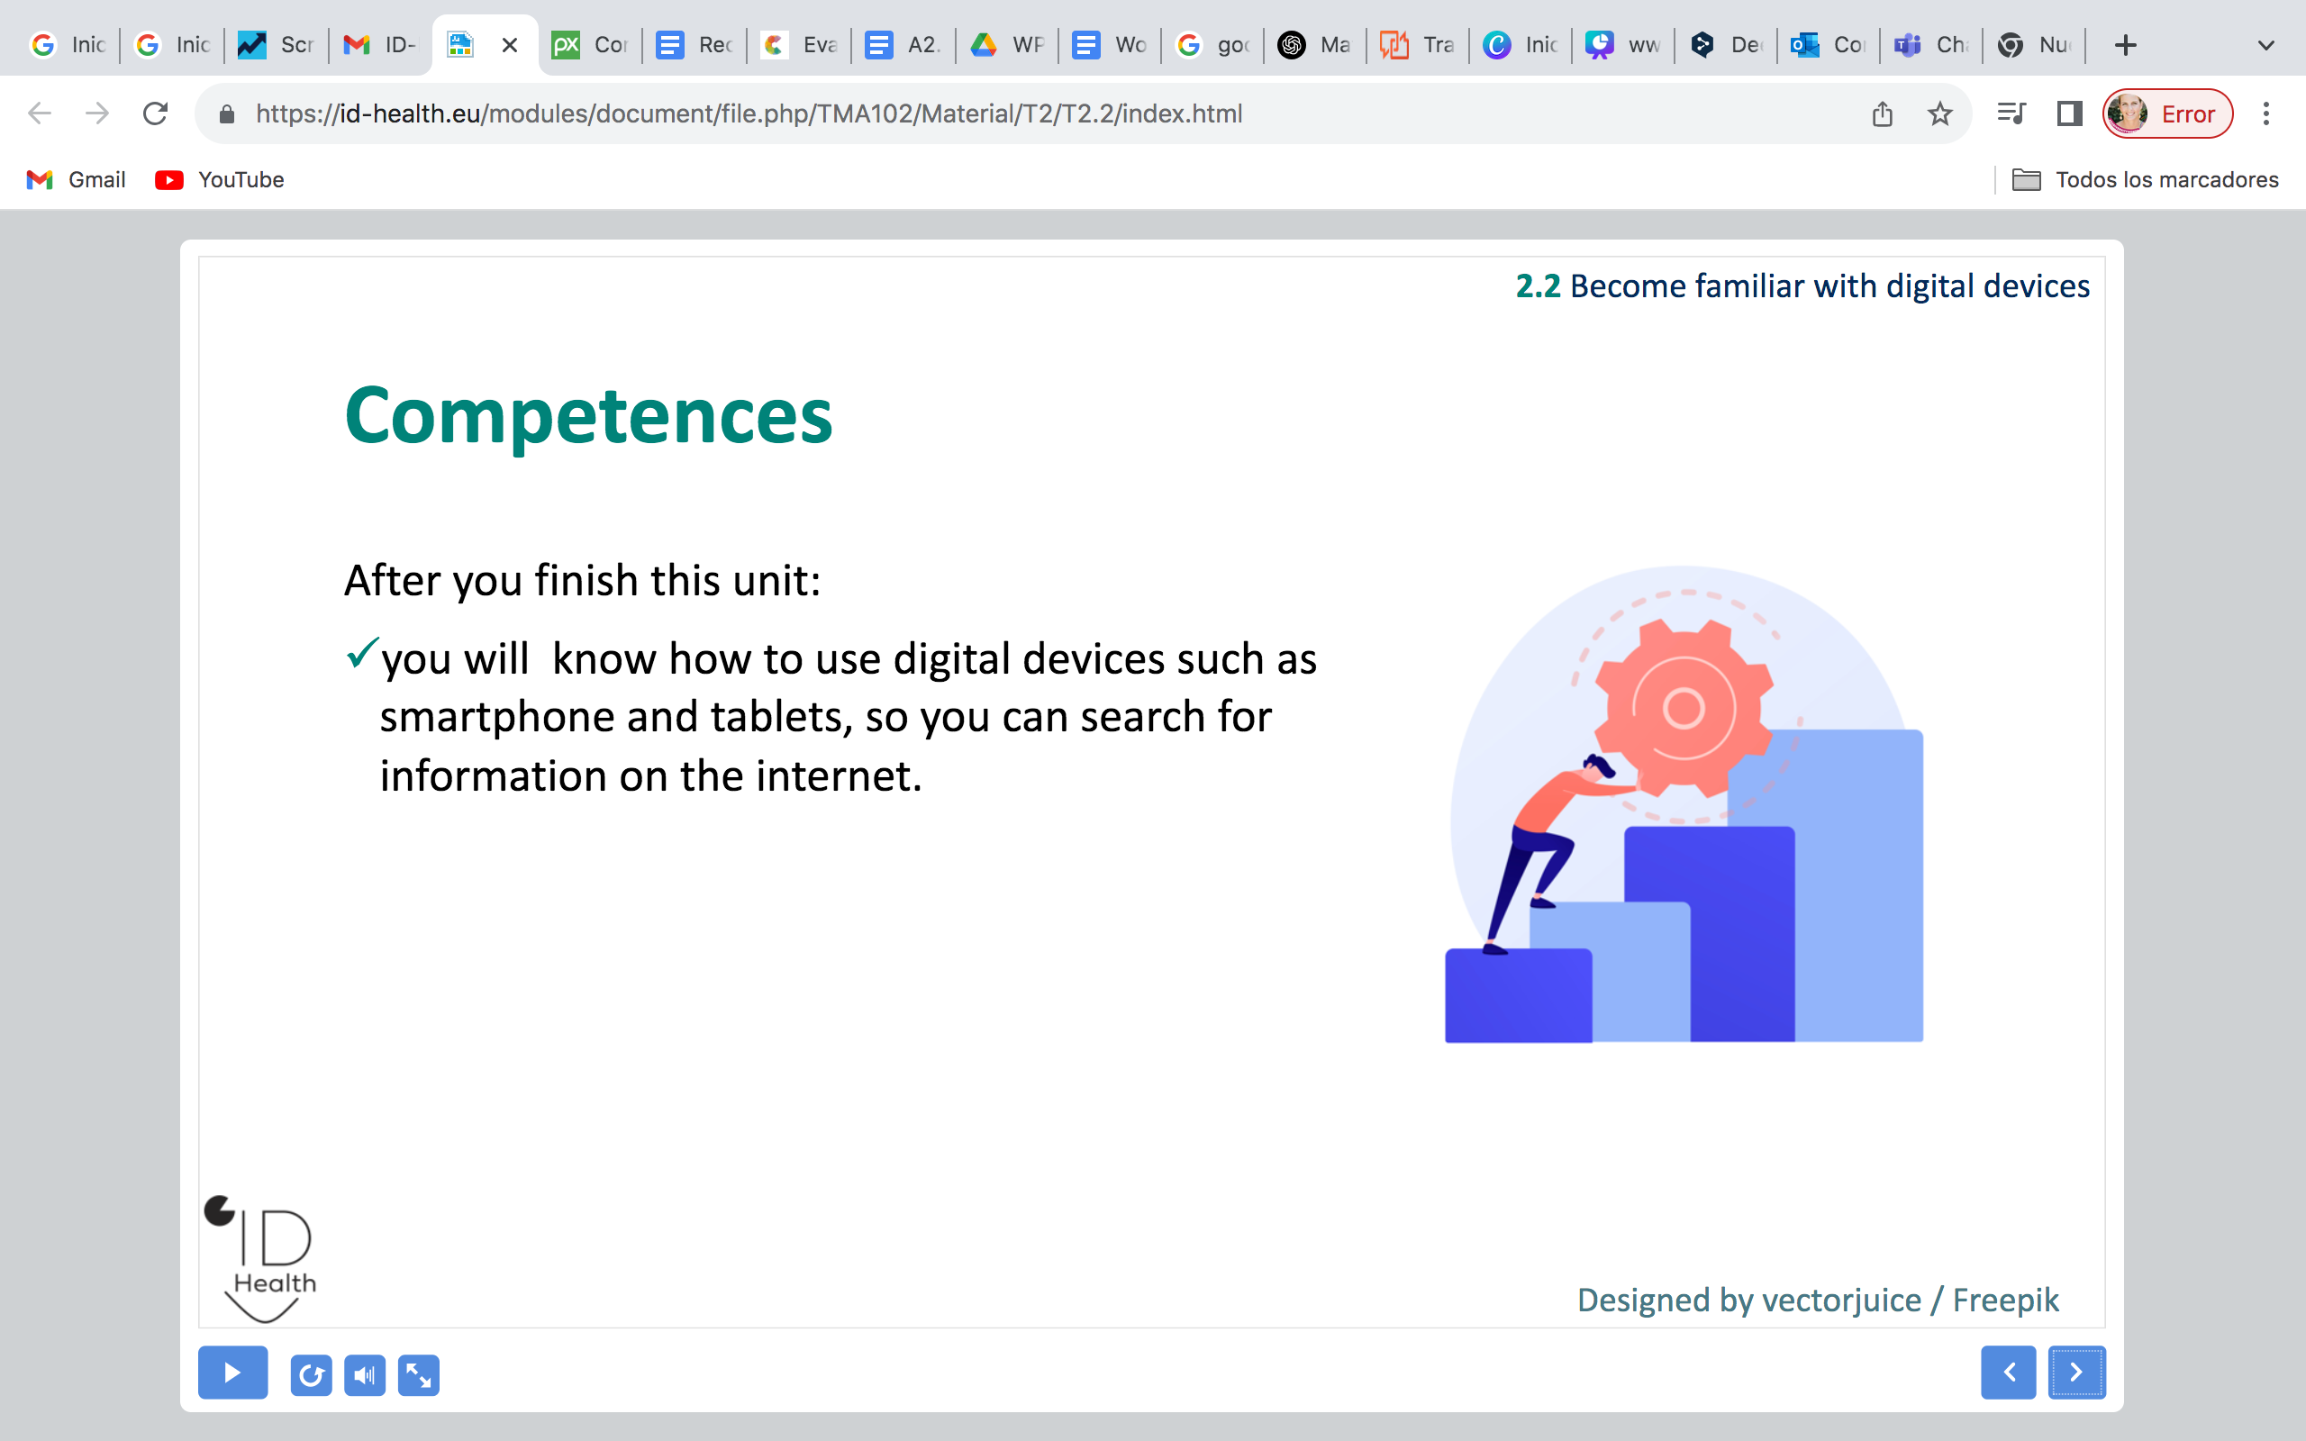
5.1
Recognize good health information on the internet
TOPIC Nº 5: List of units
2.1 Recognize good health information on the internet
2.2 Find good health information

Slide 4





5.1
Recognize good health information on the internet
After completing the session:
You recognize good health information.
You know the 5 rules.
You can differentiate good and bad websites.
You can check a website with the 5 rules-Checklist.
✓
✓
✓
✓

Slide 5

5.1
Recognize good health information on the internet
Hopping and jumping
Everyone is moving

Slide 6
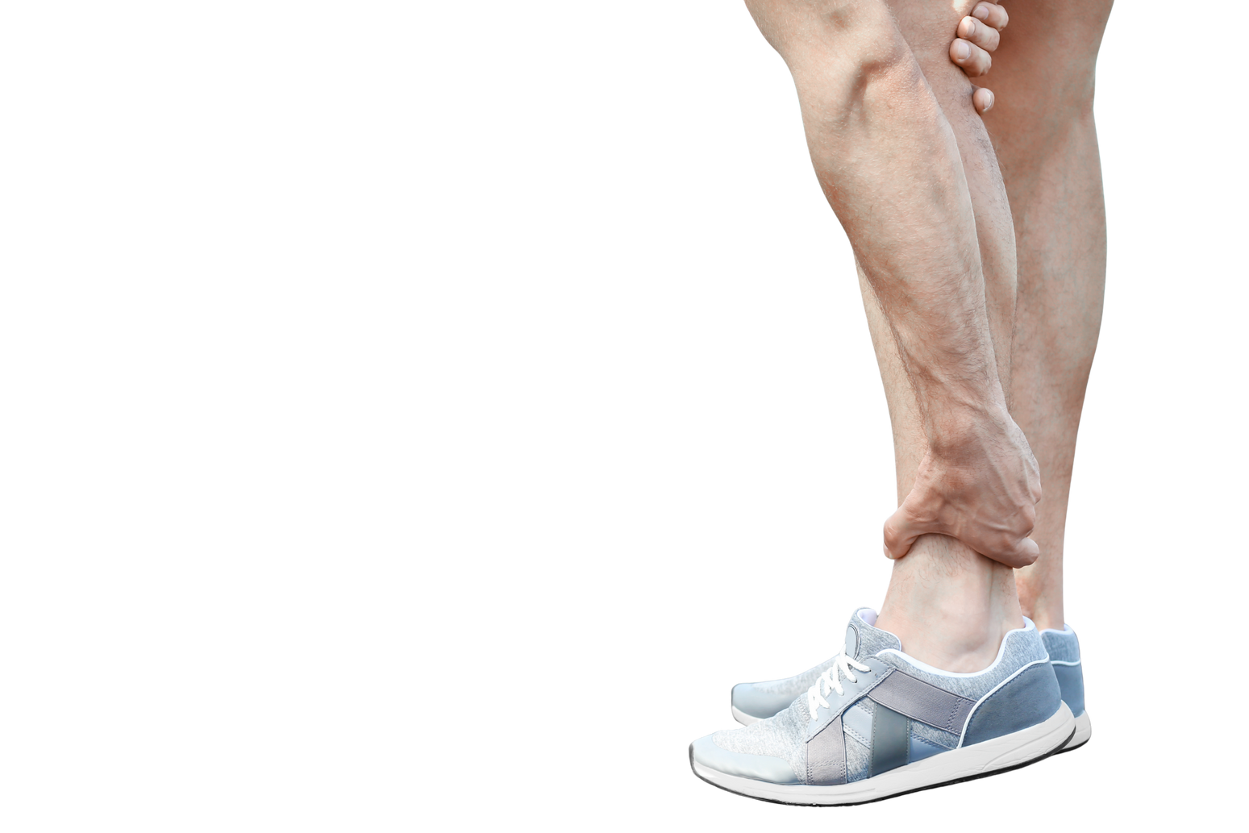
5.1
Recognize good health information on the internet
Hopping and jumping
You injured yourself while jumping. Now you want to find information about a sprained ankle.

Slide 7




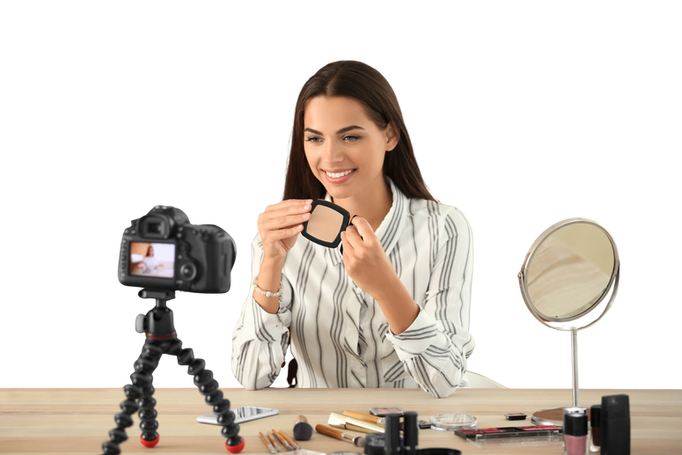

5.1
Recognize good health information on the internet
Where do you look for health information?
Brief vote by show of hands
Doctor's office / Pharmacy
Family / Friends / Caregiver
Internet / Search engine
Social Media / Groups
Then, a 1-minute exchange: What was your last search term?

Slide 8
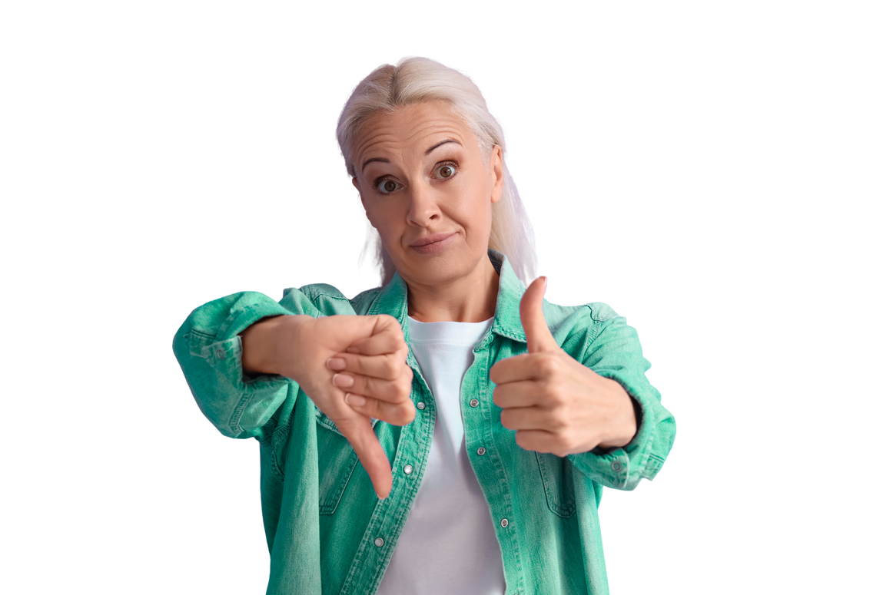
5.1
Recognize good health information on the internet
How can I recognize good health information on the internet?

Slide 9
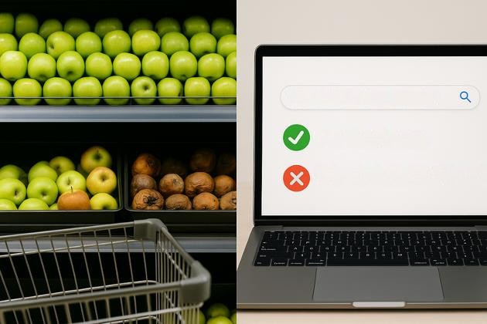
5.1
Recognize good health information on the internet
Example: Supermarket
Just like you check things in the supermarket:
"Is the fruit fresh or bad?"
Here's how you need to check on the internet:
"Is the information correct or incorrect?"
What helps with stomach aches?
Health insurance
Miracle cure with cola

Slide 10
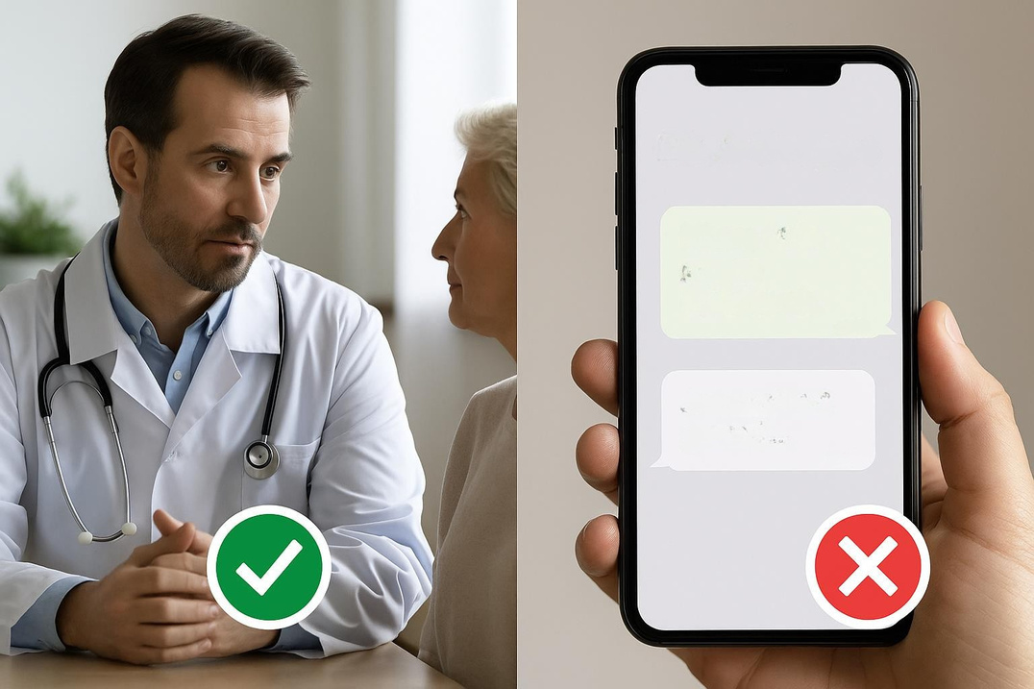


Example: doctor or chat group
5.1
Recognize good health information on the internet
Many people write in a chat group. Rumors are often circulating there.
Chat group
Drink cola for stomach aches.
Example: "Drink cola, then your stomach ache will go away."
10 15
Someone said...
10:15
incorrect
A doctor can provide reliable information. Doctors know a lot.
correct

Slide 11


5.1
Recognize good health information on the internet
Rule 1
1. Who?
Who wrote the text on the page?
For example: doctors or the public health department.

Slide 12
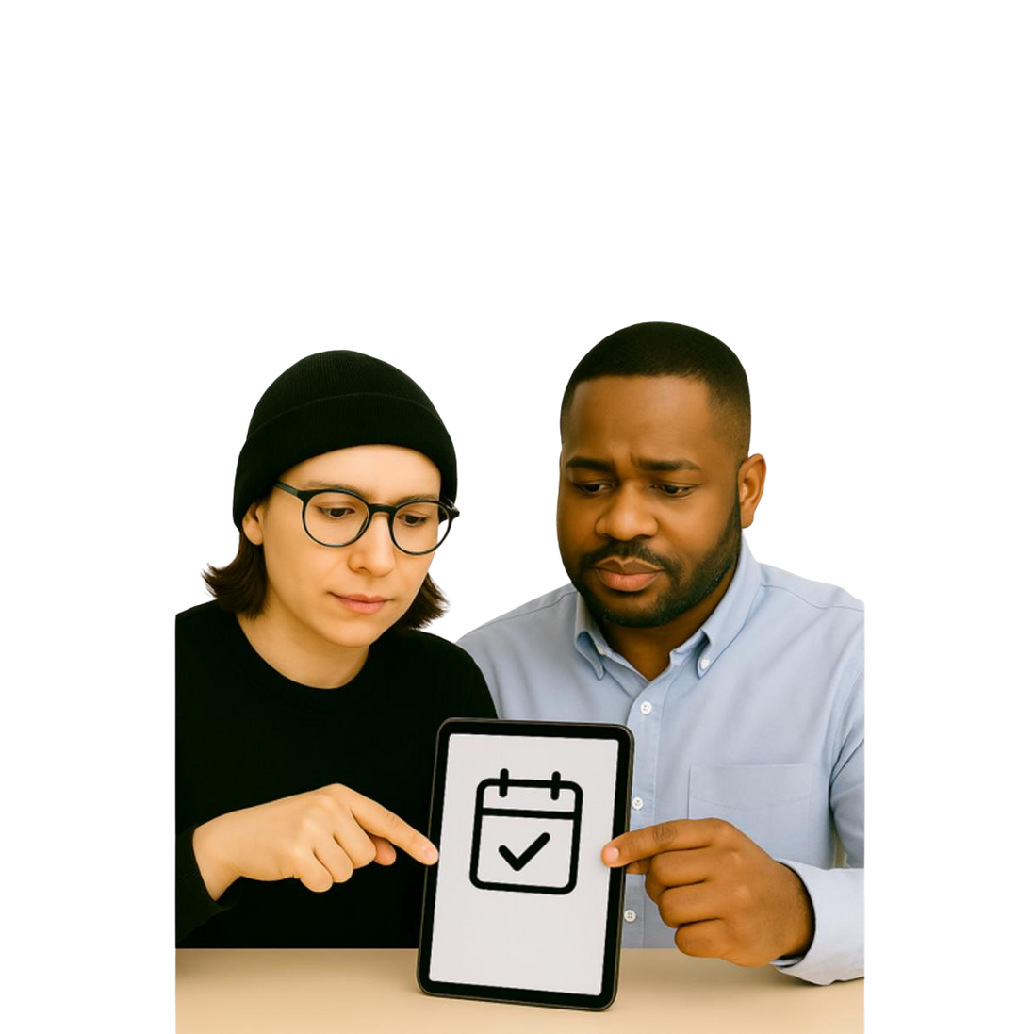

5.1
Recognize good health information on the internet
Rule 2
2. New?
Is this information new? Is there a date listed?

Slide 13

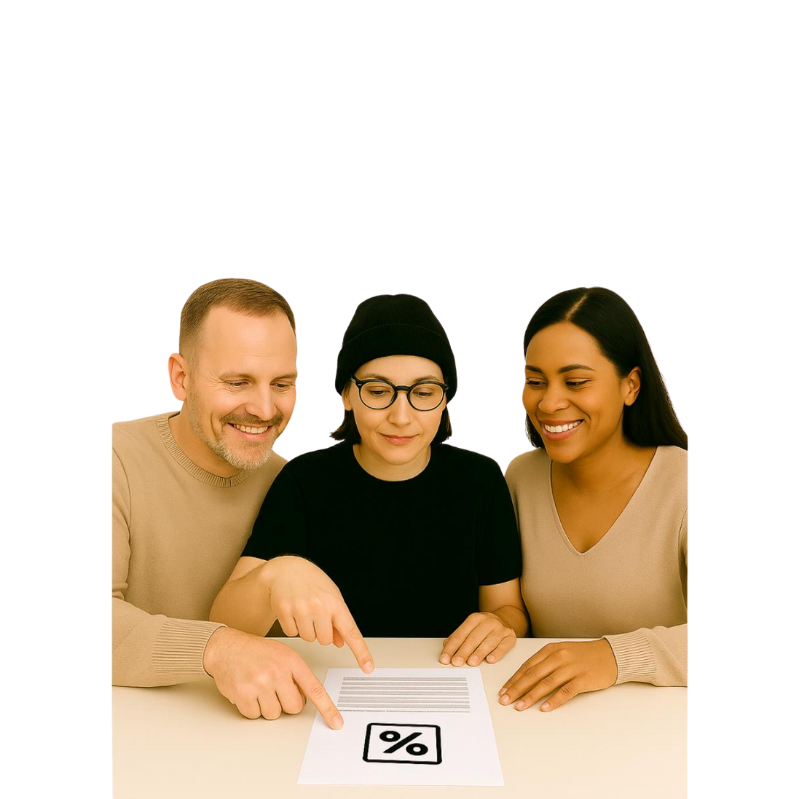
Rule 3
5.1
Recognize good health information on the internet
3. Advertising?
Is there advertising?
Check whether something is being sold to you before you trust the information.

Slide 14


5.1
Recognize good health information on the internet
Rule 4
4. Where from?
Where does this information come from? Is there a name or address listed?

Slide 15


5.1
Recognize good health information on the internet
Rule 5
5. Easy?
Can you understand the text well?

Slide 16


5.1
Recognize good health information on the internet
The 5 rules for good information
Who?
  who wrote the text? – For example: doctors or the public health department.
New?
  Is the information new? –Is there a date?
Advertising?
  Is there advertising? –Is the site trying to sell something?
Where from?
  Where does the information come from?
  Is there a name or address?
Easy?
  Can you understand the text well?

Slide 17

Example: Good websites
5.1
Recognize good health information on the internet
Officially
The website belongs to a government agency or state. See example.
Source visible
It says: "Who wrote the text".
Example: Federal Ministry of Health
Date of publication
The page shows when the information was last changed. Example "May 2025"

Slide 18
Example: Good websites
5.1
Recognize good health information on the internet
No advertising
This site won't sell you anything.
Simply explained
The information is clearly written.
Some websites offer texts in simplified language.

Slide 19
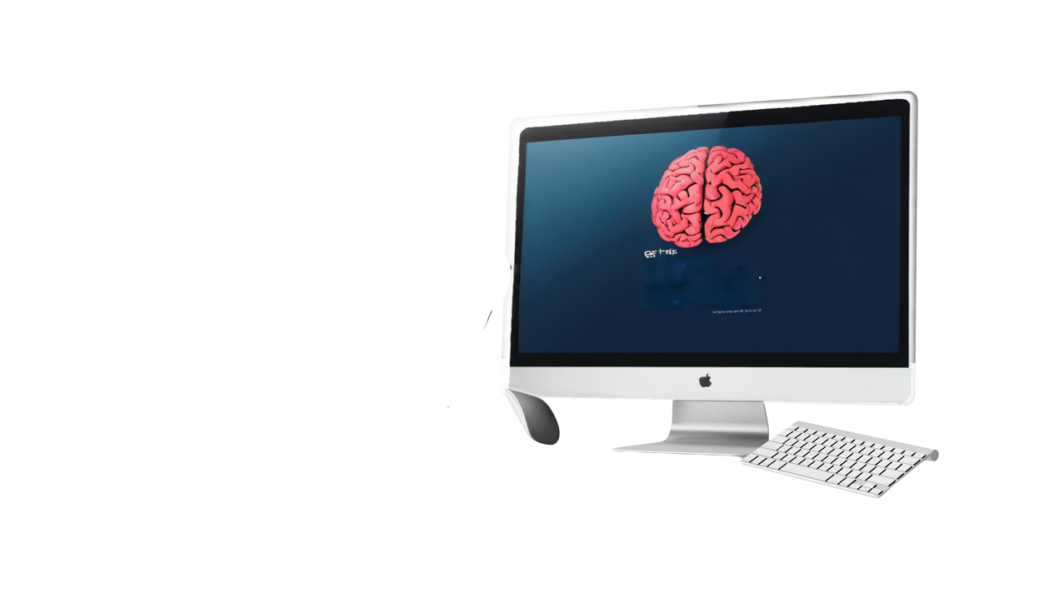
5.1
Recognize good health information on the internet
Example: No good websites
Unofficial
This site is not affiliated with any government agency or state.
Cola is good for the brain
No clear source
It doesn't state who wrote the text.

Slide 20
5.1
Recognize good health information on the internet
Example: No good websites
No date
Sometimes you can't see when the information was last updated.
Advertising
This page displays advertising or aims to sell products.
Cola is good for the brain
Not trustworthy
The information is neither verified nor scientifically proven.
Difficult to understand
The information is difficult to understand.

Slide 21
5.1
Recognize good health information on the internet
Let's practice
Check websites
Steps:
1. Choose a topic, e.g. “Toothache”.
2. Search the internet.
3. Check using the 5 rules:
Checklist next page

Slide 22

5.1
Recognize good health information on the internet
Practical exercise: Evaluating websites
Checklist:
Who wrote it? (e.g., a doctor or an official body)
1.
☐
2.
☐
Is this information new? (Check the date)
Is there any advertising? (Flashing ads, sales offers)
3.
☐

Slide 23
5.1
Recognize good health information on the internet
Practical exercise: Evaluating websites
Checklist:
Where does this information come from?
4.
☐
Is it easy to understand? (Simply explained, easy to read)
5.
☐
Check the box if the rules are followed on the website.

Slide 24


5.1
Recognize good health information on the internet
Summary: The 5 rules
☐
Who wrote it? (e.g., a doctor or an official body)
1.
2.
☐
Is this information new? (Check the date)
☐
Is there any advertising? (Flashing ads, sales offers)
3.
4.
☐
Where does this information come from?
Is it easy to understand? (Simply explained, easy to read)
5.
☐
Memory aid: Think of your hand- Each finger represents a rule. This way you can always have the rules with you.

Slide 25

5.1
Recognize good health information on the internet
Quiz

Slide 26
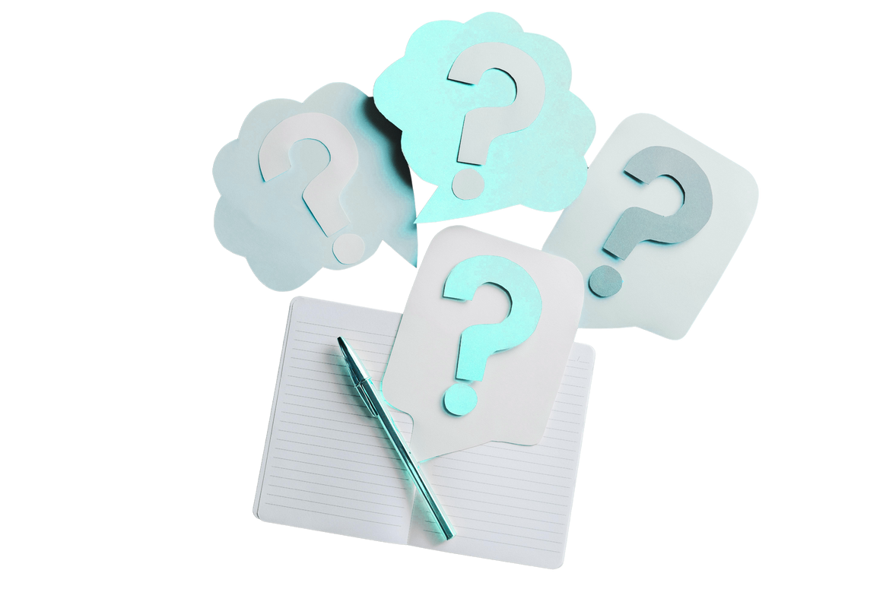
5.1
Recognize good health information on the internet
Mini-quiz: Checking websites
Quiz without materials – Instructions for trainers
Participants show their answer with gestures or movements. This way everyone can participate – including people who cannot read or write. Quiz questions with two possible answers (A or B)
Five methods without materials
Hand signals – A = one hand up, B = both hands up
Side change – A = left side of the room, B = right side of the room
Thumbs up/down – A = thumbs up, B = thumbs down
Acoustic – A = clap, B = stomp
Body language – A= stand up, B= remain seated
Important: Ask questions clearly and slowly.
Everyone shows their answer simultaneously
Explain the solution immediately
Mistakes are allowed and are learning opportunities.

Slide 27


5.1
Recognize good health information on the internet
Mini-quiz: Checking websites
"The website belongs to a government agency or the state. Is that a sign of a good website?"
Question 1
Answer: A (Yes)
Explanation: Official sites are verified and trustworthy.
"The page displays many flashing advertisements."
Question 2
Is this a sign of a good website?
Answer: B (No)
Explanation: Advertising is distracting and shows that the site wants to make money.
Question 3
"This page shows when the text was last changed."
Is that a sign of a good website?
Answer: A (Yes)
Explanation: Current information is important and reliable.

Slide 28
5.1
Recognize good health information on the internet
Mini-quiz: Checking websites
Question 4: "It doesn't say who wrote the text.“ Is that a sign of a good website?
Answer: B (No)
Explanation: Without a source, it's impossible to know if the information is correct.
Question 5: "The information is explained in simple language."
Is that a sign of a good website?
Answer: A (Yes)
Explanation: Easily explained information is understandable for everyone.

