Slide 1



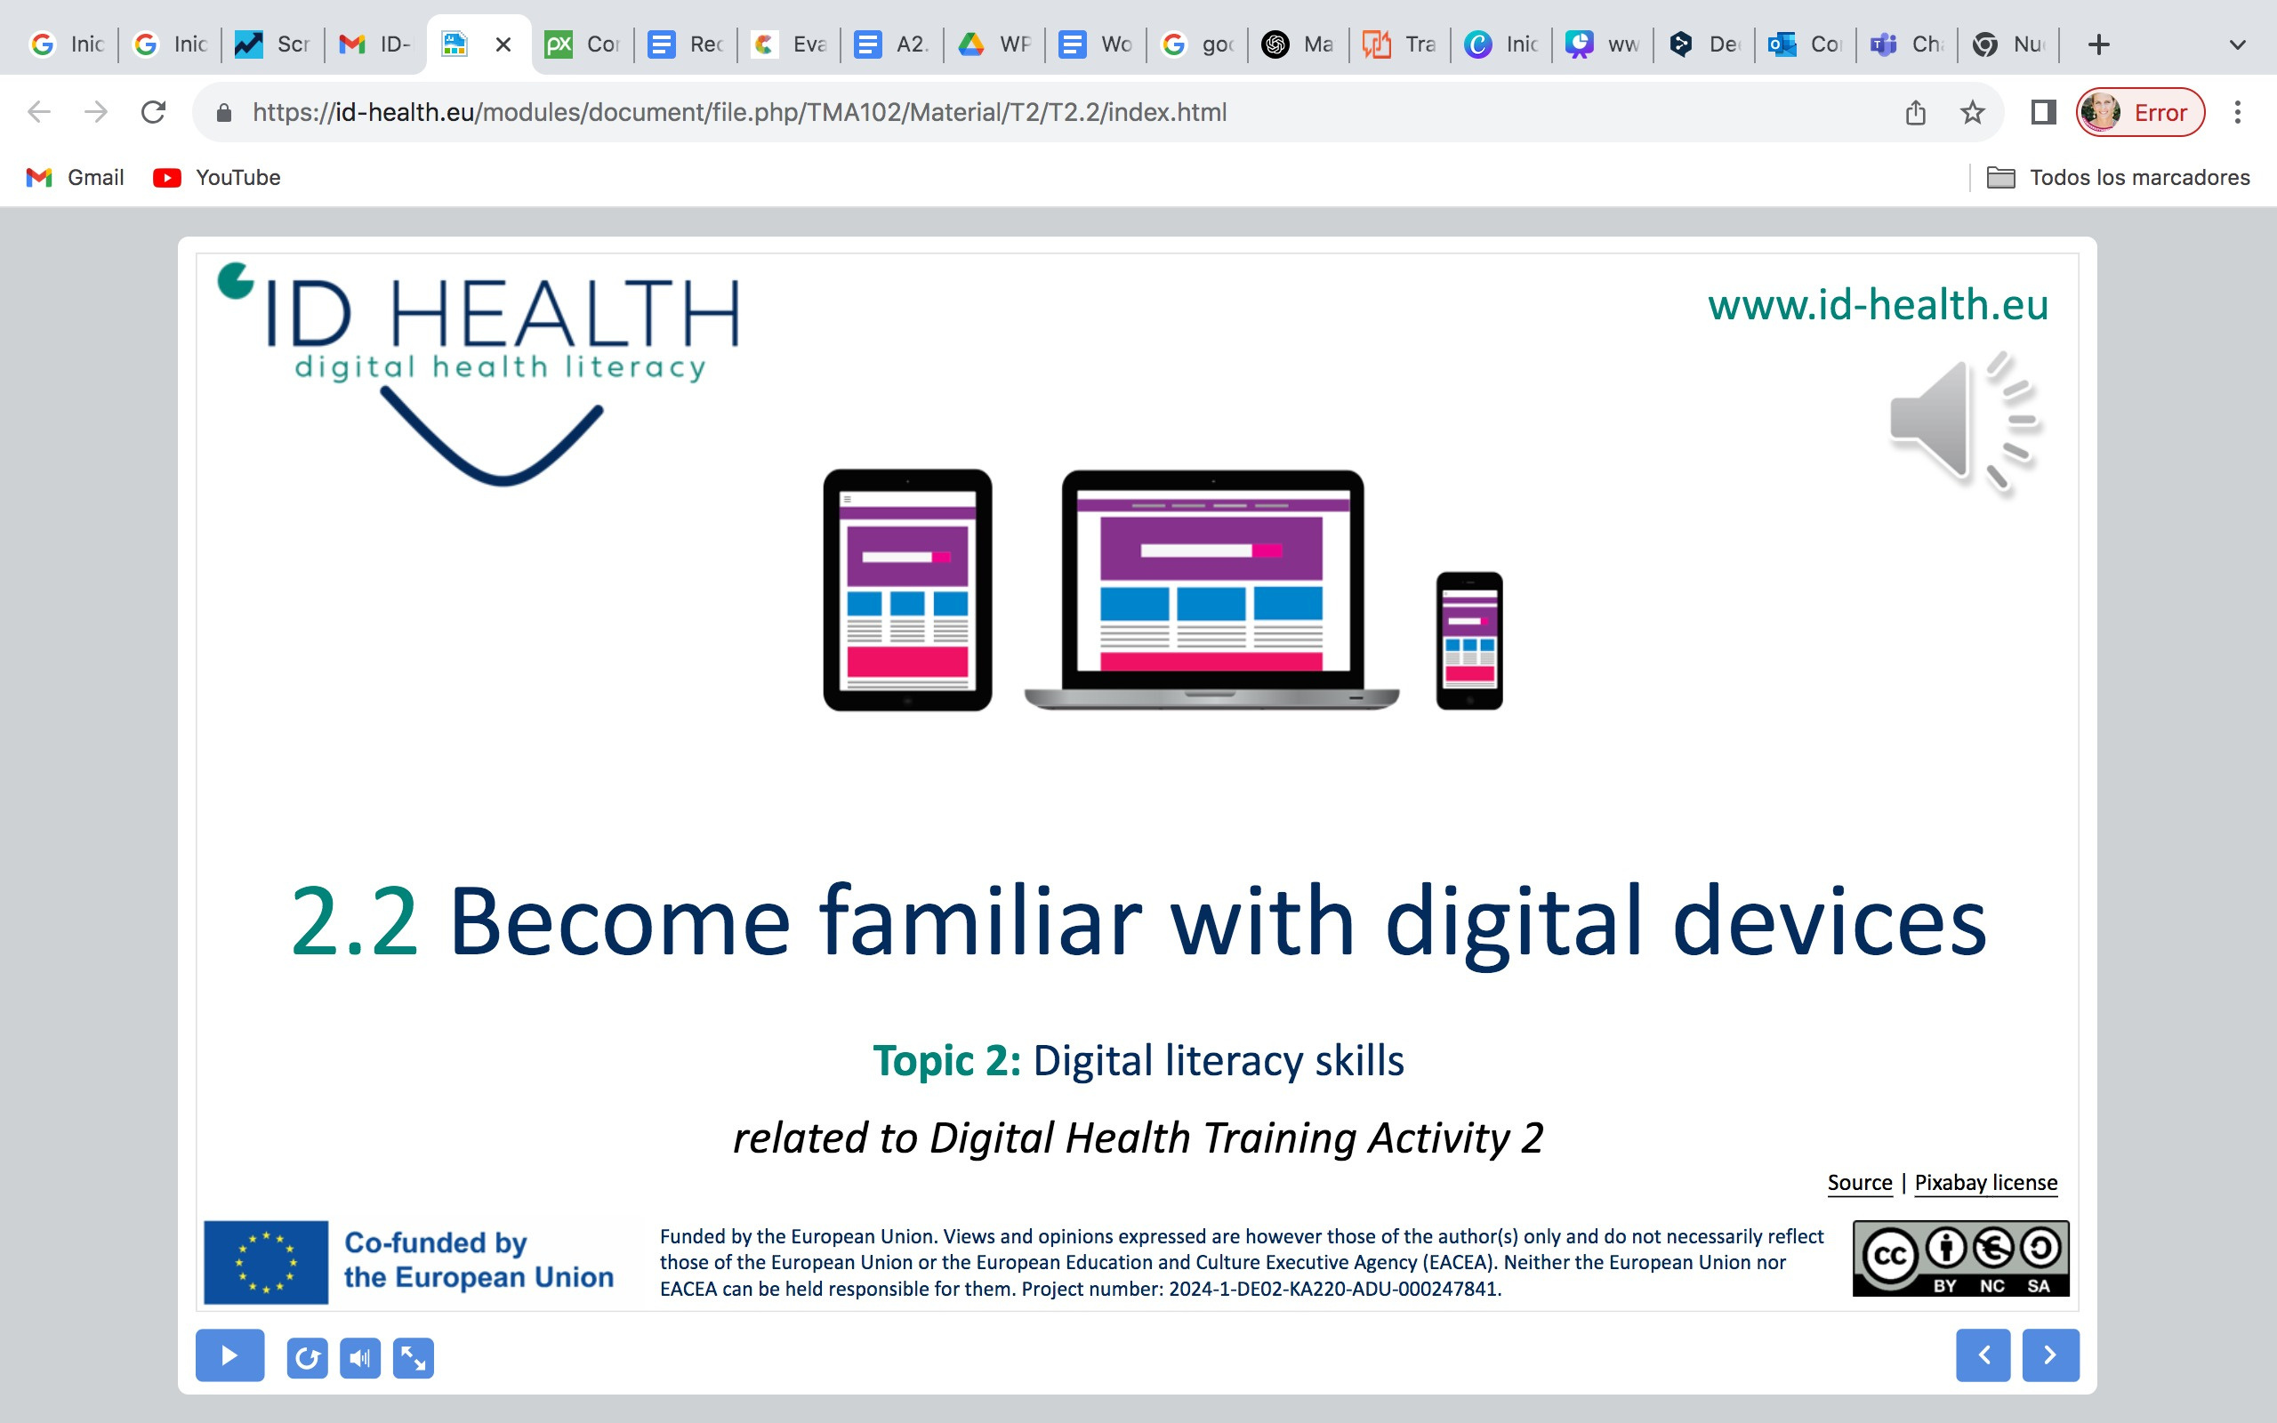
www.id-health.eu
3. What is digital health literacy?
5. Using health information from the internet
5.1
Recognizing good health information on the internet

Slide 2








www.id-health.eu
Partners

Slide 3
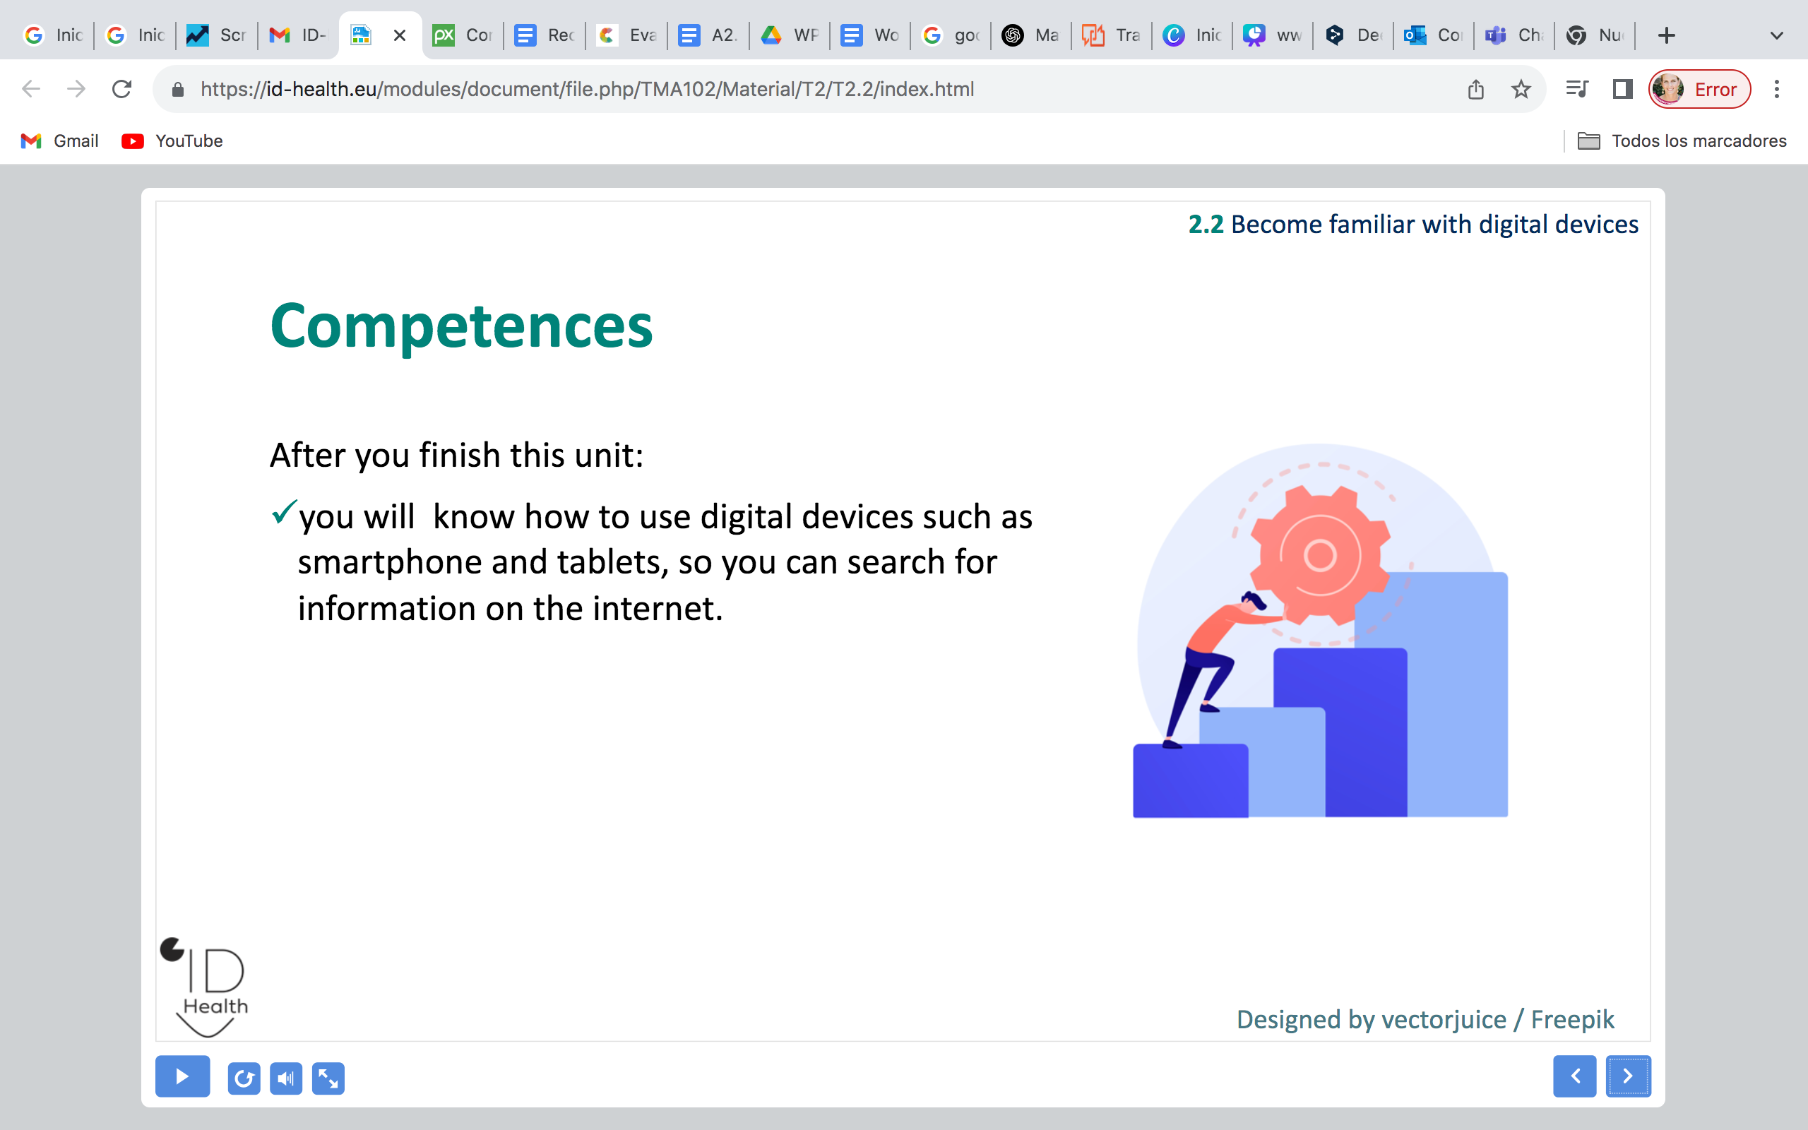
5.1 Recognizing good health information on the internet
Self-Evaluation Quiz 1/3
1. How can you recognize good health information on the internet?
a) By checking if the information is correct and comes from a good source like doctors or official organisations. | b) Watching videos about sports
2. What is one of the 5 rules to check good health information?
a) Check who wrote the text, for example doctors or public health departments. | b) Only look at pictures on the website.
3. Why should you check if there is advertising on a website?
a) Because advertising makes the website more colorful. | b) Because advertising means the site wants to sell something. You should check if you can trust it.
Notes:
1) A correct; 2) A correct; 3) B correct

Slide 4
5.1 Recognizing good health information on the internet
Self-Evaluation Quiz 2/3
4. What does it mean if a website shows when the information was last changed?
a) It means nothing. | b) It means you can check if the information is up-to-date.
5. Why is it important that health information is easy to understand?
a) So everyone can read and use it well, even if they are not experts. | b) It is more beautiful.
Notes:
4) B correct; 5) A correct

Slide 5
5.1 Recognizing good health information on the internet
Self-Evaluation Quiz 3/3
Indicate which statement is correct.
a) It is important to check, by whom the text was written, to see if the source is trustable. | b) It is not important to check, by whom the text was written, as everything you can find on the internet is correct.
a) It is important to check if a date is published, to see if the information is new. | b) It is not important to check if a date is published. Everything on the internet is new.
a) It is good if a website has advertising, because someone get paid for publishing these information. | b) It is not good if a website has advertising, because that can indicate that the information is not neutral.
a) It is not important to check, where the information comes from, as everything on the internet is correct. | b) It is important to check, where information comes from, to see if it is a good source.
a) The information needs to be complicated, as this indicates that it is scientific. | b) The information needs to be easy to understand, so everyone can understand it.
Notes:
1) A correct; 2) A correct; 3) B correct

