Slide 1



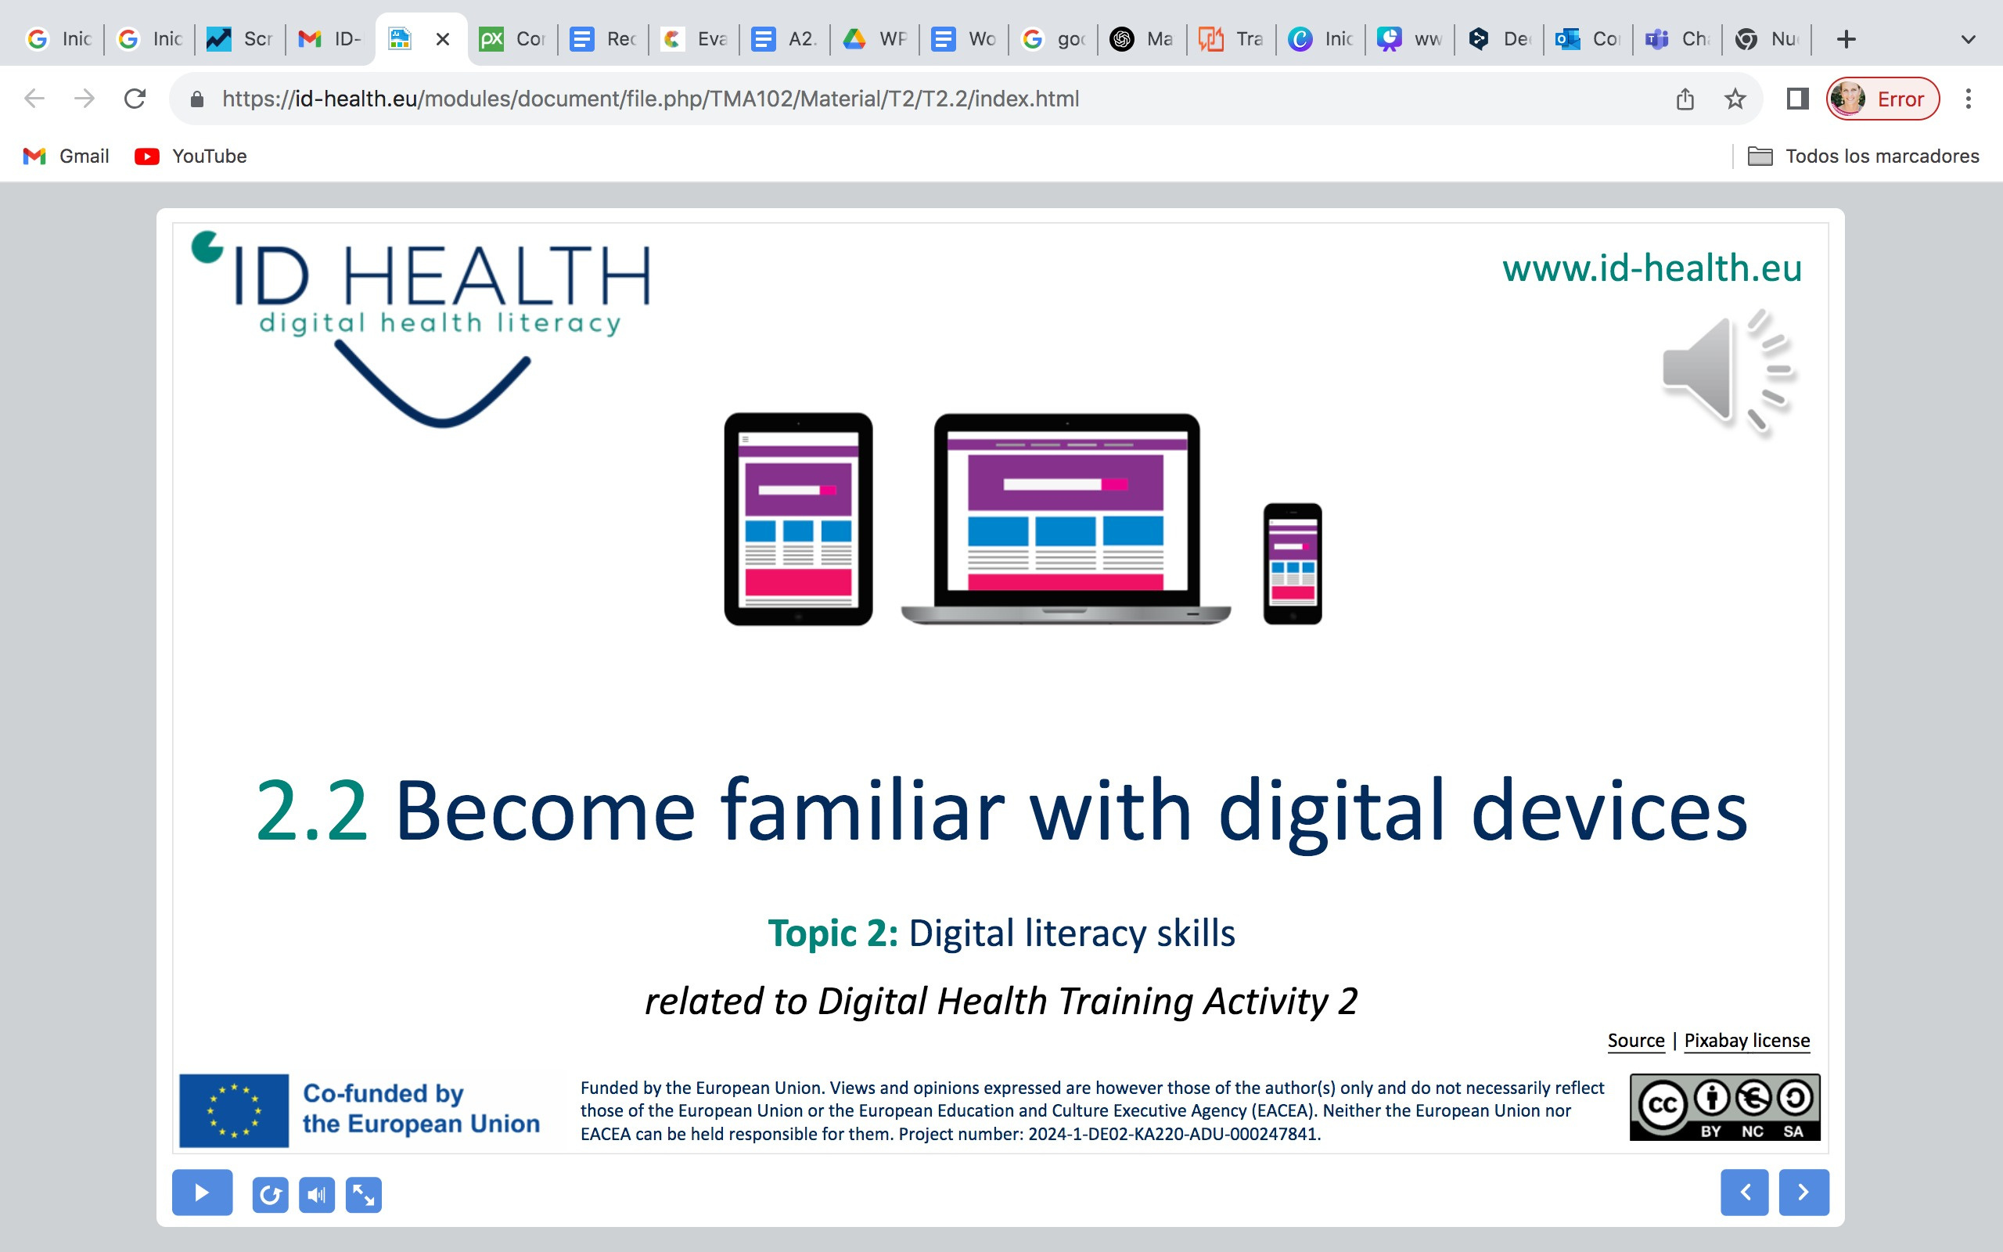
www.id-health.eu
5. Using health information from the internet
5. 2 Find good health information:
ID-Health Catalog Benefits

Slide 2








www.id-health.eu
Partner

Slide 3
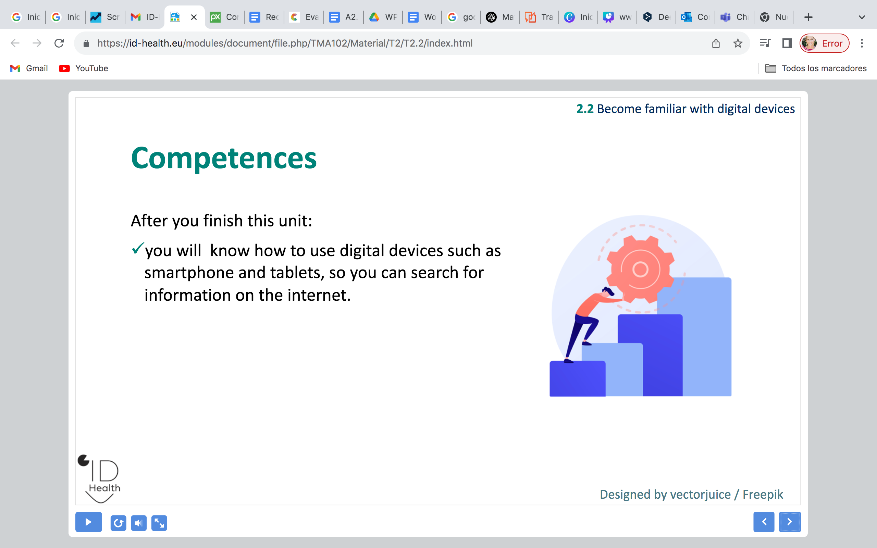
5. 2 FIND GOOD HEALTH INFORMATION:
USE THE ID HEALTH CATALOGUE
TOPIC Nº 5: List of units
2.1 Recognize good health information on the internet
2.2 Find good health information

Slide 4

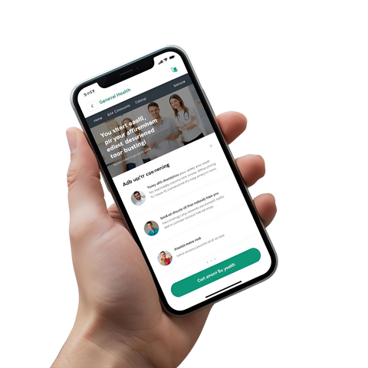





5. 2 FIND GOOD HEALTH INFORMATION:
USE THE ID HEALTH CATALOGUE
Review:
We learned 5 rules.
We checked examples from the internet.
We did a quiz.
What was new for you?

Slide 5
5. 2 FIND GOOD HEALTH INFORMATION:
USE THE ID HEALTH CATALOGUE
5 Rules
Who? – Who wrote the text?
New? – Is the information up-to-date?
Advertising? – Is there advertising?
Where from? – Is the source stated / where does the information come from?
Easy? – Can you understand the text?

Slide 6


5.2 FIND GOOD HEALTH INFORMATION:
USE THE ID HEALTH CATALOGUE
After completing the session you will be able to:
open the ID-HEALTH catalogue
choose a topic (e.g., cough, diabetes, vaccination)
check a page with the checklist (Who? New? Date? Source? Advertisement?)
briefly explain why the site is good.

Slide 7



5.2 FIND GOOD HEALTH INFORMATION:
USE THE ID HEALTH CATALOGUE
What is the ID-HEALTH catalog?
The catalog is a list of verified health websites.
You can find topics quickly.
The catalog is a tool to help you search.
Important:
The catalog does not provide a diagnosis.
It does not replace a doctor.

Slide 8
5.2 FIND GOOD HEALTH INFORMATION:
USE THE ID HEALTH CATALOGUE
The catalog

Slide 9
5.2 FIND GOOD HEALTH INFORMATION:
USE THE ID HEALTH CATALOGUE
Live demo: Step by step
1. Open the ID-HEALTH catalogue.
2. Enter a search term. For example: cough.
3. Click on a result.
4. We check the page with the checklist.
5. Then each person tries it themselves on the device.

Slide 10

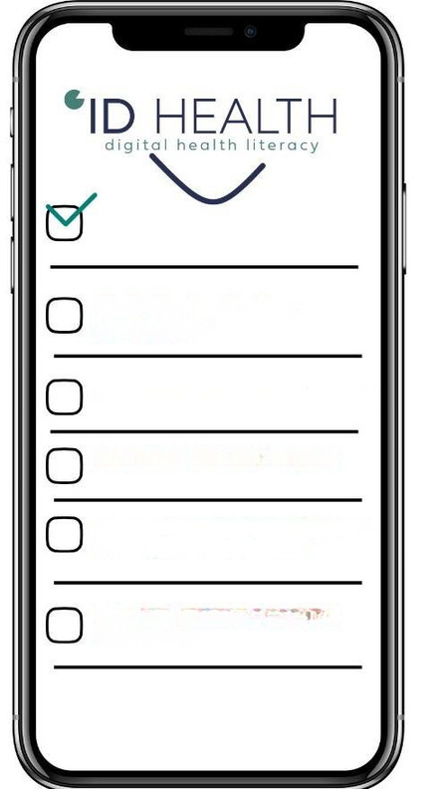
(15 Min)
5.2 FIND GOOD HEALTH INFORMATION:
Exercise: Your topic
USE THE ID HEALTH CATALOG
1. Choose a topic.
2. For example: cough, toothache, diabetes.
3. Find a page in the catalog that relates to your topic.
4. Check the 5 questions:
Who? – Who wrote the text?
New? – Is the information up-to-date?
Advertising? – Is there advertising?
Where from? – Is the source stated / where does the information come from?
Easy? – Can you understand the text?
Who? - Who wrote the text?
New? - Is the information up-to-date?
Advertising? - Is there advertising?
Where from? - Is the source stated / where does the information come from?
Easy? - Can you read the text?
understand?
Brief reports:
Why do you like this site?

Slide 11

5.2 FIND GOOD HEALTH INFORMATION:
USE THE ID HEALTH CATALOGUE
Exchange: What did you find?
We'll talk about your experience with the catalog.
What was good?
What worked well?
Was there anything that didn't work well?
Did you understand everything?
Was something too difficult to understand?
What was your experience with the catalog?
Did you like the help?

