Slide 1



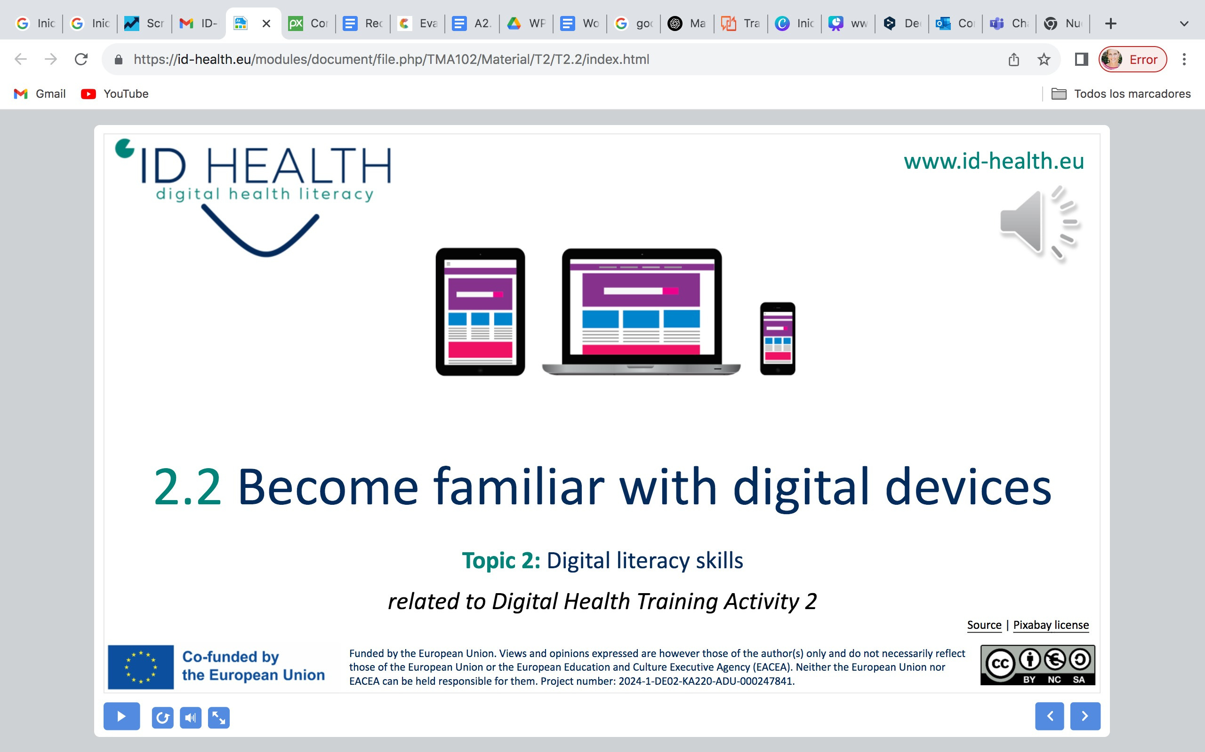
www.id-health.eu
3. What is digital health literacy?
5. Use health information from the internet
5. 2 FIND GOOD HEALTH INFORMATION:
ID-HEALTH CATALOG BENEFITS

Slide 2








www.id-health.eu
Partner

Slide 3
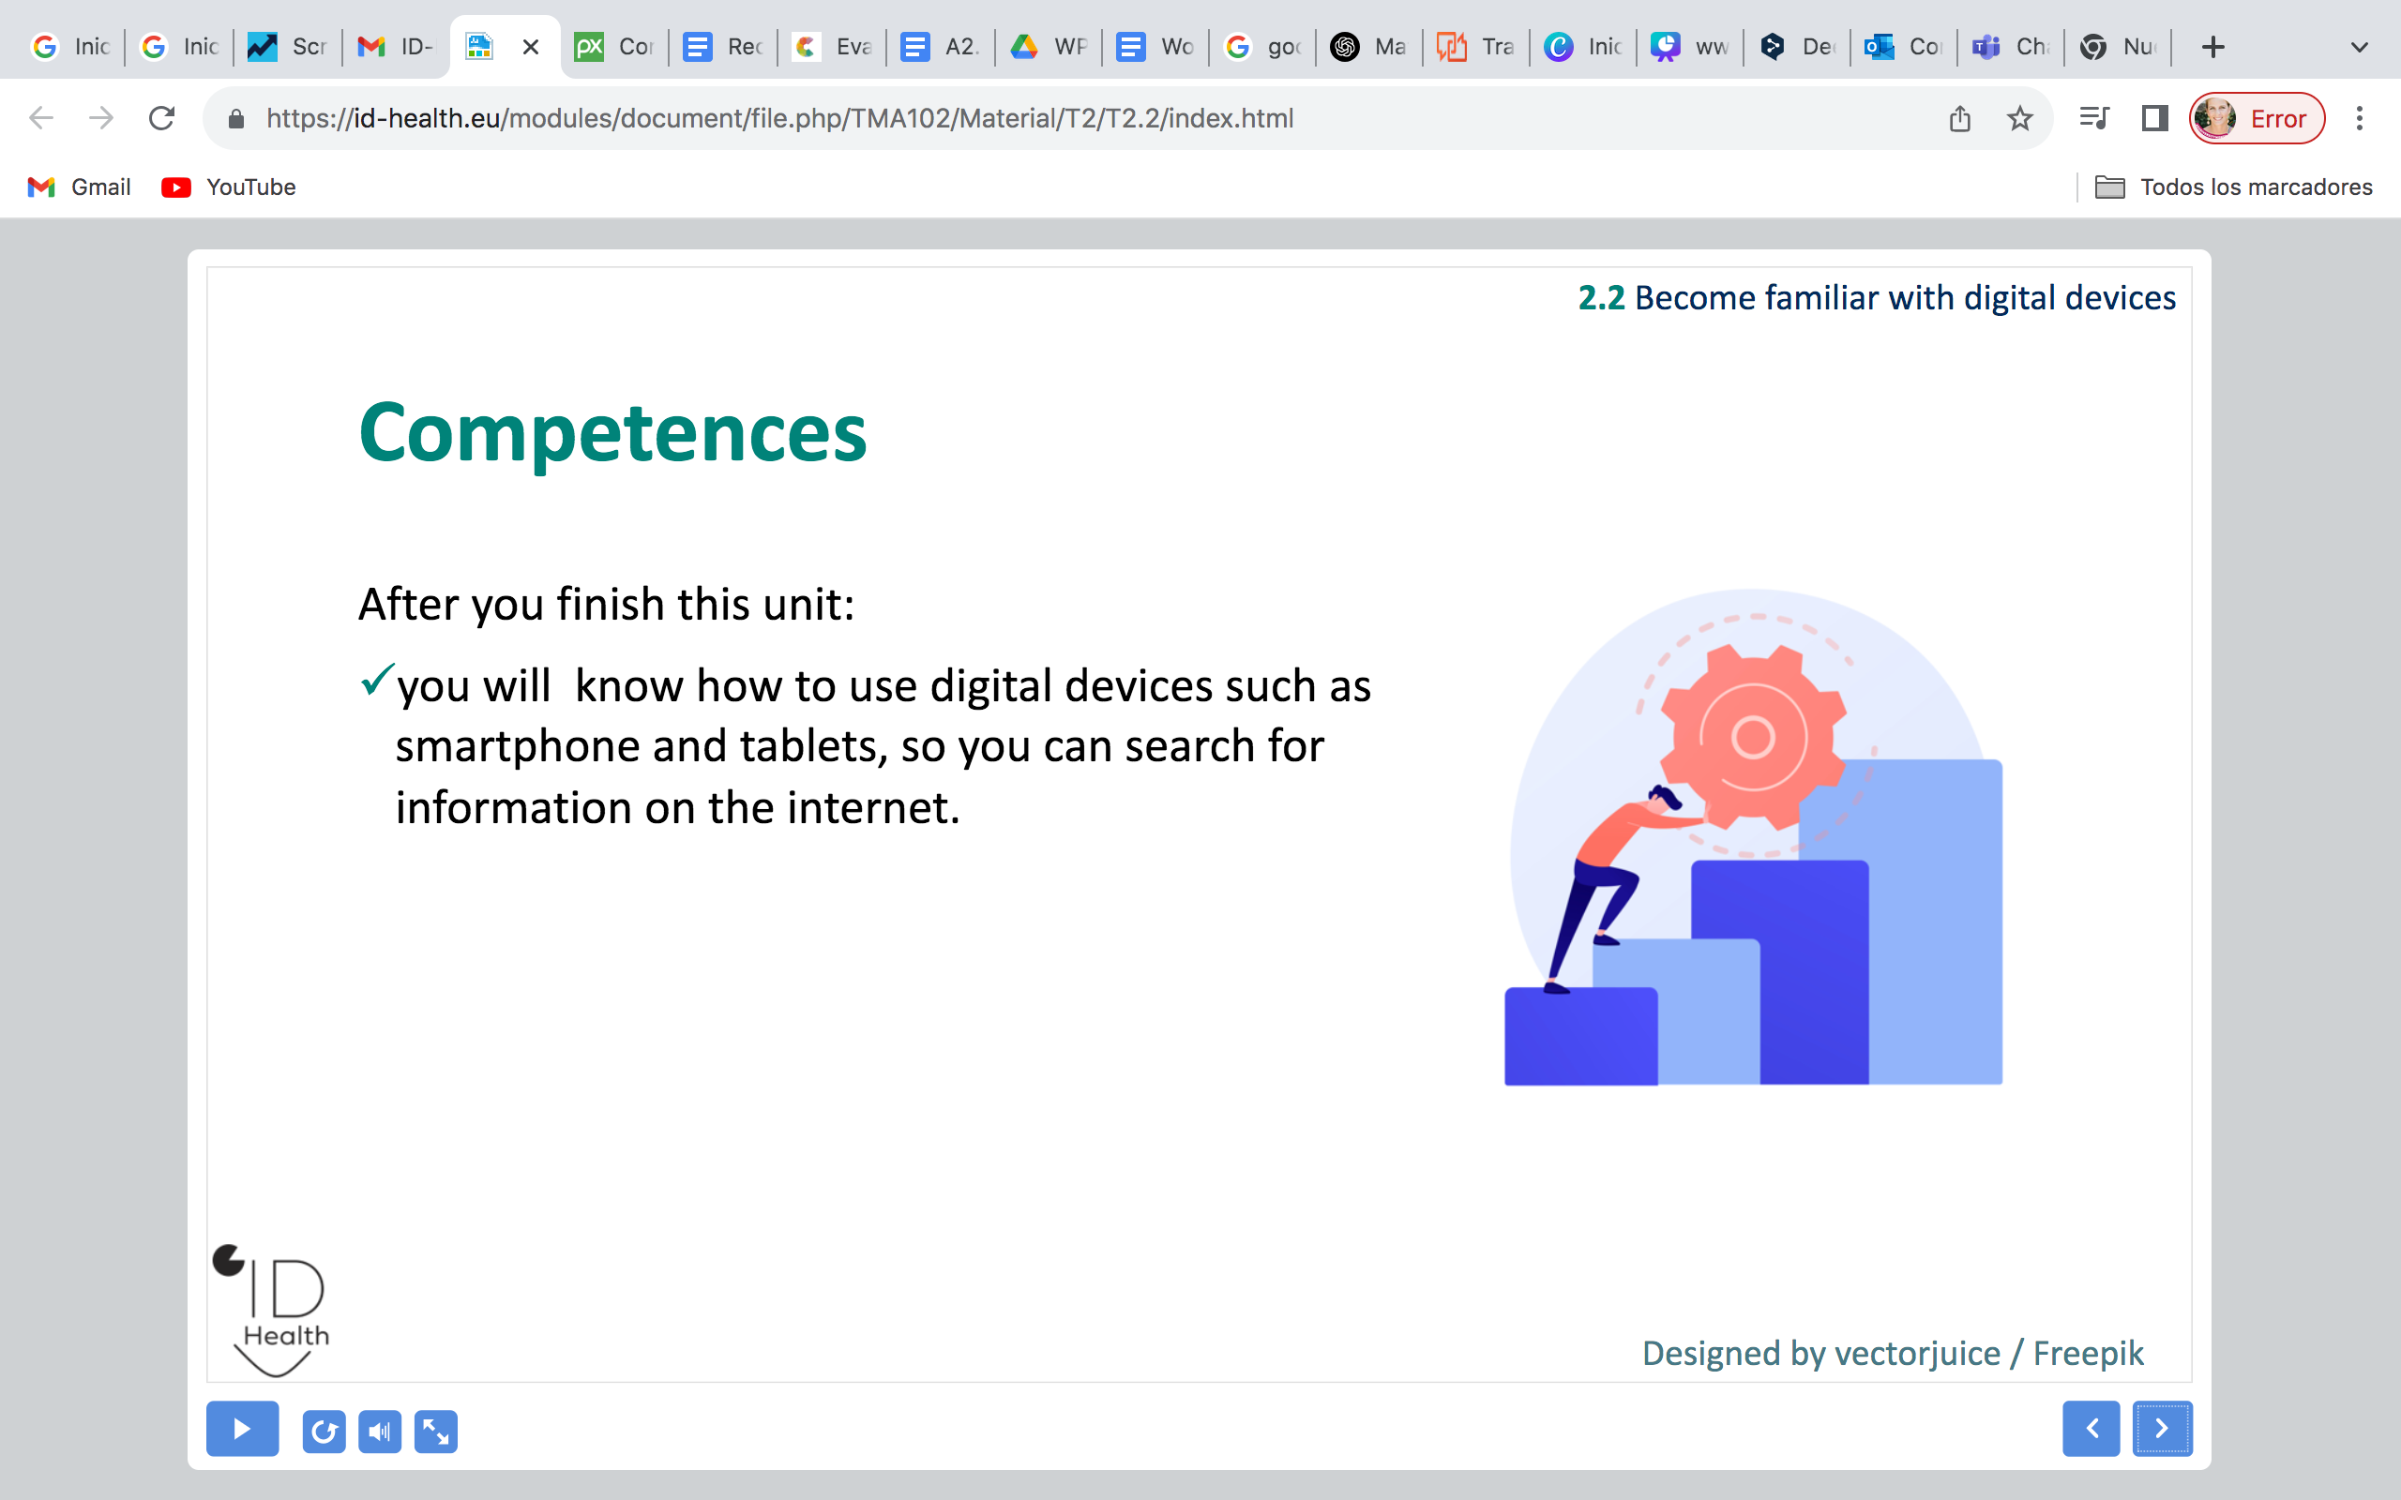
5.2 Find good health information: ID-Health catalog benefits
Self-Evaluation Quiz
1. What is the ID-HEALTH catalog?
a) A list of verified health websites to help you find good health information quickly. | b) A place where you get cat videos.
2. Does the ID-HEALTH catalog replace a doctor’s advice?
a) Yes. | b) No.
3. What is still a good idea to do after finding a website in the catalog?
a) Use the 5 rules to check if it is a good website. | b) Write the websites name on a table.
Notes:
1) A correct; 2) B correct; 3) A correct

