Slide 1
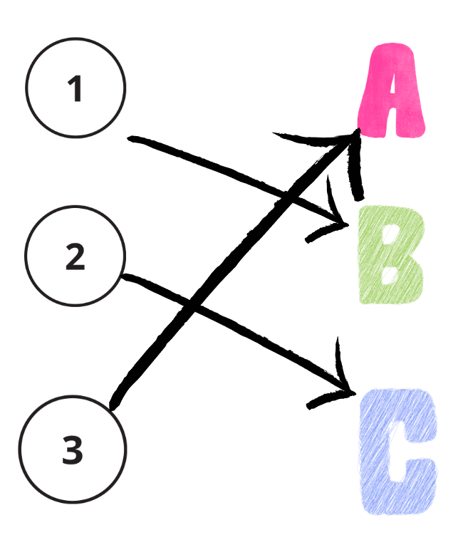
Activity
Let's Play!
Match the device
to its main use

Slide 2
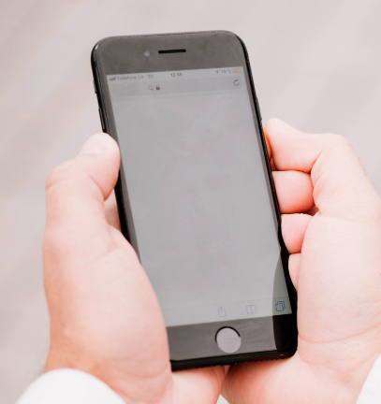
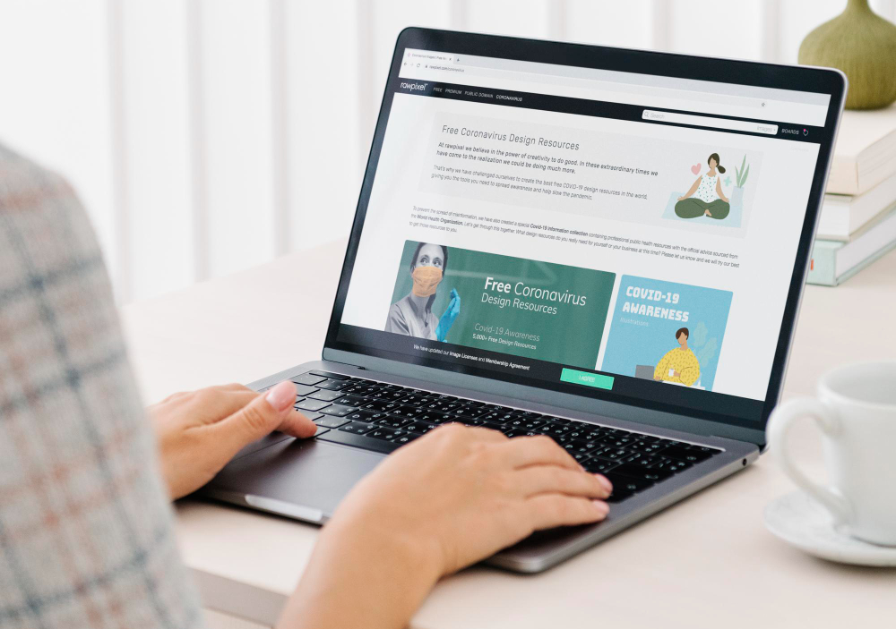
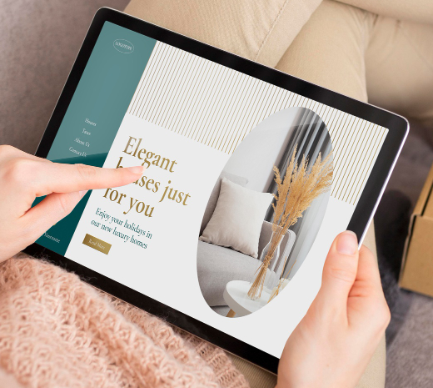
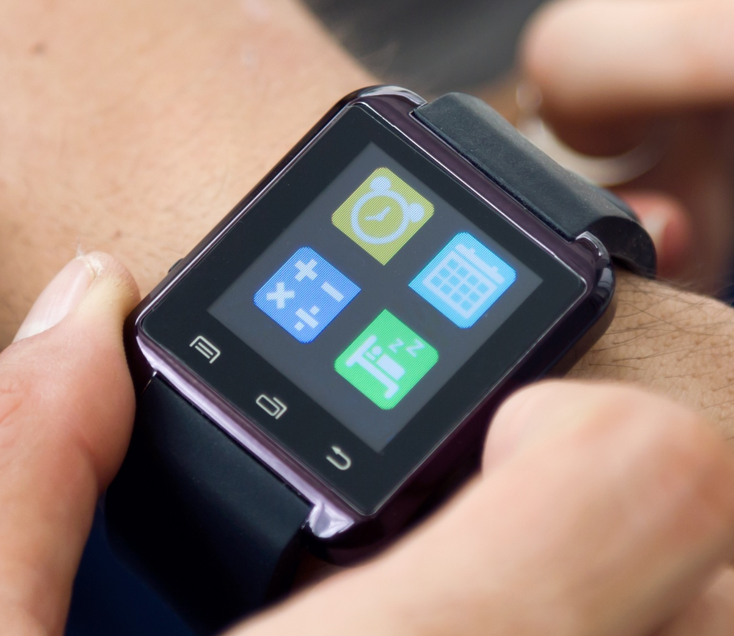
A. Your job is to match each Digital Device in Column 1 with the Main Task it is best used for in Column 2
Column 1: Digital device
Column 2: Main task
1. Smartphone
A. Read a book or attend a virtual doctor's appointment on a screen bigger than your phone's.
2. Personal Computer
Β. Make a video call to a family member, send a text message, or quickly search for an address.
3. Tablet
C. Check your heart rate and count your steps while you walk.
4. Smartwatch
D. Write a long paper or manage your medical records in detail.

Slide 3
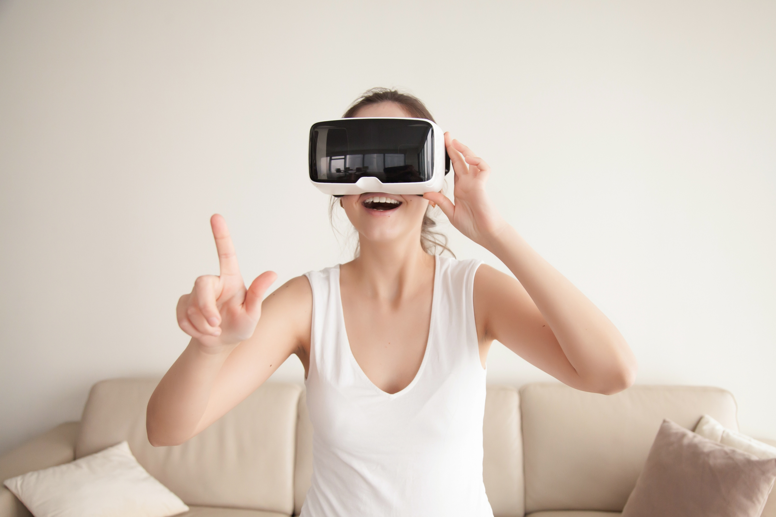
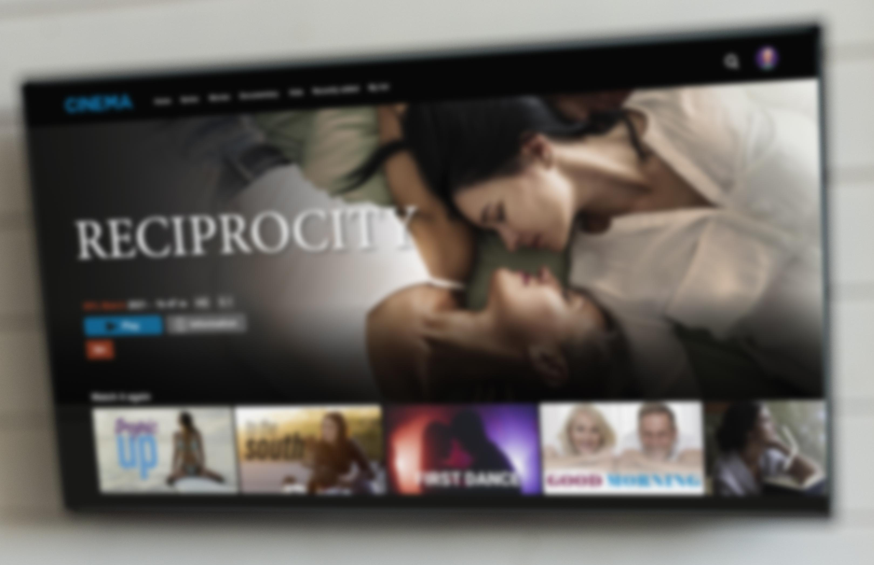
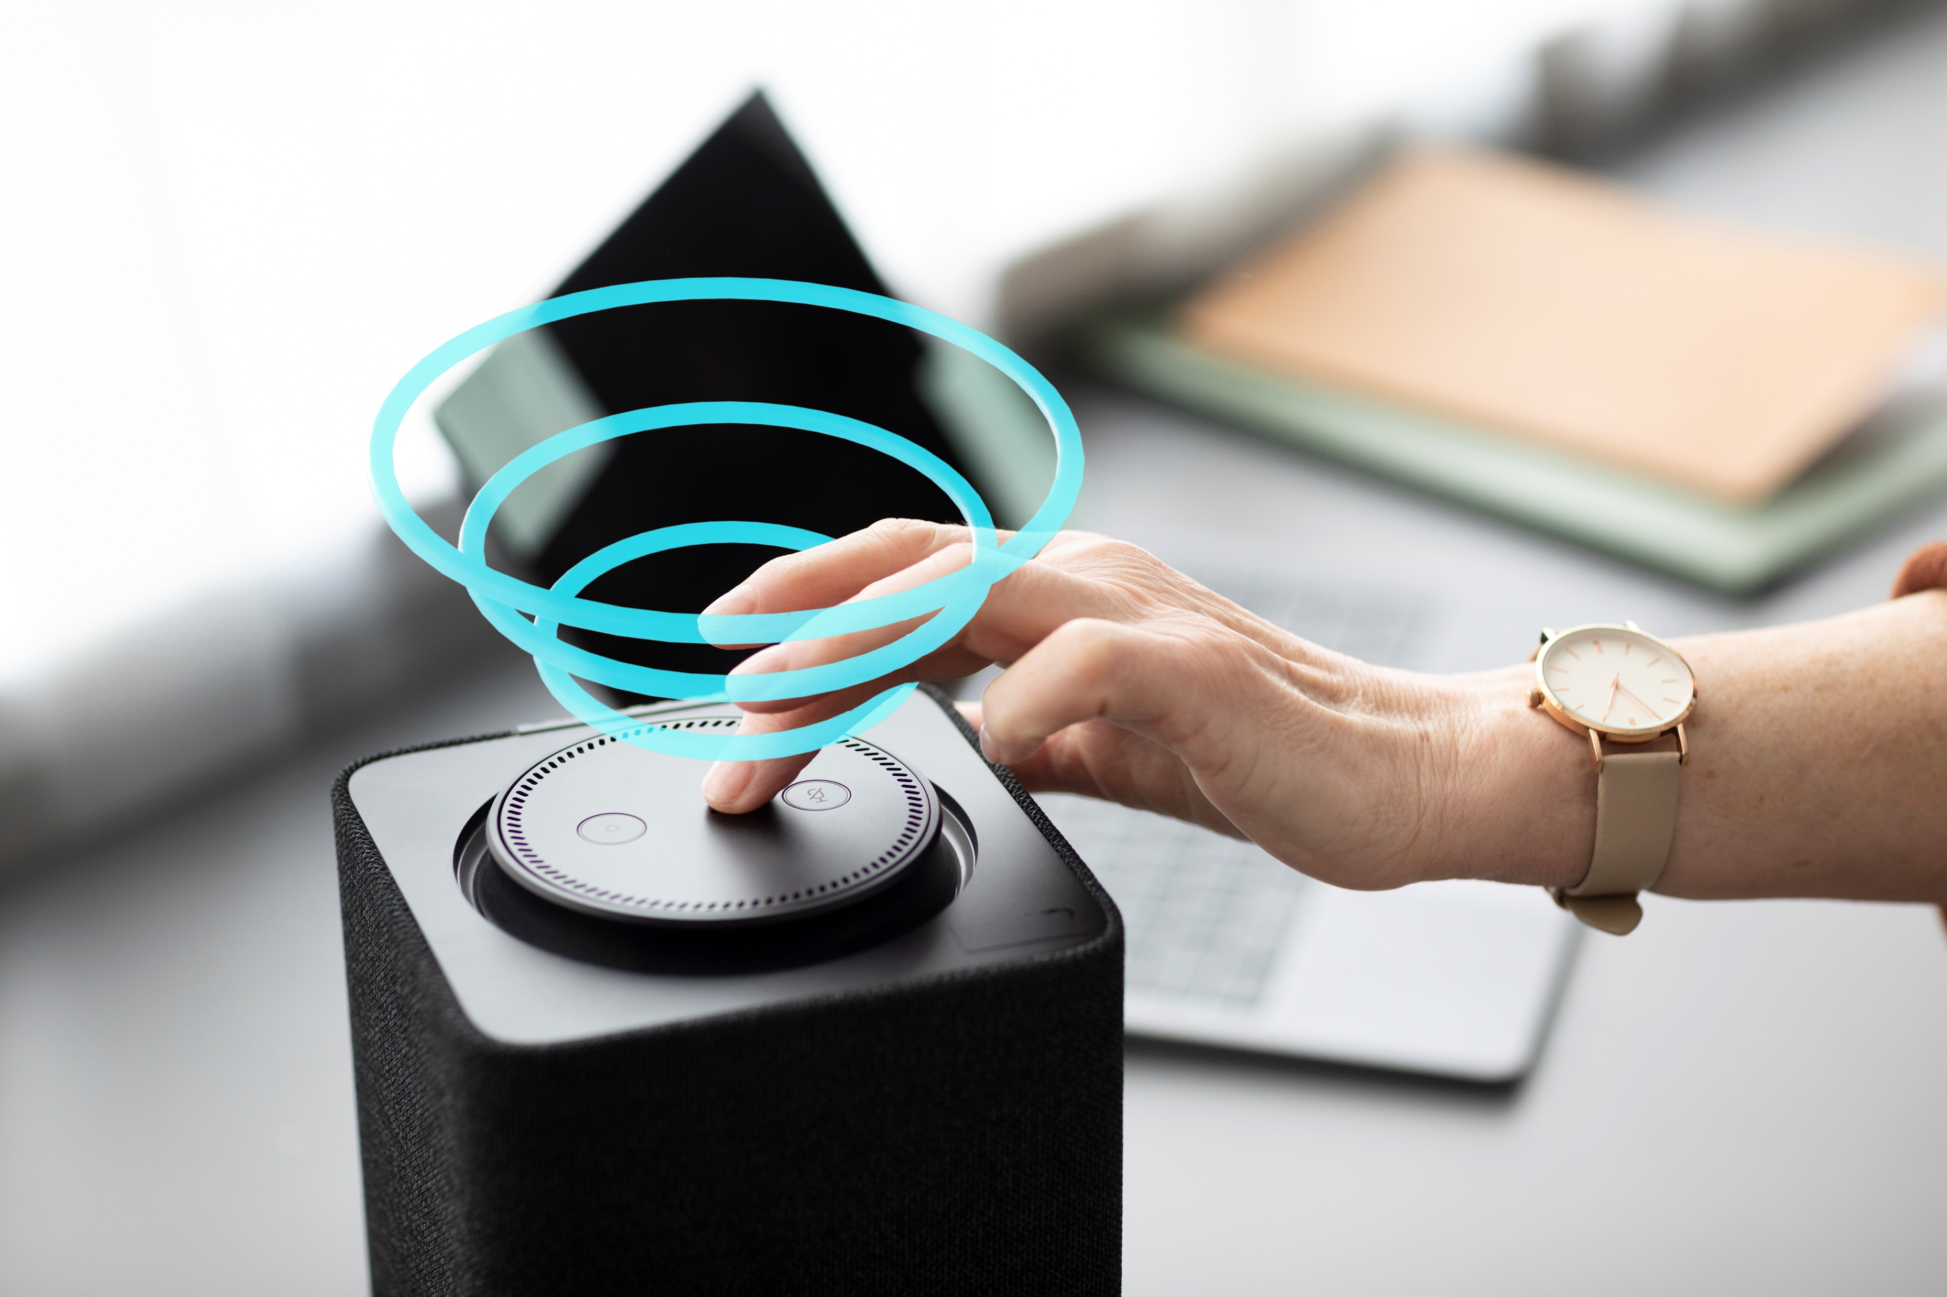
B. Your job is to match each Digital Device in Column 1 with the Main Task it is best used for in Column 2
Column 1: Digital device
Column 2: Main task
5. Virtual Reality glasses
E. Watch series or movies on a big screen and follow exercise videos
6. Smart TV
F. Perform tasks using your voice and to give you information or entertainment through sound.
7. Smart speaker
G. See a completely new, digital world to play games or help you relax

