Slide 1

The device
in the picture is a …
Activity
Check what you have learn!
Quiz – The device in the picture is a…
Image by zinkevych on Freepik

Slide 2

1. View the picture. The device in the picture is a …
Only one answer is correct!
Source | Freepik
A. Tablet
B. Personal Computer
Laptop
C. Smart phone
Notes:
View the picture. The device in the picture is a …
Tablet
Laptop
Smart phone
Only one answer is correct!

Slide 3

2. View the picture. The device in the picture is a …
Only one answer is correct!
Source | Freepik
A. Tablet
B. Laptop
C. Smart phone

Slide 4
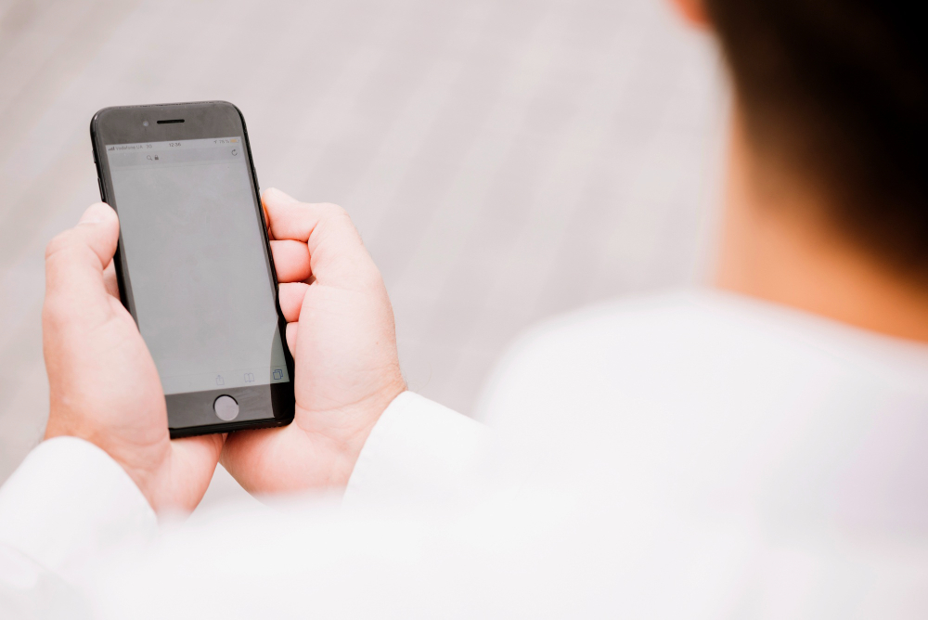
3. View the picture. The device in the picture is a …
Only one answer is correct!
Source | Freepik
A. Tablet
B. Laptop
C. Smart phone

Slide 5
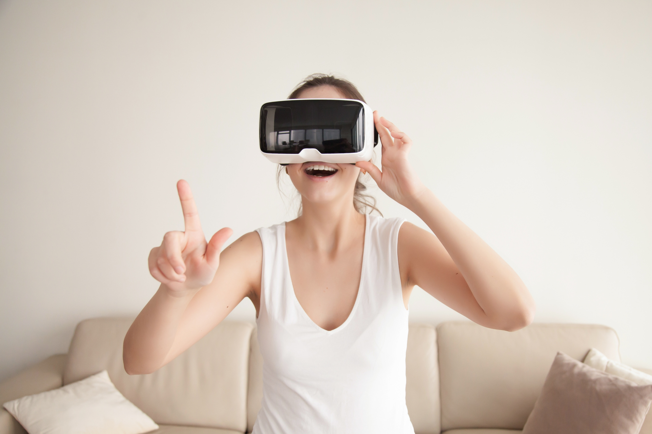
4. View the picture. The device in the picture is a …
Only one answer is correct!
Image by yanalya on Freepik
A. Virtual Reality Glasses
B. Tablet
C. Smartwatch

Slide 6
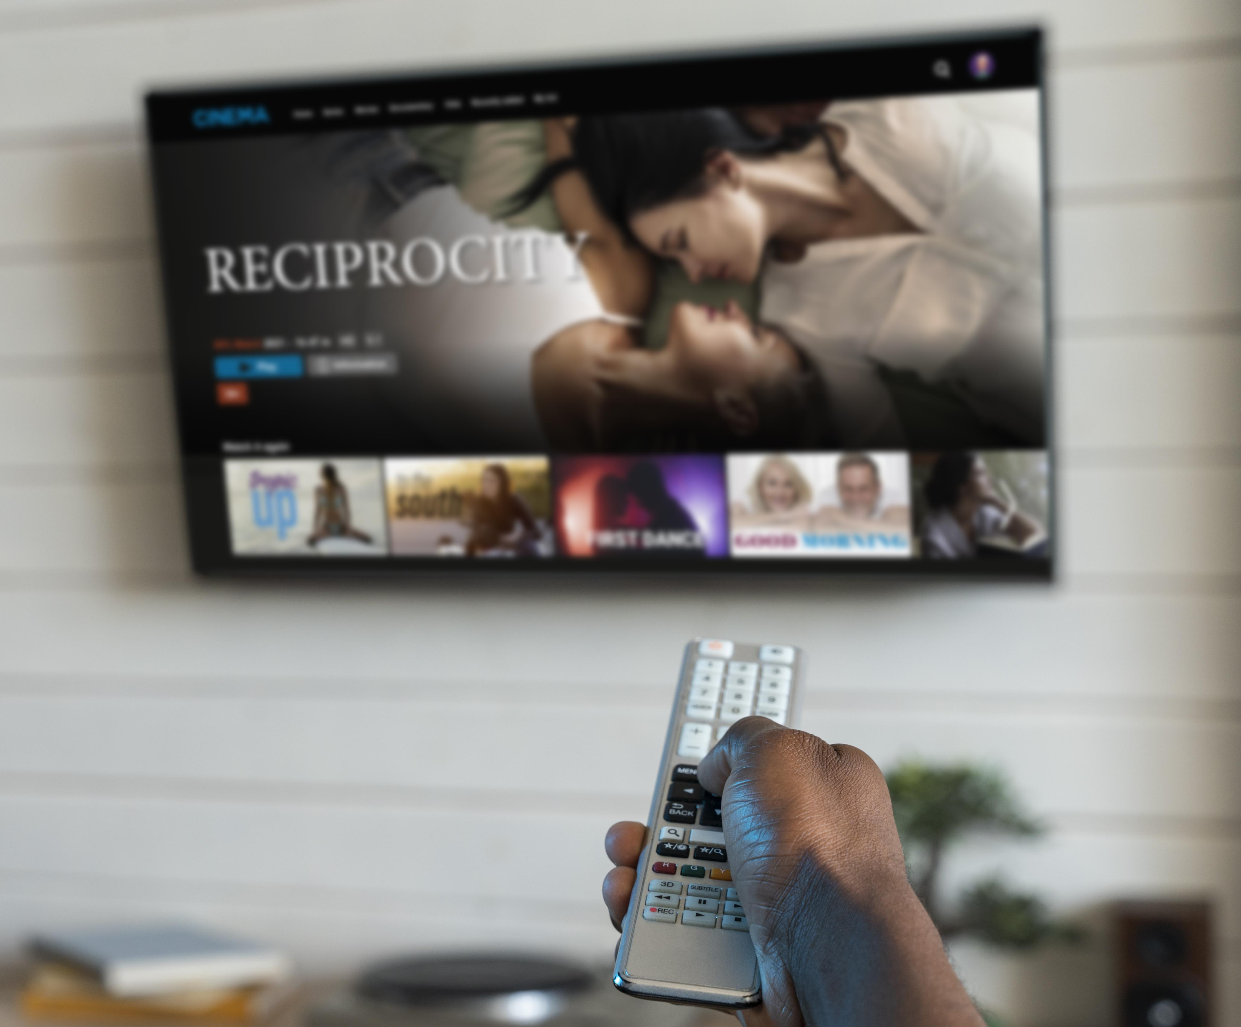
5. View the picture. The device in the picture is a …
Only one answer is correct!
Image by Freepik
A. Smart TV
B. Smartwatch
C. Tablet

Slide 7
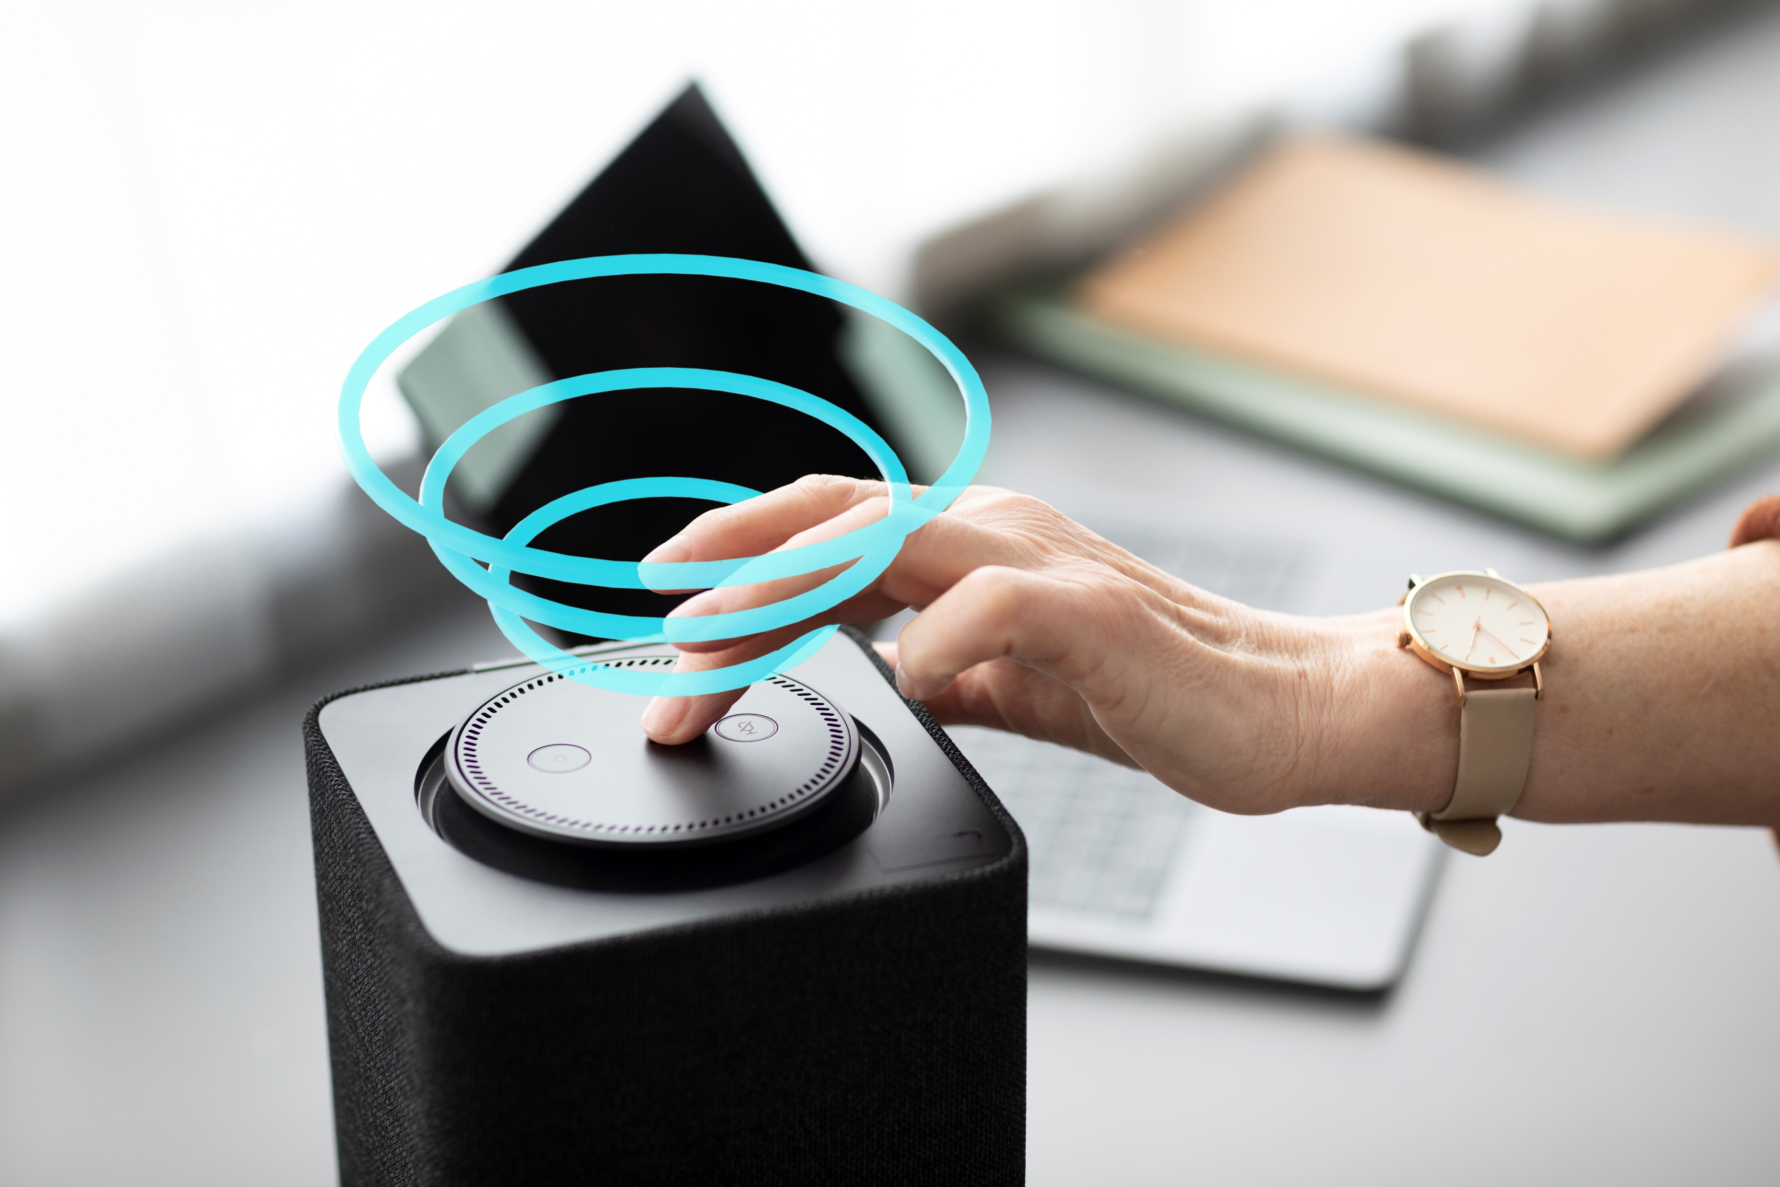
6. View the picture. The device in the picture is a …
Only one answer is correct!
Image by Freepik
A. Smartwatch
B. Smart speaker
C. Tablet

Slide 8
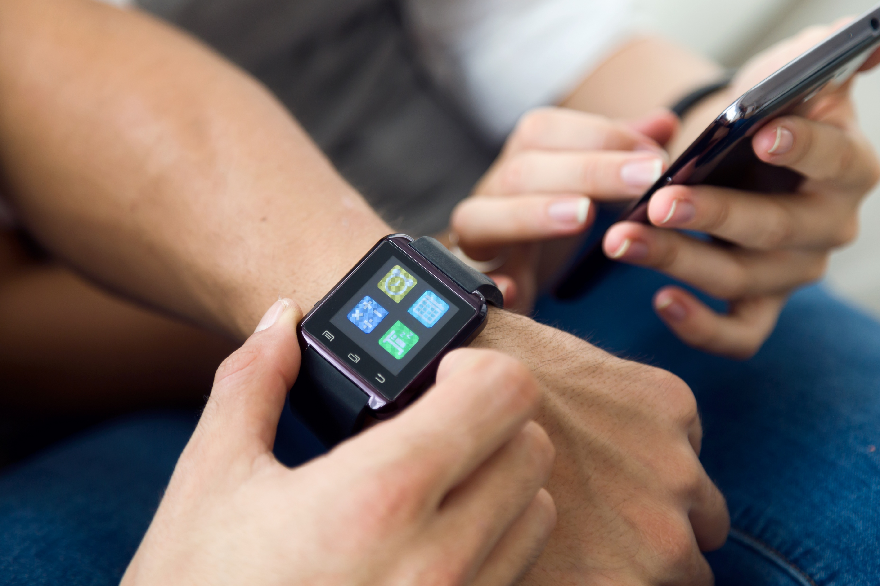
7. View the picture. The device in the picture is a …
Only one answer is correct!
Image by nensuria on Freepik
A. Smart speaker
B. Smart TV
C. Smart watch

