Slide 1




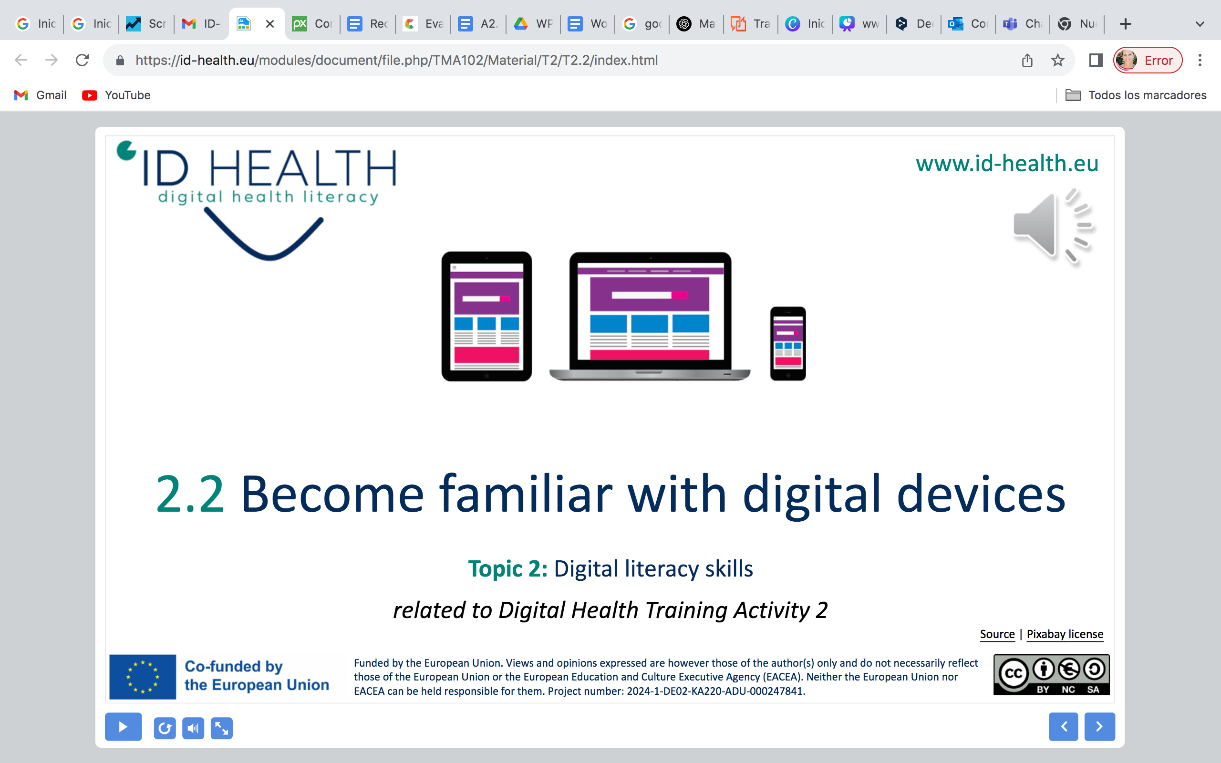
www.id-health.eu
Topic 1: Health management
TRAINING ACTIVITY 2 – SESSION 1
2.1 Health Literacy
Icon created by Awicon - Flaticon

Slide 2








www.id-health.eu
Partners

Slide 3
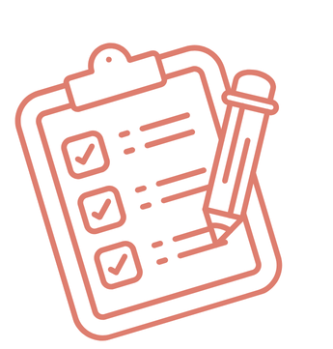
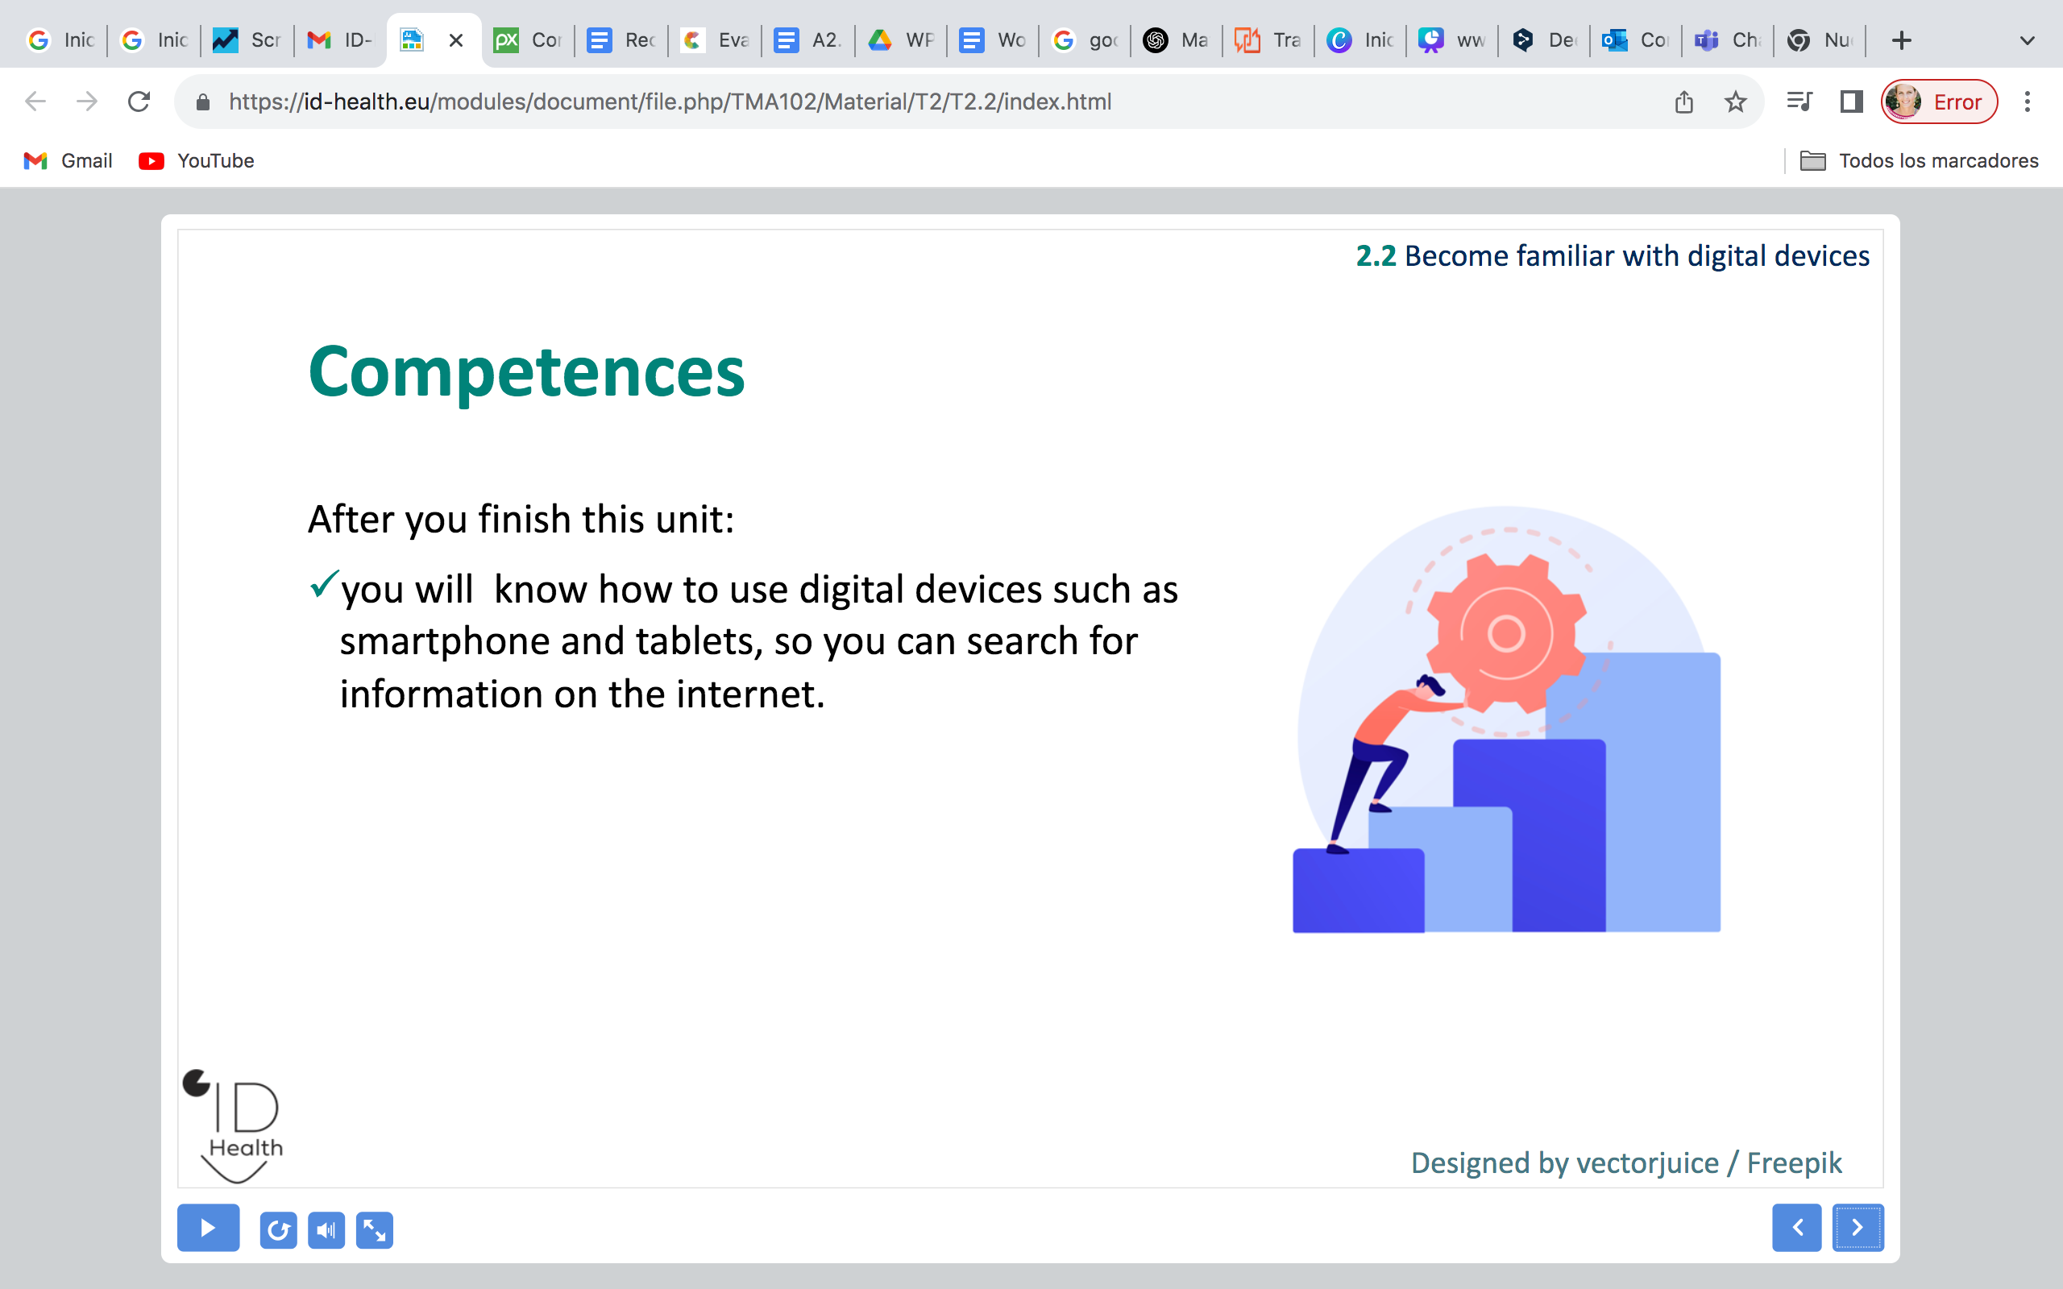
SESSION 1 SCHEME
2.1 Health Literacy
Initial activity | Meet my classmate Each student introduces and says the name of the person on his or her right.
Reminder | Brief reminder of the topics covered in previous sessions, remembering what we learned
Presentation | Let's see what this session is about
Video | 2 influencers (Rafael & Alejandro) talk to us about the topic
Group discussion | Share your personal experience
Practical activity | The health literacy panel
Practical activity | Exploring the PIL
Conclusions | Group reflection
Evaluation | Let's check if we have understood the main concepts
Closure | See you soon!

Slide 4
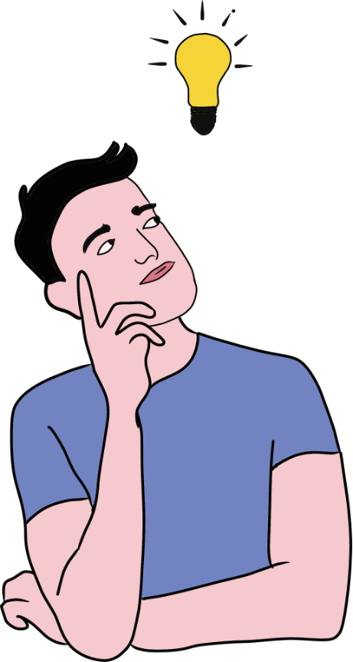
2.1 Health Literacy
Reminder
In previous sessions we talked about...
Self-knowdlege: how can we improve
the knowledge of our body and mind?
Main health issues that can affect us
Physical activity, healthy food, doctor visits...We can take care of ourselves
Icon: Canva

Slide 5
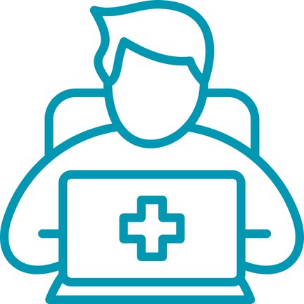
2.1 Health Literacy
Skills
After you finish this unit:
  You can read and understand health information.
  You can tell if health information is good or not.
  You can ask questions when something is not clear.
  You can use health information in your life.
  You can share easy health information with others.
Icon: Canva

Slide 6
www.id-health.eu
TOPIC 1 : Health Management
2.1 Health Literacy
a. Introduction to the
concept of health literacy
c. Health literacy for greater autonomy
e. Helping myself and others through health literacy
d. Examples for the daily life
b. Why is it important?

Slide 7
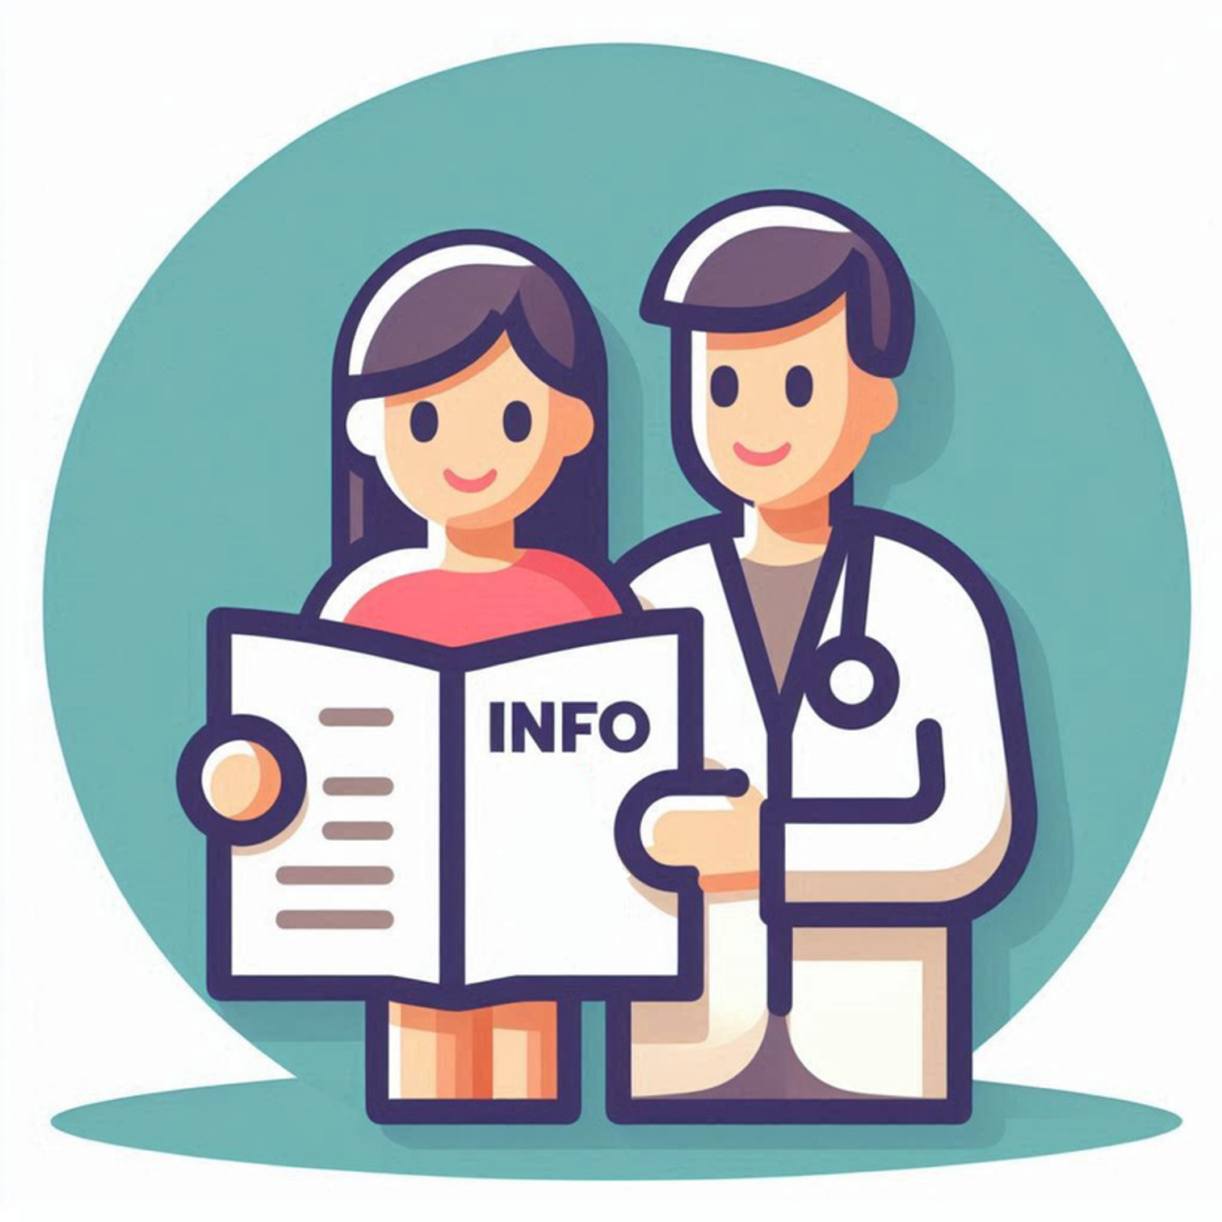
2.1 Health Literacy
What is Health Literacy?
  Health literacy means:
  You understand health information.
  You know how to use health information for daily choices.
Image made by AI from Microsoft Designer

Slide 8


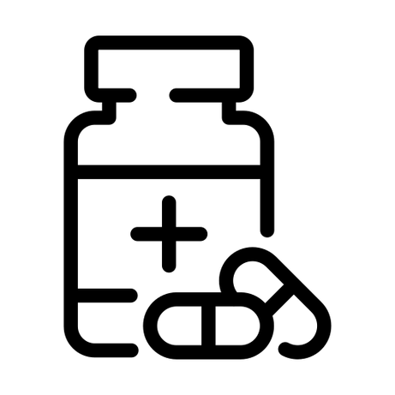
2.1 Health Literacy
Why is health literacy important for you?
To make decisions about your body and your health.
To understand medicines and know how to use them.
To make doctor visits easier.
Icon made by juicy_fish from Flaticon
Icon made by andinur from Flaticon
Icon made by ghost_icon from Flaticon

Slide 9
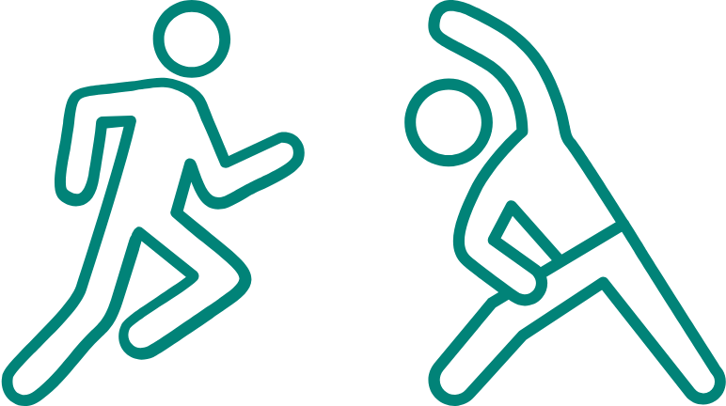
2.1 Health Literacy
When is health literacy important?
  Not only when you are sick.
  Also to stay healthy.
  When you want to avoid illnesses.
  For example, by eating well and exercising.
  Every day, to make good choices for your health.
Icons: Canva

Slide 10

2.1 Health Literacy
What skills do we need?
  Find information, for example in brochures, from a doctor, or on the internet.
  Check information: Is it correct and good?
  Use information: Apply it in daily life.
Icon: Canva

Slide 11
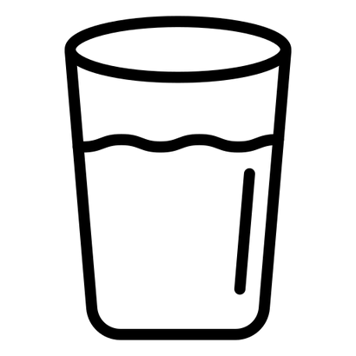
Everyday examples:
Where do you need health literacy?
2.1 Health Literacy
When reading medicine instructions.
When you want
to decide if you need
to see a doctor or
if home remedies
are enough.
When you want
to understand
simple health tips,
for example:
drink water
when it is hot outside
Icon made by andinur from Flaticon
Icon made by ghost_icon from Flaticon
Icon made by Graphix’s Art from Flaticon

Slide 12
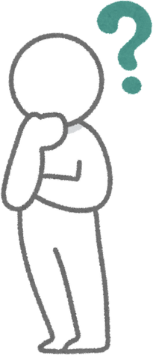
2.1 Health Literacy
Questions you should ask yourself
  Did I understand the information?
  Can I explain it to someone else,
  so they understand too?
  Do I know what to do next?
Icon: Canva

Slide 13
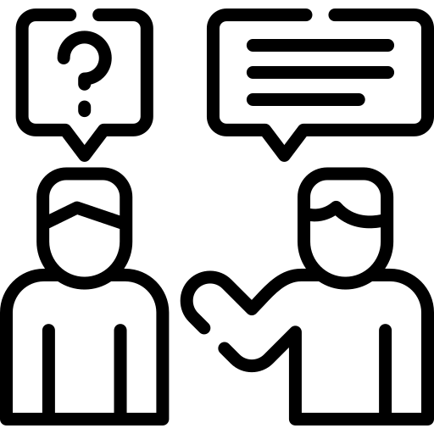
2.1 Health Literacy
Help for you and others with health literacy
  Share information in easy language
  with friends who are interested.
  Help each other: practice asking questions.
  Use trusted sources, like a doctor, nurse, or official leaflets
Icon made by Freepik from Flaticon

Slide 14
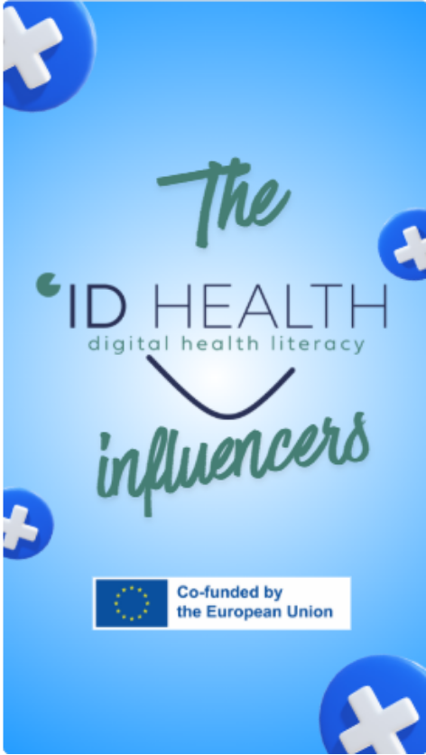

2.1 Health Literacy
Video 1
Rafael
We're going to see some influencers
who will talk to us about this topic.
Stay tuned for the videos!
Icon: Canva

Slide 15
2.1 Health Literacy
Video 2
alejandro
We're going to see some influencers
who will talk to us about this topic.
Stay tuned for the videos!
Icon: Canva

Slide 16
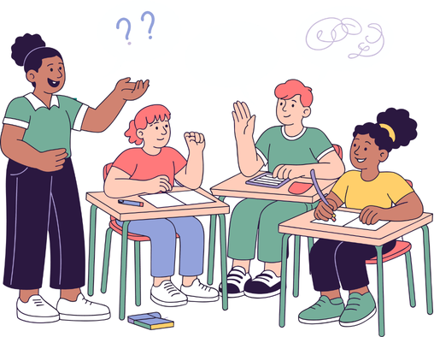
2.1 Health Literacy
Group discussion
The trainees talk about health literacy
according to the previous presentation
an videos.
You can share your personal experience
by raising your hand to participate.
Icon: Canva

Slide 17
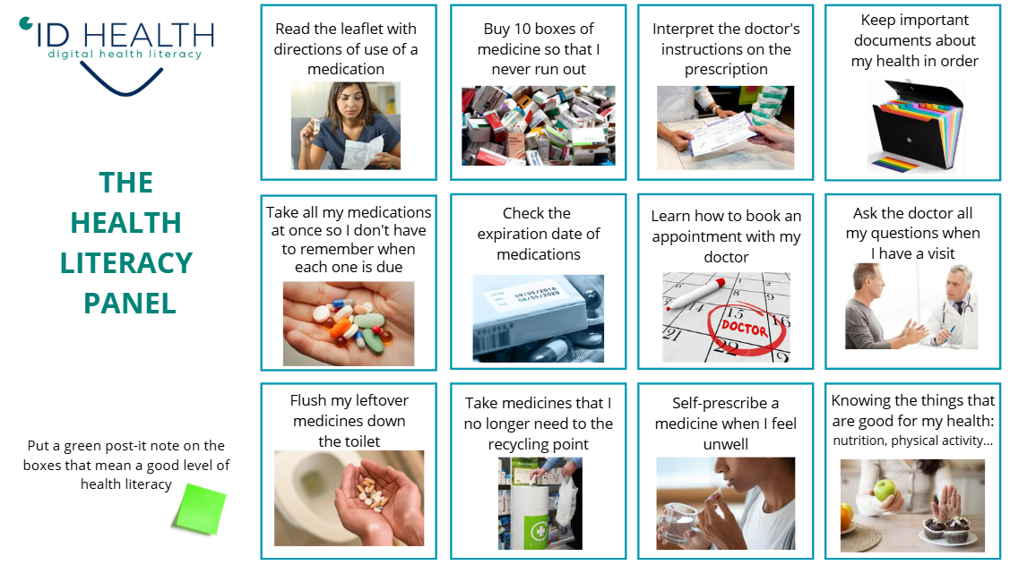
2.1 Health Literacy
Practical activity 1:
THE HEALTH LITERACY PANEL
We display a mural with 12 actions
related (or not) to health literacy.
Go to the mural
and put a green Post-it note
on the good ones.

Slide 18
2.1 Health Literacy

Slide 19

Practical activity 1:
THE HEALTH LITERACY PANEL
2.1 Health Literacy
You can also print the images.
Print them separately, one image per sheet.
Put them on the wall and
perform the activity in the same way
(sticking post-it notes on the actions
you consider correct).

Slide 20
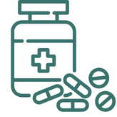
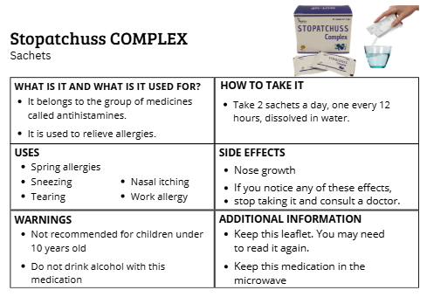
2.1 Health Literacy
Practical activity 2:
EXPLORING THE PIL
It's important to know how to interpret the PIL (Patient Information Leaflet)
because it tells us a lot about a medication:
type of medicine, what it's for, how to take it, side effects, etc.
Let's see if you can find some mistakes
that we have slipped into these
medicines leaflets.
Icon: Canva

Slide 21
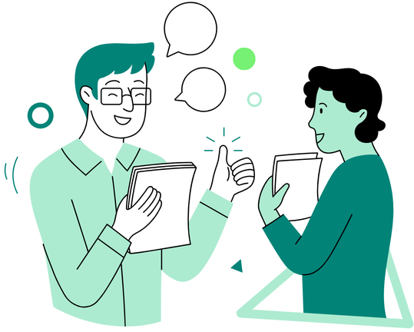
2.1 Health Literacy
Conclusions
  Do you think you have a good level of health literacy?
  Why is it important to have a good level of health literacy?
Icon: Canva

Slide 22
2.1 Health Literacy
Self-Evaluation Quiz 1/2
1. What is health literacy?
a) You can read and understand health information and use it for daily choices. | b) You only watch TV about health.
2. Why is health literacy important?
a) It helps you make decisions about your body and health. | b) It helps you play games better.
3. When do you need health literacy?
a) Only when you want to buy clothes. | b) Not only when you are sick, but also to stay healthy every day.
Notes:
1) A correct; 2) A correct; 3) B correct

Slide 23
2.1 Health Literacy
Self-Evaluation Quiz 2/2
4. What skills do we need for health literacy?
a) Be able to listen to music all day. | b) Find information Check information Use information.
5. What questions should you ask yourself about health information?
Did I understand the information? Can I explain it to someone else, so they understand too? Do I know what to do next? | b) Did I like the color of the paper?
Notes:
4) B correct; 5) A correct

Slide 24

2.1 Health Literacy
And we’re all done for today!!!
  We hope you enjoyed the session,
  see you next time!
Icon: Canva

