Slide 1



www.id-health.eu
4 Digital Health Applications
7. Monitor your physical health
Session 1 – Different devices and their uses

Slide 2








www.id-health.eu
Partners

Slide 3



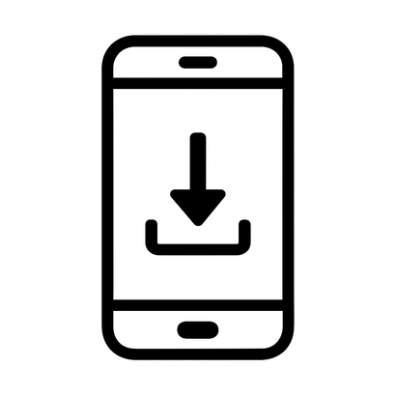

Skills
7.1 Monitoring my physical health
After the training you will be able to:
  Identify important data.
  Data = numbers about your body.
  Examples: steps, heart rate, weight.
  Choose a device or app.
  App = a small program on your mobile phone.
  download an app.
  Downloading = You get the app from the internet to your phone use a device or an app. app.

Slide 4

7.1 Monitoring my physical health
Different devices and their uses!
Quiz

Slide 5
7.1 Monitoring my physical health
QUESTION 1
Which device can measure your pulse?
A watch (smartwatch)
A pillow

Slide 6
7.1 Monitoring my physical health
QUESTION 2
Which device can count steps?
a mobile phone or a watch
a toaster

Slide 7
7.1 Monitoring my physical health
QUESTION 3
What can you do with apps?
Just make phone calls
Count your steps and write down how much you drink

Slide 8
7.1 Monitoring my physical health
QUESTION 4
How do you download an app?
Open the App Store. Tap the name. Tap "Install". Open the app.
Turn off your phone. The app will then be available automatically.

Slide 9

7.1 Monitoring my physical health
Introduction: What is physical health?
  Physical health means that your body functions well and you feel resilient, mobile and capable in everyday life.
  Your heart, lungs, muscles and organs are working as they should.
  You have enough strength, stamina, and energy for the things you want to do.

Slide 10
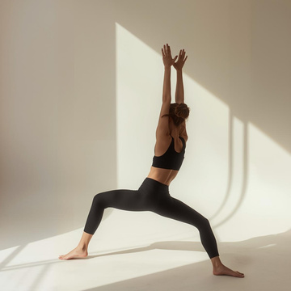
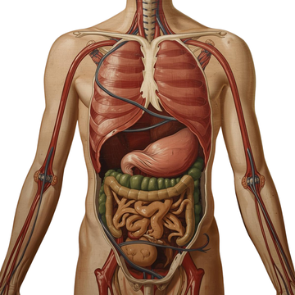
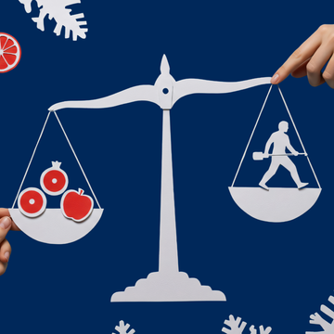
Introduction: What is physical health?
7.1 Monitoring my physical health
Physical health encompasses several areas:
1. Fitness and exercise
You can move well without becoming exhausted immediately under minor exertion. This includes strength, endurance, flexibility, and coordination.
2. Body functions
Your heart rate, breathing, blood pressure, temperature, and other bodily functions are within the normal range. Your body is responding appropriately to stress or strain.
3. Nutrition and energy balance
You consume enough nutrients, drink enough fluids, and maintain a healthy body weight.

Slide 11
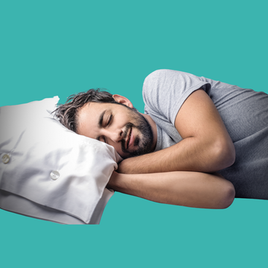


7.1 Monitoring my physical health
Introduction: What is physical health?
4. Sleep and rest
Your body gets enough sleep and rest so that muscles, immune system and brain can regenerate.
5. Immune defense
You won't get sick all the time, and your immune system is good at fighting off infections.
6. Medical check-ups
Regular check-ups, vaccinations, the correct use of medications, and taking symptoms of illness seriously are also part of it.

Slide 12
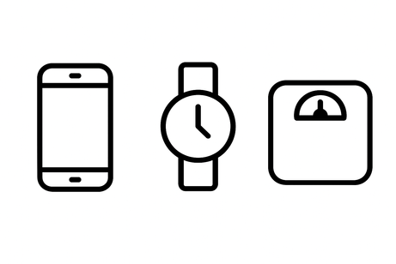
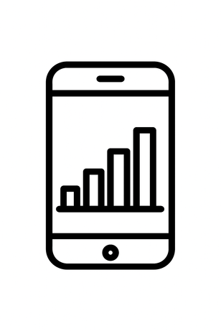
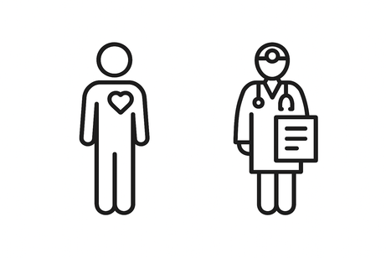
7.1 Monitoring my physical health
There are devices to monitor physical health.
There are devices for health.
Examples include:
  a mobile phone
  a clock
  a scale
  The devices display numbers.
  These numbers are called data.
  Data will help you:
  You understand your body better.
  Data also helps doctors.

Slide 13
VIDEO
7.1 Monitoring my physical health
You will find a YouTube Link here soon

Slide 14
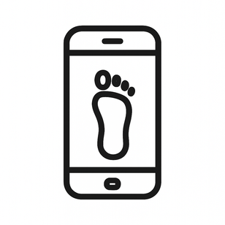
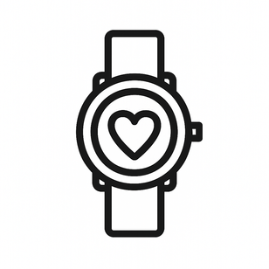
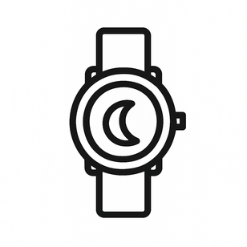

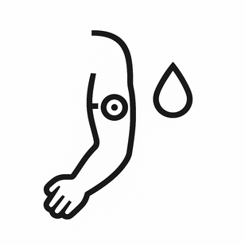
Devices
7.1 Monitoring my physical health
Examples of devices:
  Mobile phone → counts steps
  Clock → measures heartbeat
  Clock → measures sleep
  Scales → show weight
  Sensor → measures blood sugar

Slide 15
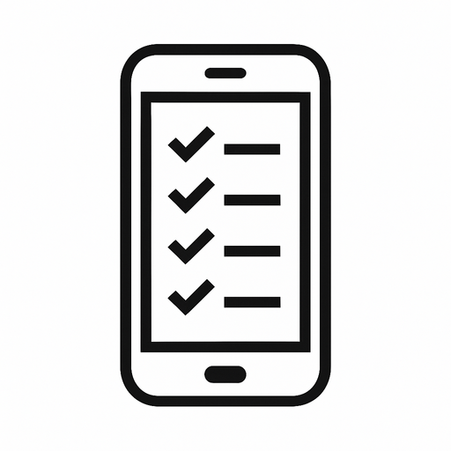
Apps
7.1 Monitoring my physical health
With apps you can also:
  Count steps
  Write down how much you drink
  Measure heartbeat
  Write down your sleep patterns
  Write down what you ate

Slide 16

Exchange
7.1 Monitoring my physical health
Questions for you:
    What health data is important to you?
    Which app do you like?
    Which app would you like to use to collect health data?

Slide 17
7.1 Monitoring my physical health
Let's practice!

Slide 18
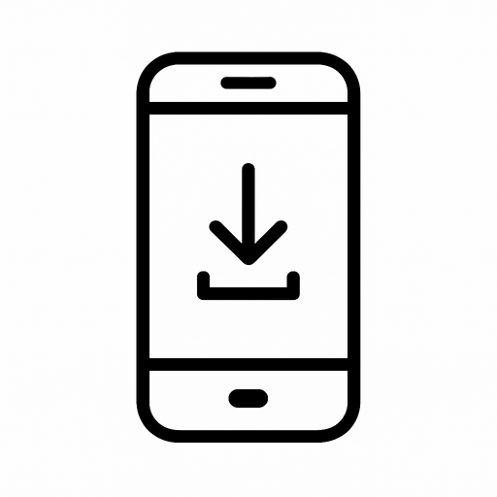
7.1 Monitoring my physical health
Download an app from the catalogue
Here's how it works:
    Open catalog
    Choose an app
    Search for the app in the App Store
    Tap the app name
    Press "Install".
    Open app

Slide 19
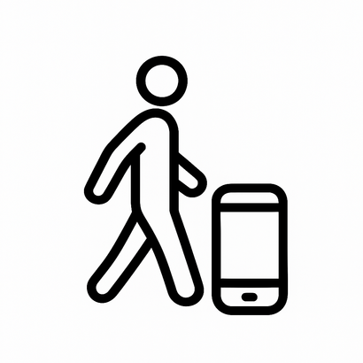
EXERCISE
7.1 Monitoring my physical health
Try the app you chose now. Examples:
    Count your steps → Go for a short walk
    Measure heart rate → Use a watch or app

Slide 20

Feedback
7.1 Monitoring my physical health
Questions:
    What went well?
    Were there any problems?
    How was it for you?

Slide 21
Quiz / Self-Assessment
7.1 Monitoring my physical health
Part 1 –Did You understand everything?
1. Do you now know what physical health means? 🤔
☐ Yes ✔
☐ No ✖
☐ A little bit🤔
2. Can you give examples of devices that measure health data? 🖥️
☐ Yes ✔
☐ No ✖
☐ A few 🤔
3. Do you know what an app is? 📱
☐ Yes ✔
☐ No ✖
4. Can you download an app? ⬇️
☐ Yes ✔
☐ No ✖
☐ With the help of my supporter 🤝

Slide 22

QUIZ/ Self-Assessment
7.1 Meine körperliche Gesundheit überwachen
5. Which data are you able to measure with devices or apps now?? ​
​
☐ 👣 Steps ​
☐ ❤️ Heartrate ​
☐ ⚖ Weight ​
☐ 🛏 Sleep ​
☐ 💧 Blood sugar ​
6. Do you feel safe using devices or apps? ​
☐ Yes ✔ ​
☐ No ✖ ​
7. What was easy for you? ​
​
8. What was hard for you? ​
Notes:
Dinge, die man messen kann: z.B. Gewicht, Schritte zählen, Flüssigkeitszufuhr, aufgenommene Kalorien, Menstruationkalender, Sauerstoffsättigung, Herzfrequenz, Blutdruck...
18

