Slide 1



www.id-health.eu
4 Digital Health Applications
7: Monitor your physical health
Session 2: Testing devices and apps

Slide 2








www.id-health.eu
Partners

Slide 3
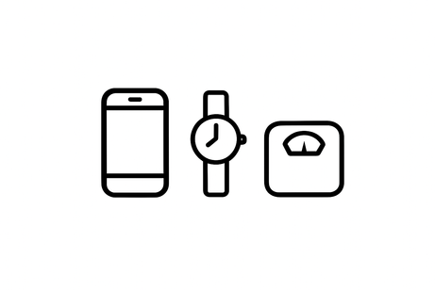



7.2 Monitoring my physical health
Introduction
    There are devices for health.
    Today we're testing devices.
    Examples: Mobile phone. Watch. Scales.
    Today we're testing apps.
    App = small program on the mobile phone.
    We're practicing to collect data.
    Data = numbers about your body.
    Data also helps doctors.

Slide 4
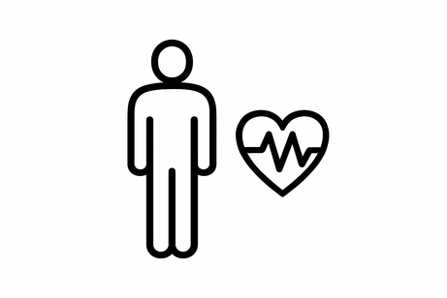

7.2 Monitoring my physical health
Skills
What you will be able to do after this session:
  You will recognize important standard values.
  Examples: heart rate, blood pressure, weight.
  You can better assess your own health indicators

Slide 5

7.2 Monitoring my physical health
QUIZ
QUESTION 1
What is a standard value?
A standard value is a number which is normal for many people
A standard value is a password for a smartphone

Slide 6
7.2 Monitoring my physical health
QUIZ
QUESTION 2
What is a pulse?
Pulse means: How often your heart beats in 1 minute
Pulse means: How much water you drink

Slide 7
7.2 Monitoring my physical health
QUIZ
QUESTION 3
What should I do if a value is too high?
I'll take another measurement when I have more time
I throw away the device

Slide 8
7.2 Monitoring my physical health
QUIZ
QUESTION 4
Which device can measure your heart rate?
A watch (smartwatch) can measure your pulse
A pillow can measure your pulse

Slide 9
Video
7.2 Monitoring my physical health
You will find a YouTube Link here soon

Slide 10




Standard values
7.2 Monitoring my physical health
Standard values ​​= numbers that are normal for many people.
    ❤️ Pulse (heartbeat): 60–80 beats per minute at rest. It is normal for the heart to beat faster when you exert yourself or are excited.
    💉 Blood pressure: 120 over 80
    💧 Drinking intake: 1.5–2 liters of water per day
    🍬 Blood sugar: 60–100 mg/dl when you haven't eaten yet

Slide 11
7.2 Monitoring my physical health
Devices for monitoring health values
These devices are available:
    ⌚ Watch/Smartwatch
    📱 Handy
    ⚖️ Scale
    🔘 Sensor = small device on the body
Notes:
July 1, 2013
Equipment Presentation
- The instructor presents her own equipment.
- Participants have the opportunity to present their equipment.
- Each person briefly explains the functions of their equipment.
‹#›

Slide 12

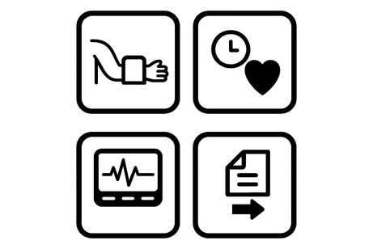
Everyone shows:
7.2 Monitoring my physical health
I use this device or app
What does my device measure?
How do I use it?
Notes:
July 1, 2013
Equipment Presentation
- The instructor presents her own equipment.
- Participants have the opportunity to present their equipment.
- Each person briefly explains the functions of their equipment.
‹#›

Slide 13
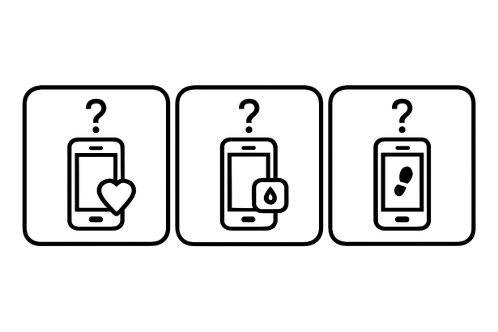
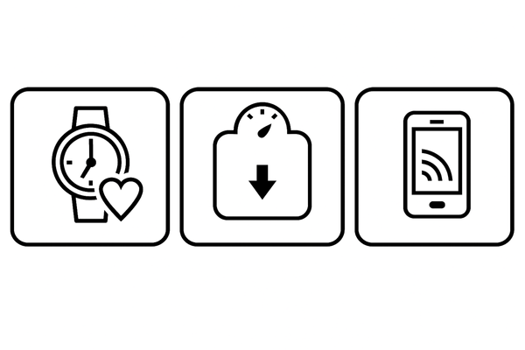

7.2 Monitoring my physical health
Exchange
Questions for you:
    What are the benefits of the app?
    Examples:
    Google Fit → counts steps.
    Water Reminder → reminds you to drink.
    What benefit does this device offer me?
    Examples:
    Clock. Scales. Mobile phone.
    Does it fit into my everyday life?
    For example:
    at work, during leisure time, and at home.

Slide 14
7.2 Monitoring my physical health
Let's practice!

Slide 15

7.2 Monitoring my physical health
Practice
Exercise:
Test a device.
App testing.
Are there other apps that can do the same job?
Example: Two pedometer apps.

Slide 16
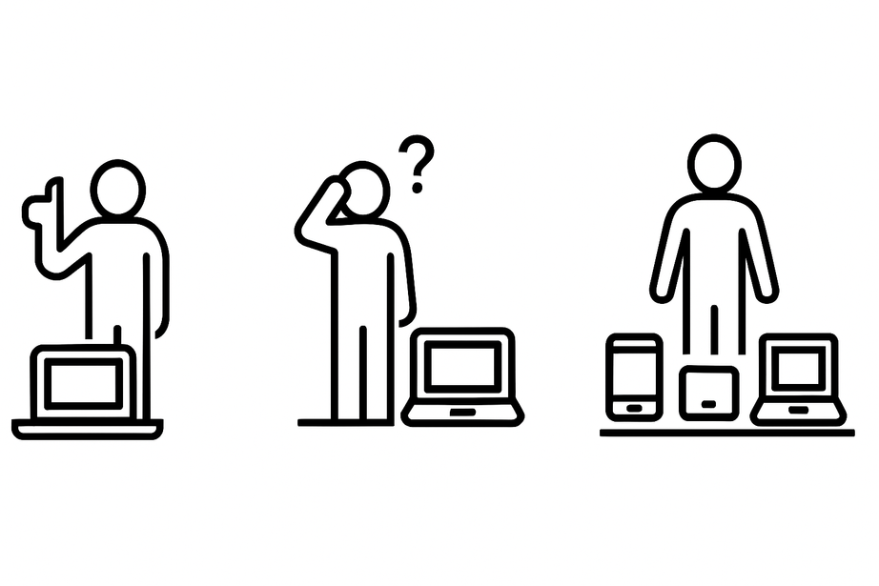
7.2 Monitoring my physical health
Feedback
Questions:
What was easy?
What was difficult?
Which device suits you best?

Slide 17

7.2 Monitoring my physical health
Quiz/ Self-Assessment
1. Do you now know what standard values are? 🤔
☐ Yes ✔
☐ No ✖
☐ A little bit 🤔
2. Can you give examples of standard values? 📏
☐ Yes ✔
☐ No ✖
3. Do you know which devices measure health values? 🖥
☐ Ja ✔
☐ Nein ✖
4. Did you test an app or a device? 📱
☐ Yes ✔
☐ No ✖

Slide 18

7.2 Monitoring my physical health
Quiz/ Self-Assessment
5. Which values are you able to measure?
☐ ❤️ Heartbeat
☐ 💉 Blood pressure
☐ ⚖ Weight
☐ 💧 Fluid intake
☐ 🍬 Blood sugar
6. Do you feel safe using devices or apps?
☐ Yes ✔
☐ No ✖
7. What was easy for you?
8. What was hard for you?

