Slide 1



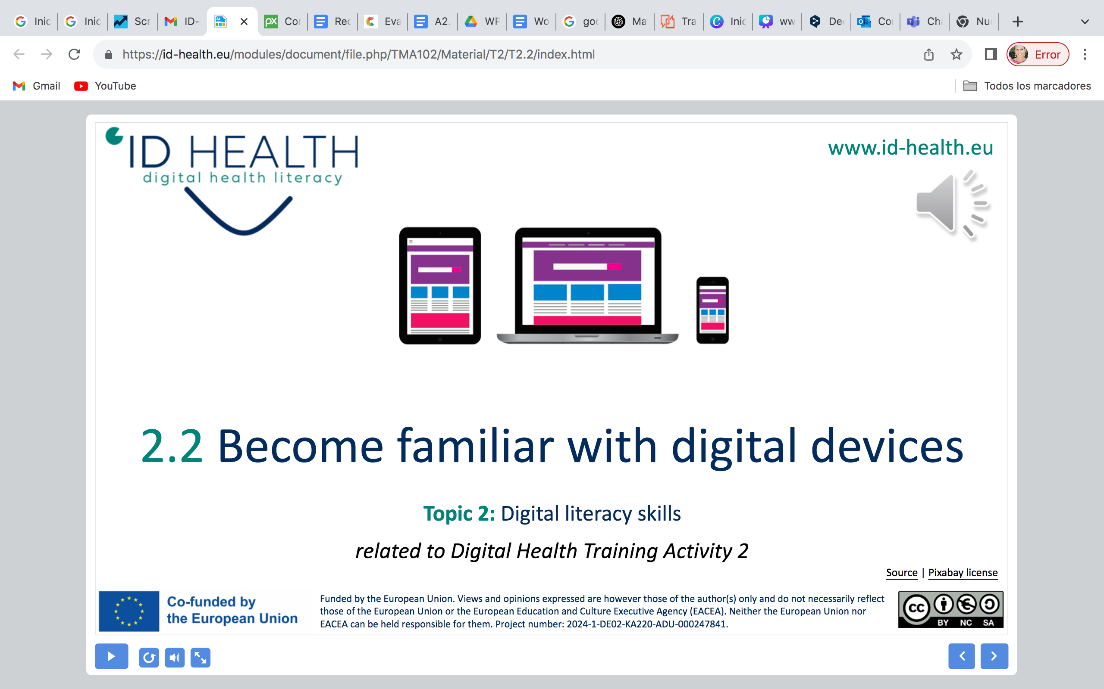
www.id-health.eu
3. Digital Health Literacy

Slide 2








www.id-health.eu
Partners

Slide 3
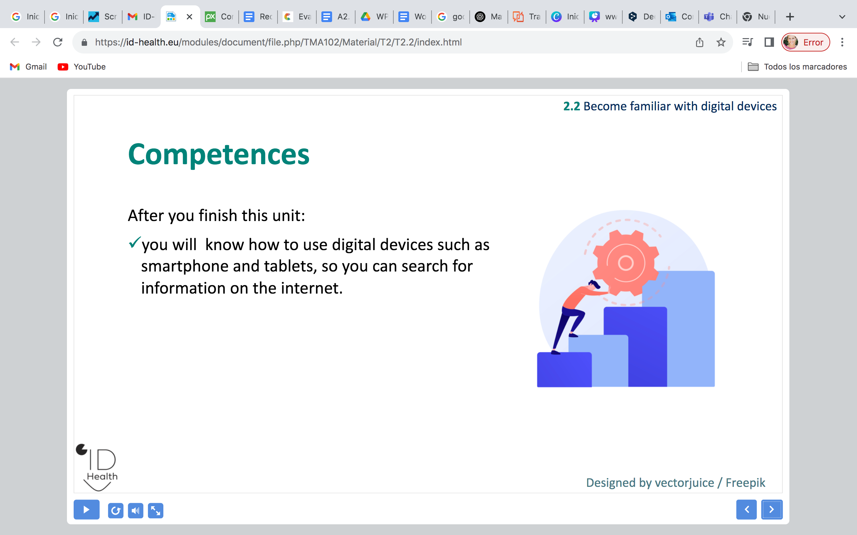
3.2 Digital Health Literacy
TOPIC Nº 3: List of units
3.1 Health Literacy
3.2 Digital Health Literacy

Slide 4
3.2Health Literacy
Competences
After you finish this unit:
  Finding information: Know where to find reliable digital health information.
  Checking information: Make sure the information is correct and trustworthy.
  Using information: Apply the information for decisions and daily life.
  Using digital tools: Use apps and websites safely and correctly.

Slide 5
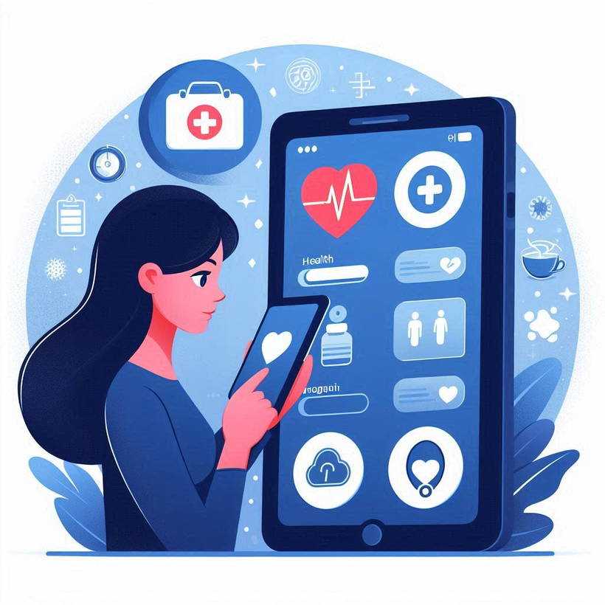
3.2 Digital Health Literacy
What is Digital Health Literacy?
  Digital Health Literacy = understanding health information online or in apps
  Knowing how to find, understand and use digital health information
Image from Microsoft Designer

Slide 6
3.2 Digital Health Literacy
Why Digital Health Literacy matters
  More and more health information is online (apps, websites)
  Makes everyday life easier (appointments, recipes, prevention)
  Helps us take care of our health earlier, not only when sick

Slide 7
3.2 Digital Health Literacy
Skills to practice
  Use search engines (“How do I find the right info?”)
  Check sources (“Who wrote this? Can I trust it?”)
  Apply info (“What does this mean for me?”)

Slide 8
3.2Digital Health Literacy
Using health information
  Try healthy recipes you find online
  Do simple exercises from a video
  Learn tips to stay safe (sun protection, vaccinations)

Slide 9



3.2 Digital Health Literacy
Where can I find information?
Health apps on phones or tablets
Internet websites
Videos about health
Icon made by prettycons from Flaticon
Icon made by Freepik from Flaticon
Icon made by Freepik from Flaticon

Slide 10
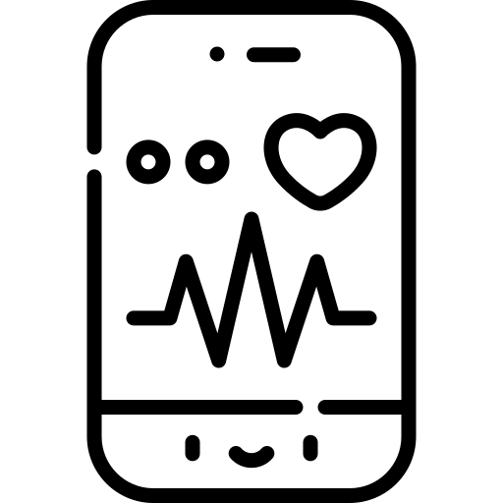
3.2 Digital Health Literacy
How health apps can help me
  Track your activity (steps, walking, exercise)
  Remind you to take medicine or drink water
  Learn about healthy habits
Image made by Freepik from Flaticon

Slide 11


3.2 Digital Health Literacy
Reliable and unreliable sources
Reliable sources: doctors, nurses, official health websites, government sites
Unreliable sources: random posts, social media without sources, false information
Image made by Roundicons from Flaticon
Image made by Roundicons from Flaticon

Slide 12


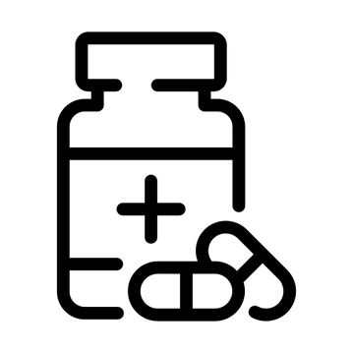

3.2 Digital Health Literacy
Different health topics online
  Nutrition and healthy food
  Exercise and daily activity
  Finding a doctor or clinic
  Medicine and treatments
Icon made by Smashicons from Flaticon
Icon made by Smashicons from Flaticon
Icon made by ghost_icon from Flaticon
Icon made by joalfa from Flaticon

