Slide 1



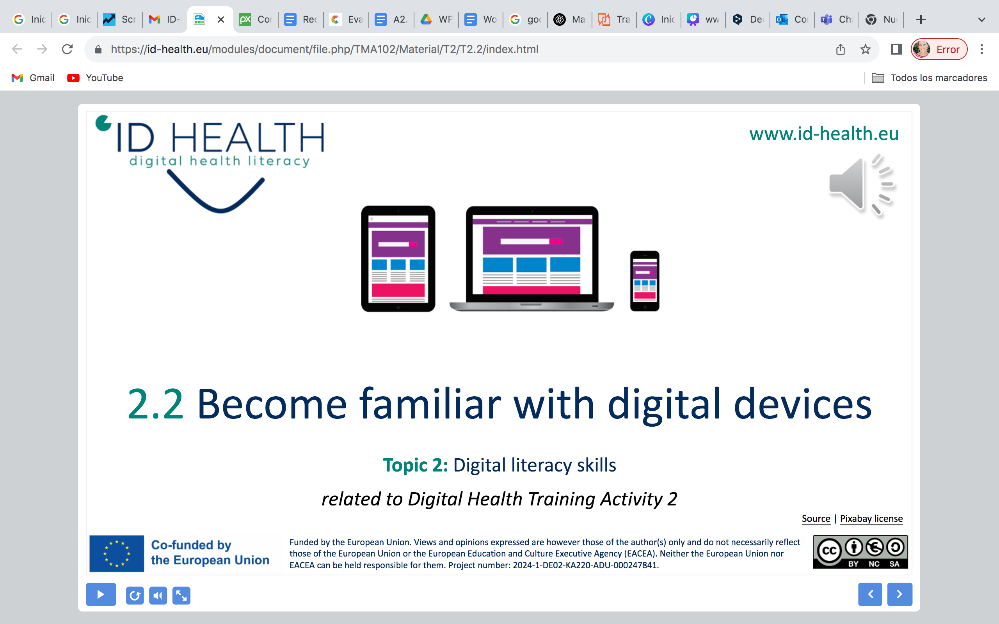
www.id-health.eu
Training on the use of Digital Health Tools for healthier lifestyles
Training Activity 9: Digital Health Media for PID (Session 2)

Slide 2








www.id-health.eu
Partners

Slide 3










www.id-health.eu
TOPIC Nº 9: List of units
1.1 Introduction
1.2 What is Mindfulness
1.3 Self-Compassion
1.4 My Feelings
1.7Competences
1.6 Activities
(Examples)
1.5 Scenarios

Slide 4
We will learn to notice how we feel, in our body, our mind, and our heart.
We will practice breathing slowly and staying calm when we feel worried or upset.
We will pactice talking kindly to ourselves, just like we talk kindly to a good friend.
When we make a mistake, we will say: “It’s okay. I am learning. I can try again
We will learn to use simple apps, like Cozi, to help us plan our day, eat well, rest, and do fun things.
Competences

Slide 5
1.1 Ιntroduction
Introduction
Using Apps for Our Feelings
Some apps can help us be calm, kind to ourselves, and understand others.
Icebreaker
“What feeling do you have right now?” (Show emoji cards).

Slide 6

1.2 Mindfulness
1.2 What is Mindfulness?
Mindfulness means paying attention to what is happening right now
to your body, your thoughts, and your feelings, without feeling bad for them.
It is like saying to yourself:
“I notice what I feel and what I think, and that’s okay.”
When we are mindful, we try to:
  Breathe slowly,
  Notice what we see, hear, or touch,
  Stay in the moment, not worry about the past or the future.
  For example:
When you eat, notice the taste and smell of your food.
When you walk, feel your feet on the ground.
When you feel sad or angry, take a deep breath and say:

Slide 7
1.3 What is Self-Compassion
1.3 What is Self-Compassion
Self-compassion means being kind to yourself, especially when things go wrong or when you make a mistake.
It is like being your own best friend!
Self-compassion has three parts:
  Being kind to yourself, talk to yourself the way you would talk to a friend who is sad or tired.
  Instead of saying “I’m stupid,” say “I tried my best, and that’s okay.”
  Remember we all make mistakes and everyone has problems sometimes. You are not alone!
  Notice when you feel pain, but don’t fight it or hide it
  We treat ourselves with care, not anger or shame.
.

Slide 8
1.3 Mindfulness and Self Compassion (Cont.)
1.3 Why they matter
Mindfulness helps you:
  Feel calmer and safer inside.
  Worry less about things you cannot change.
  Focus better on what you are doing.
Self-compassion helps you:
  Feel more confident and accepted.
  Be patient with yourself.
  Build kinder relationships with other people
  Together, mindfulness and self-compassion help your mental health, your emotions, and your daily life so you can live with more peace, kindness, and joy!

Slide 9
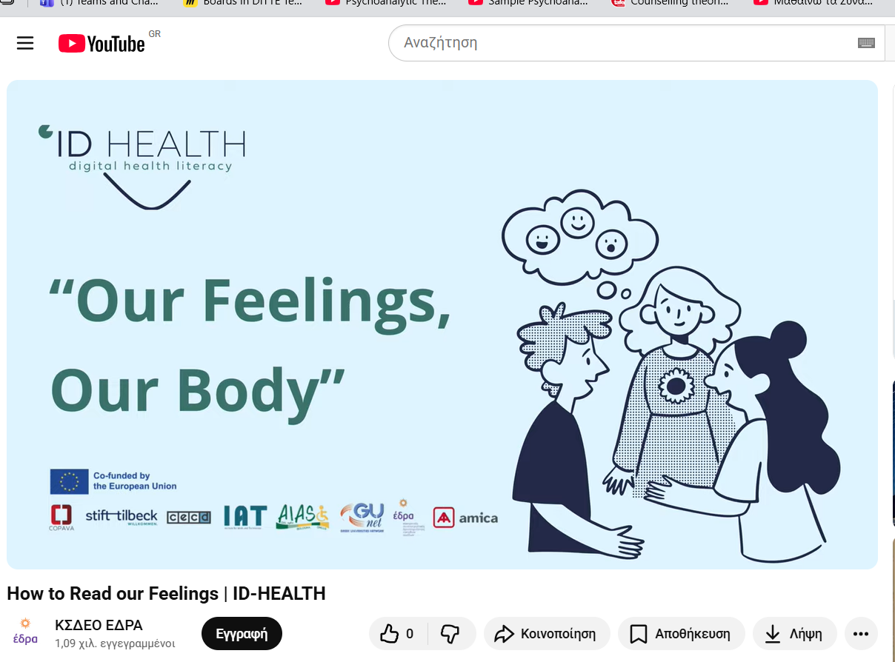
1.4 My Feelings
1.4 My Feelings
(Also check Training Activities No 3 & 6)
See You Tube video My Feelings
How to Read our Feelings | ID-HEALTH

Slide 10
1.4 My Feelings (Cont.)
1.4 My Feelings
What Are Feelings?
  Feelings are how we feel inside, in our heart and body.
  We all have many feelings, like happy, sad, angry, scared, calm.
  Feelings can change during the day, that’s normal.
  It helps to notice and name our feelings, so others can understand us

Slide 11
1.4 My Feelings (Cont.)
1.4 My Feelings
How Can We Know What We Feel?
  Listen to your body, your heart, tummy, or hands may feel different.
  Look at your face, are you smiling, frowning, or crying?
  Think about your thoughts, what are say to yourself inside?
  Tell someone you trust how you feel, with words, pictures, or moves.

Slide 12
1.4 My Feelings
1.4 My Feelings (Cont.)
My Body Map of Feelings
  Our body helps us know how we feel.
  Sometimes we feel feelings in different parts of our body.
  We can draw or color where we feel happy, sad, angry, or scared.
  There is no right or wrong, it’s just how your body feels today.

Slide 13
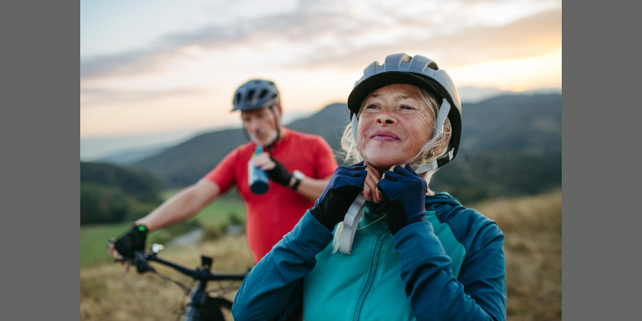
1.4 My Feelings
1.4 My Feelings (Cont.)
Facilitator’s Tip
Give each person a simple outline of a body on paper.
Ask:
“Where do you feel your feelings?”
Examples:
  “When I’m angry, my hands feel tight.”
  “When I’m happy, my chest feels warm.”
  “When I’m sad, my eyes feel heavy.”

Slide 14
1.5 Scenarios
1.5 Scenarios
Instructions for Participants
Work with a partner
Use your phone/tablet with the app (Calm, Headspace, Mood Tracker, or similar).
Follow the scenario.
Share what you feel after.

Slide 15
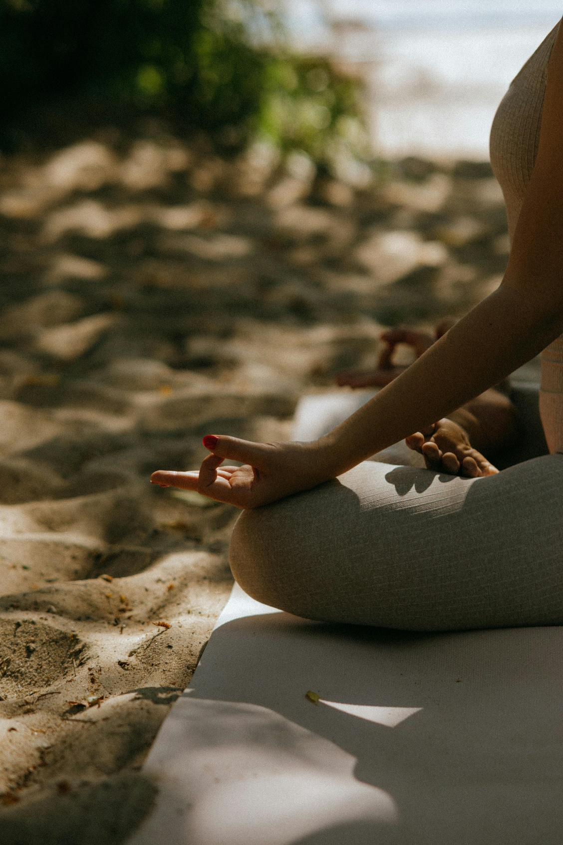
1.5 Scenarios
1.5 Scenarios
Scenario 1. Feeling Nervous Before Bed
Maria feels nervous at night. She cannot sleep.
She opens the Calm app. She listens to soft music and breathes slowly.
Try This:
Open the Calm/Headspace app.
Play one breathing or music track.
Do it together for 2 minutes.
Questions:
How did your body feel before?
How did it feel after?

Slide 16
1.5 Scenarios
1.5 Scenarios (Cont.)
Scenario 2. Feeling Angry After School/Work
Alex feels angry because someone shouted at him. He opens his Mood Tracker app. He taps the angry face. Then, he listens to a short breathing exercise.
Try This:
Open Mood Tracker and tap the face for your current feeling.
Then, open Calm/Headspace and do 3 slow breaths.
Questions:
  What feeling did you choose in the app?
  Did the breathing help calm you?

Slide 17

1.5 Scenarios
1.5 Scenarios (Cont.)
Scenario 3. Feeling Sad and Lonely
Anna feels sad because her friend is away.
She writes her feeling in the app journal.
She also listens to a kind message: ‘I am good enough. I am not alone.’
Try This:
Open the app and write or record: “I feel sad today.”
Say a kind message to yourself: “I am not alone. I am safe.”
Questions:
  How does it feel to write or say your feeling?
  Did the kind message help you feel better?

Slide 18

Activity 1: Mindful Breathing (1 minute)-Check Worksheet 2
Steps
  Sit comfortably with feet on the floor.
  Put one hand on your belly.
  Breathe in slowly through your nose, feel your belly rise.
  Breathe out slowly through your mouth, feel your belly fall.
  Say quietly:
“Breathing in, I feel calm.”
“Breathing out, I let go.”
Facilitator’s Note
Encourage slow, natural breathing, don’t force it. Model the breathing first.
If someone cannot close their eyes, ask them to look gently at a point on the floor.
If VR equipment is available: Check trainer’s manual Activity VR Guided Mindfulness Meditation
1.6 Activities
Activities
.

Slide 19
1.6 Activities (Cont.)
Activities
Activity 2: The Five Senses Game or
Steps:
Ask participants to notice:
  5 things they can see
  4 things they can touch
  3 things they can hear
  2 things they can smell
  1 thing they can taste (or imagine tasting)
  Facilitator’s Note:
  Use familiar, safe surroundings.
  Encourage descriptive words (“soft,” “bright,” “warm”).
  If someone struggles with imagination, prompt with questions:
  “Can you see something blue?” or “What sound do you hear right now?”
.

Slide 20
1.6 Activities (Cont.)
Activities
Activity 3: Kind Words to Myself
Steps:
Ask participants to say (aloud or silently):
  “I am trying my best.”
  “I deserve kindness.”
  “I am learning and growing every day.”
  Facilitator’s Note:
  Invite gentle repetition as a group.
  If someone feels shy, allow them to whisper or just listen.
  You can write phrases on cards and let participants pick one that feels right for them.
.

Slide 21
1.6 Activities (Cont.)
Activities
Activity 4: Letter to Myself
Steps:
Ask each person to write or draw a short message to themselves.
Example:
“Dear me, it’s okay to be tired today. I don’t have to be perfect.”
Facilitator’s Note:
Provide paper and colored pens.
Encourage self-expression through words, drawings, or stickers.
If someone struggles with writing, they can dictate their message to you or use symbols/pictures.
End by asking volunteers if they’d like to share something they wrote.
.

Slide 22
Activities Examples
1.6 Activities Catalogue Sheet (Cont.)
CATALOGUE SHEET
  Headspace: It offers guided meditations, breathing exercises and sleep support.
  Why it’s good: Helps build a habit of mindfulness; supports stress/anxiety relief.
  Considerations: The language may still be complex; shorter sessions might suit better.
  Adaptation tip: Use with a facilitator assisting in navigating, summarizing instructions in plain language.
  Smiling Mind: Designed for all ages and stages, promotes daily mental wellbeing.
  Why: Friendly design, suitable for various users including simpler needs.
  Considerations: Check whether the interface is simple enough for your group.
  Adaptation: Pre-select modules, use pictorial supports, do together as a group.

Slide 23
1.7 Competences
Ask participants:
“How did this make you feel?”
Invite one word from each person (calm, relaxed, happy, sleepy).
Praise every effort and remind them that there is no right or wrong way to practice.
Group reflection circle:
“Which app did you like best?”
“Which activity helped the most?”
“What will you try at home when you feel sad, angry, or nervous?”
Closing activity:
Each person points to an emoji card showing how they feel now.

Slide 24
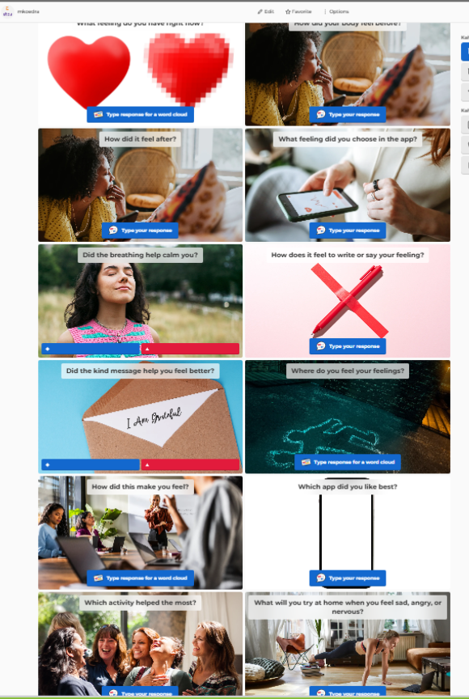
1.7 Quiz & Feedback
What did we learn today?
  Use my phone for health.
  Learn to relax with guided exercises.
  Record how I feel.
  Set small goals and achieve them.
  Quiz and your opinion
  We are taking a quiz: How do I feel now? ‘’Happy Apps, Healthy You!”

