Slide 1

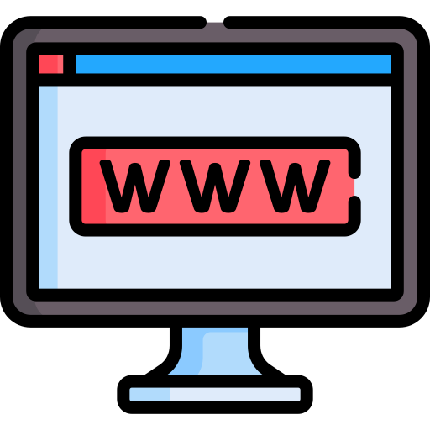


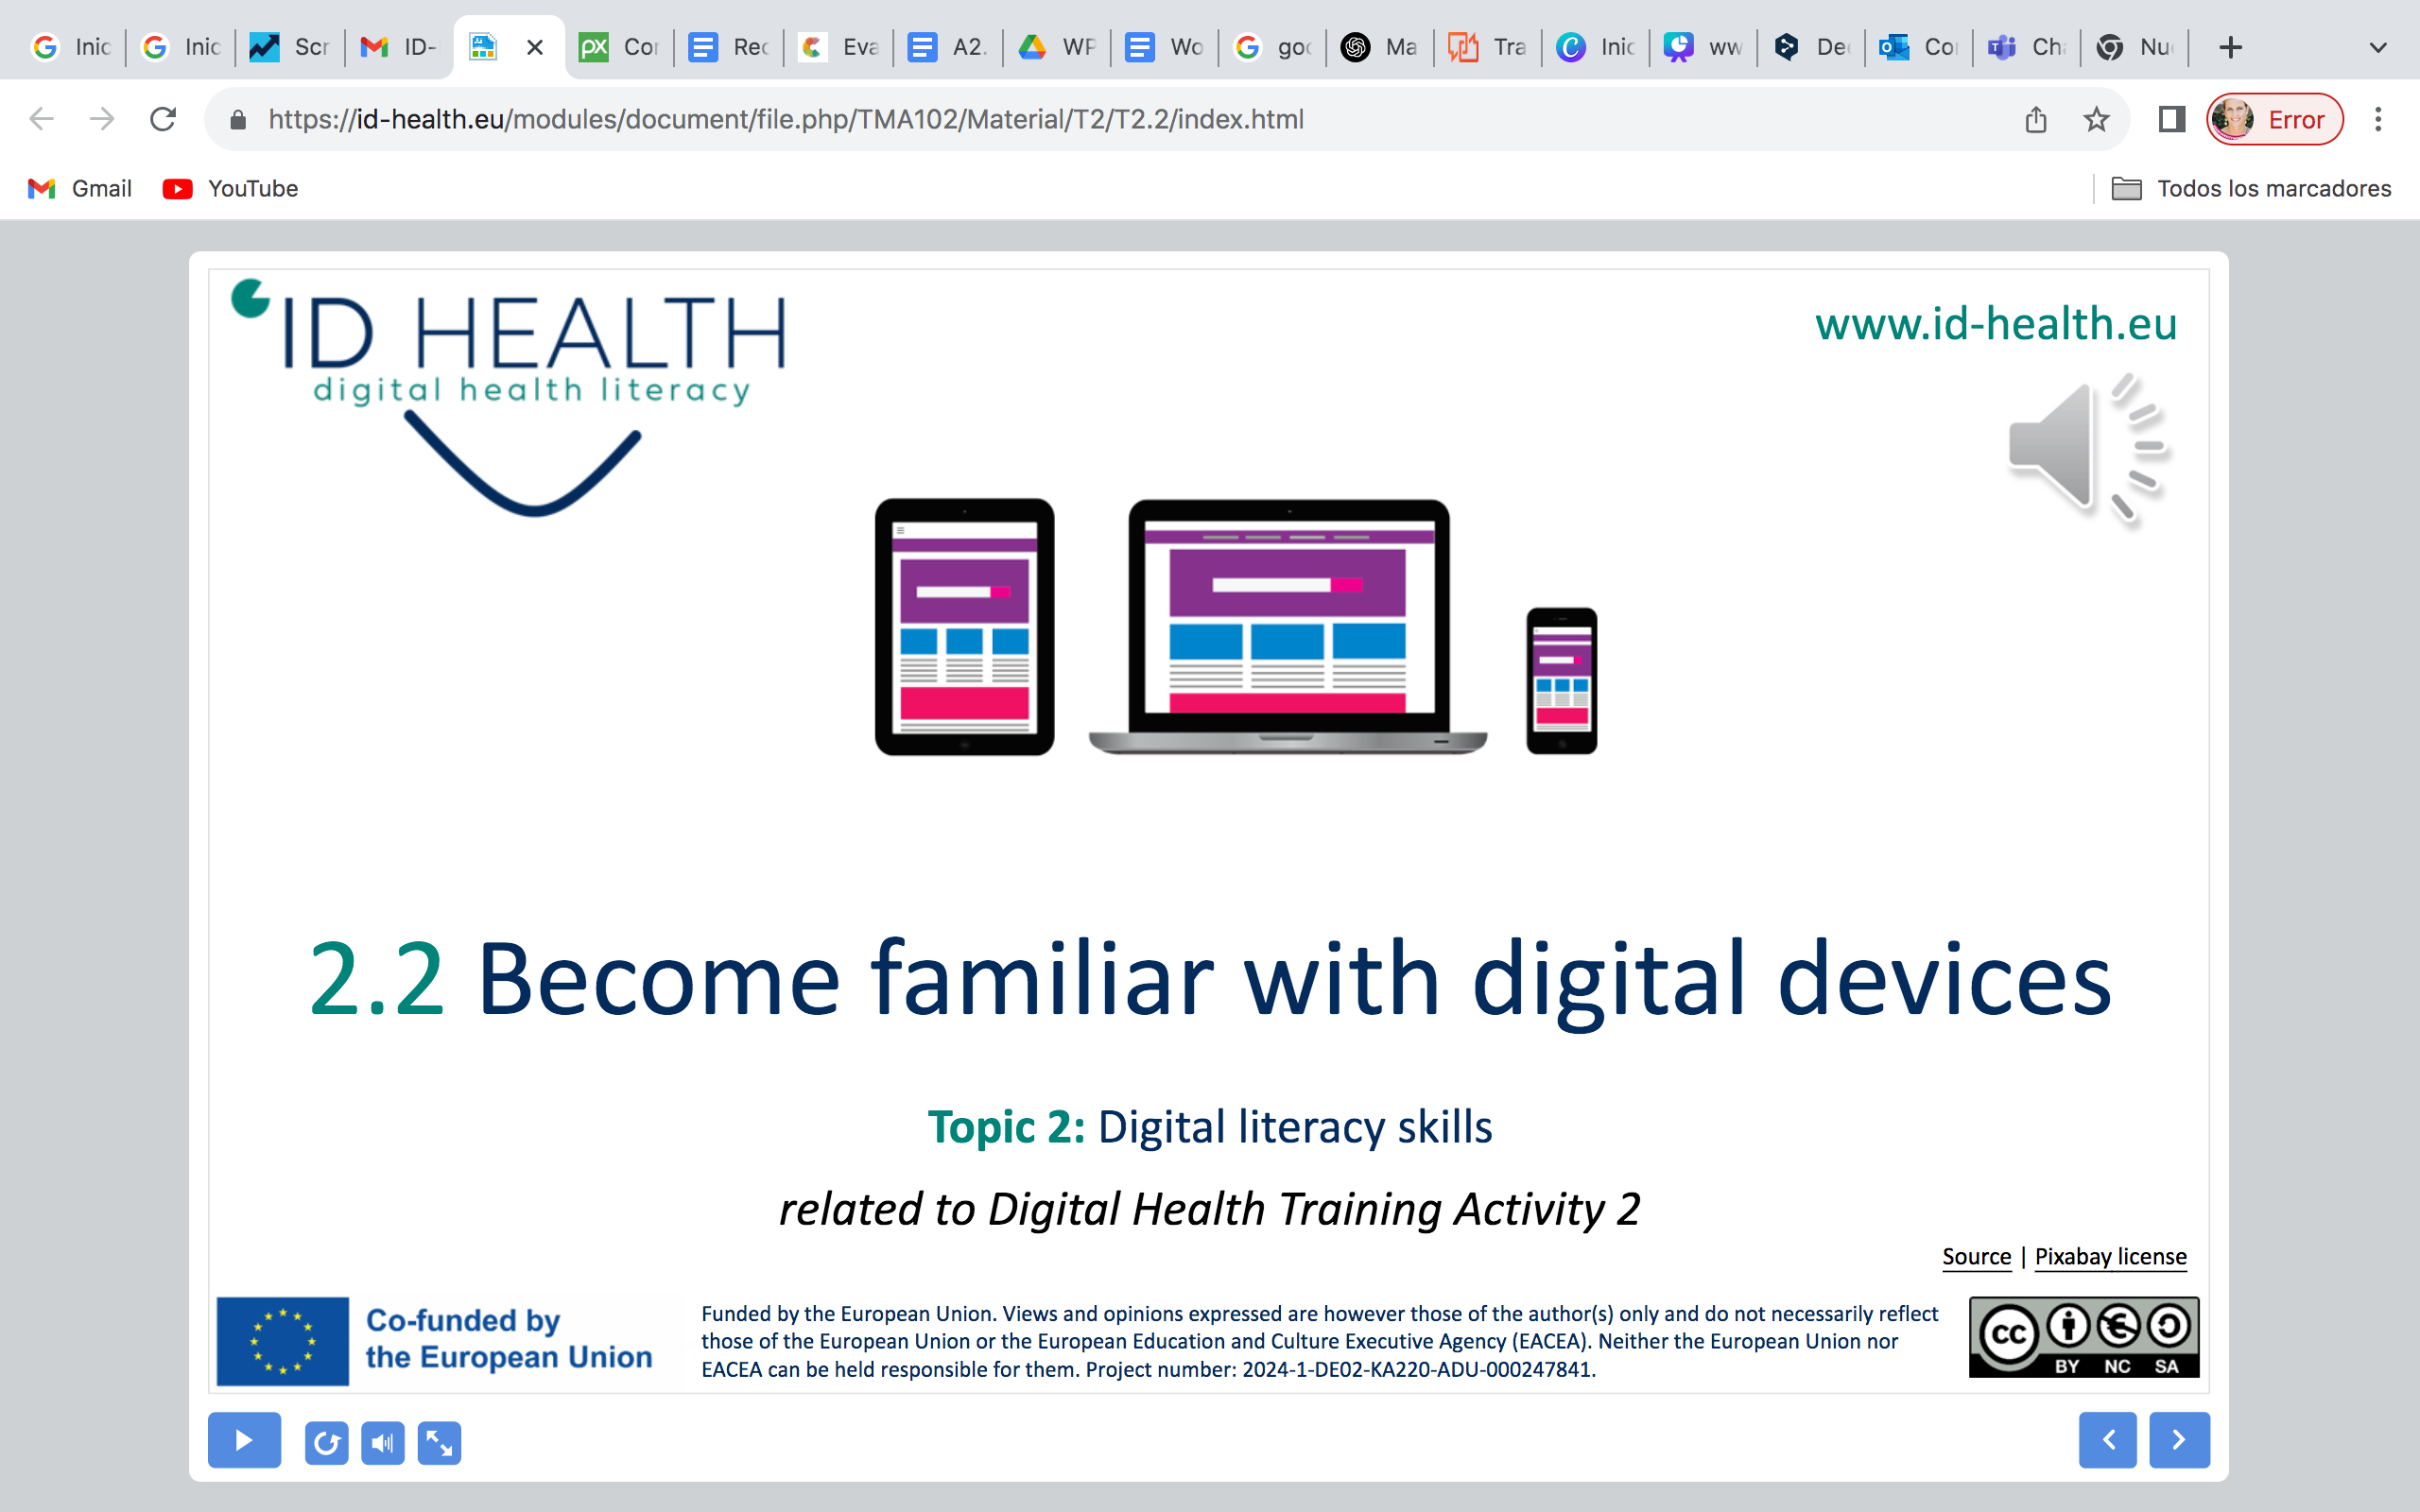
www.id-health.eu
Topic 1: Health management
TRAINING ACTIVITY 2 – SESSION 2
2.2 Digital Health Literacy
Icon created by Freepik - Flaticon

Slide 2








www.id-health.eu
Partners

Slide 3
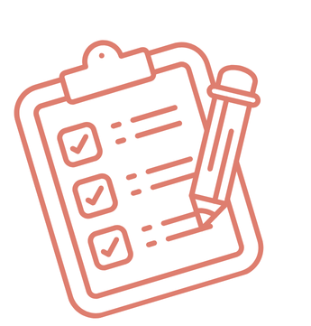
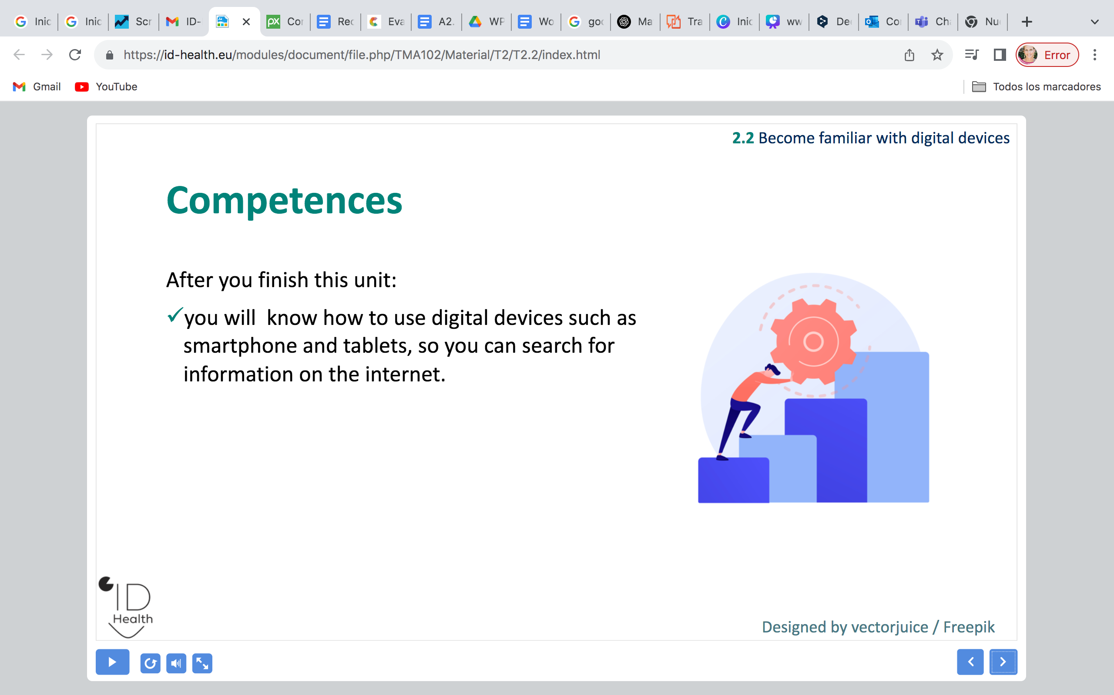
SESSION 2 SCHEME
2.2 Digital Health Literacy
Initial activity | Mindfulness Sitting in a chair (or standing in a circle), back straight and our arms, neck, and shoulders relaxed. Let's relax by listening to the teacher's voice.
Presentation | Let's see what this session is about
Video tutorial | How to use the internet to manage my health
Group discussion | Share your personal experience
Practical activity | Facts or fake news? Print the news stories and the checklist
Practical activity | Health Millionarie Let's play the TV game show
Conclusions | Group reflection
Evaluation | Let's check if we have understood the main concepts
Closure | See you soon!

Slide 4
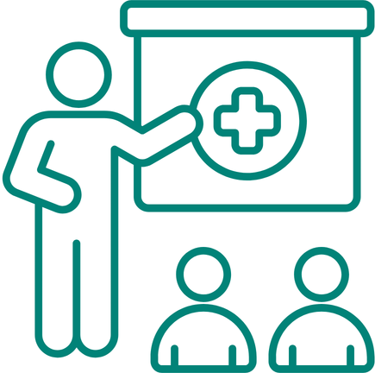
2.2 Digital Health Literacy
Skills
After you finish this unit:
  You know what digital health literacy is.
  You know why digital health literacy is important. .
  You know some first good digital sources of information on health.

Slide 5
2.2 Digital Health Literacy
TOPIC 1 : Health Management
2.2 Digital Health Literacy
b. How can technologies help me manage my health?
c. Examples of applications or websites for health management
Analyzing
my digital health literacy level

Slide 6
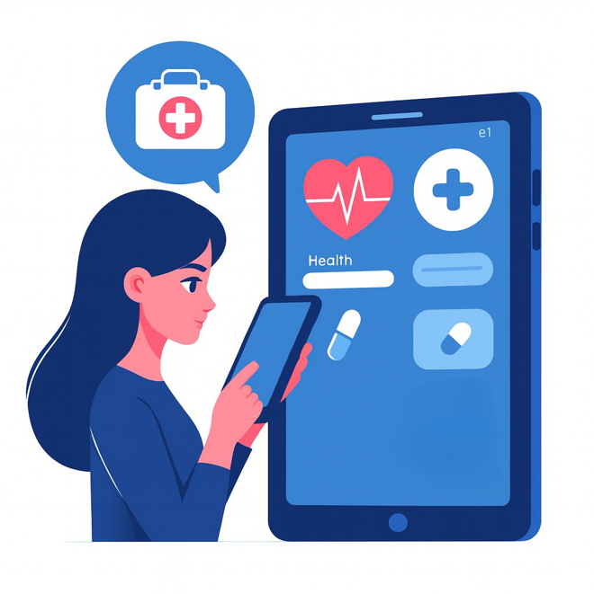
2.2 Digital Health Literacy
What is Digital Health Literacy?
  Digital health literacy means:
  You know how to find, understand,
  and use digital health information.
Image from Microsoft Designer

Slide 7
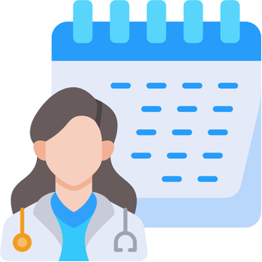
2.2 Digital Health Literacy
Why is digital health literacy important?
  More and more health information is online.
  For example, in apps or on websites.
  It makes everyday life easier.
  For example, to make doctor's appointments or search for information on specific health topics.
Image from Canva

Slide 8
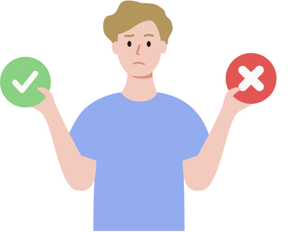
2.2 Digital Health Literacy
What can you use digital health information for
in everyday life?
1
  Finding good information
      There is a lot of information about health on the internet.
      Not all of it is accurate.
      With digital health literacy, you will know
      which information is correct and which is incorrect.
Image from Canva

Slide 9
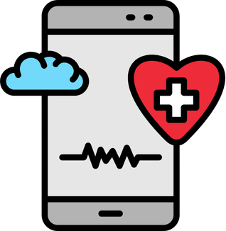
2.2 Digital Health Literacy
What can you use digital health information for in everyday life?
  Using digital services you can:
      Find reliable online information on health
      Find online information on health services
      Use health apps
2
Image from Canva

Slide 10



2.2 Digital Health Literacy
Where can I find health information?
Websites
Health apps on phones or tablets
Videos
about health
Icon made by prettycons from Flaticon
Icon made by Freepik from Flaticon
Icon made by Freepik from Flaticon

Slide 11
2.2 Digital Health Literacy
Example Health Apps:
How health apps can help you
  You can use health apps in everyday life:
  To track your activity.
  For example, counting steps.
  They can remind you to take medicine.
  You can learn more about healthy habits.
  For example, to drink enough water.
Icon made by Freepik from Flaticon

Slide 12


2.2 Digital Health Literacy
Examples of good and bad sources
Good sources are:
Websites of official organisations, for example government organisations.
Websites of hospitals
Bad sources are:
Social media posts without information about where they come from
Advertisements that promise quick cures for illnesses
Image made by Roundicons from Flaticon
Image made by Roundicons from Flaticon

Slide 13


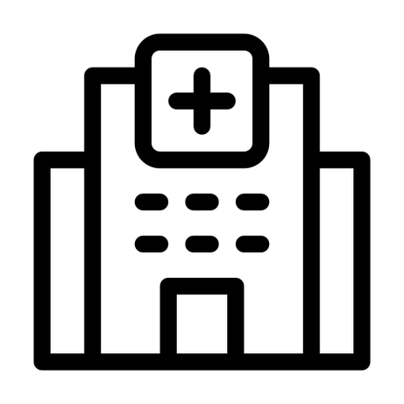
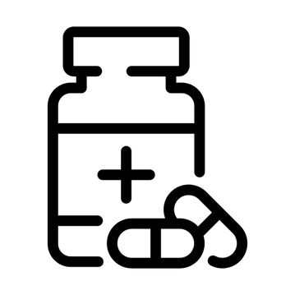
2.2 Digital Health Literacy
Health topics you can learn about online
  For example:
  Nutrition and healthy foods
  Exercise and daily activity
  Finding a doctor or clinic
  Medicine and treatments
Icon made by Smashicons from Flaticon
Icon made by Smashicons from Flaticon
Icon made by ghost_icon from Flaticon
Icon made by joalfa from Flaticon

Slide 14
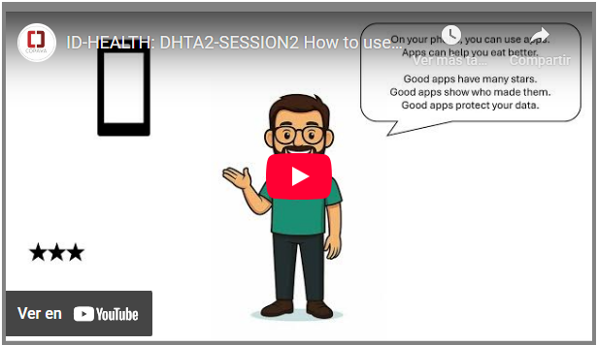

2.2 Digital Health Literacy
Video tutorial
We're going to see some examples of how to use the internet and apps for digital health.

Slide 15
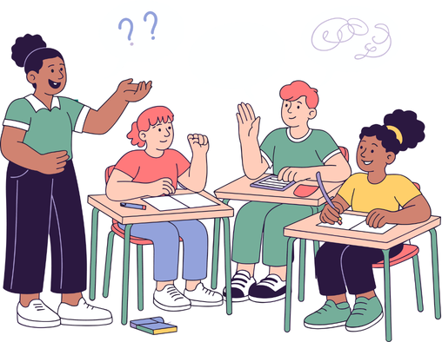
2.2 Digital Health Literacy
Group discussion
The trainees talk about digital health literacy
according to the previous presentation
and the video tutorial.
You can share your personal experience
by raising your hand to participate.
Icon: Canva

Slide 16
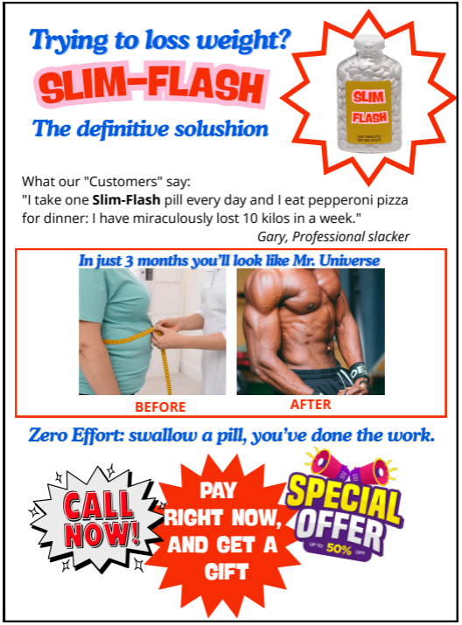
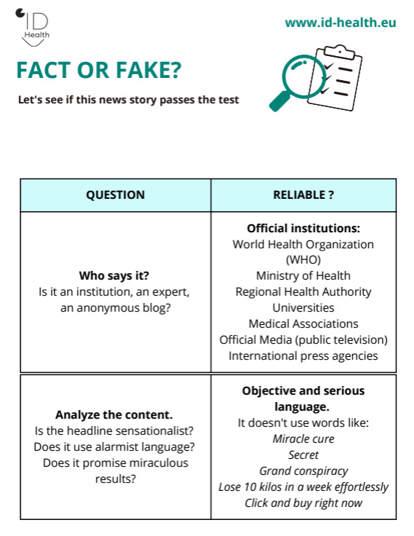
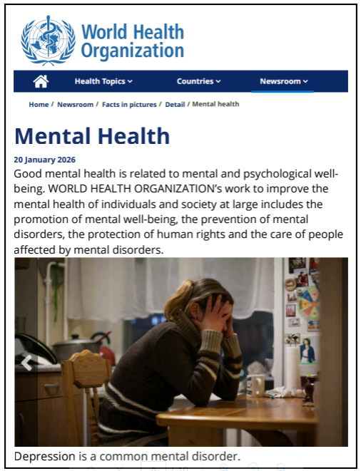

2.2 Digital Health Literacy
Practical activity 1
Health is at stake:
Misinformation about health can be dangerous!
Print the news stories and the checklist.
Let’s see if they pass the test.

Slide 17
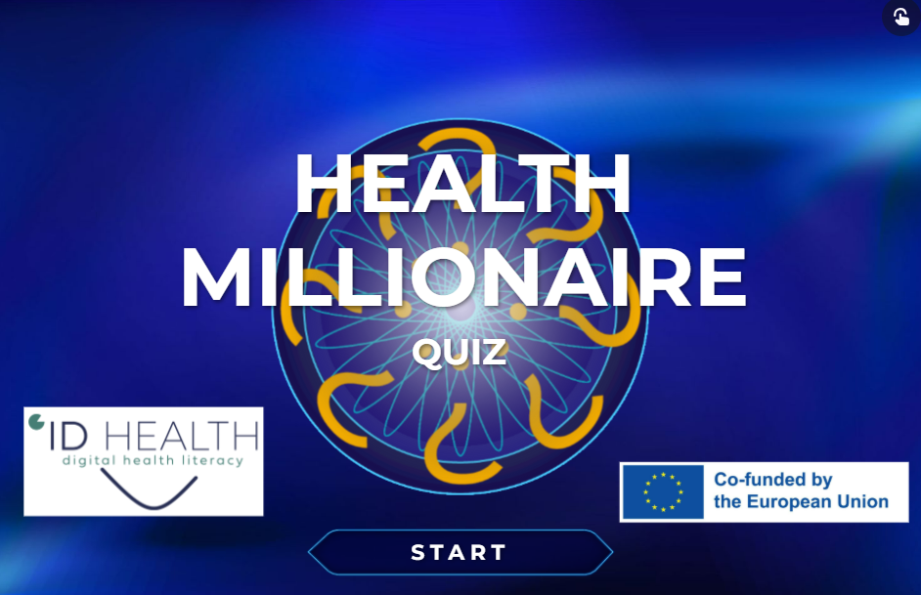
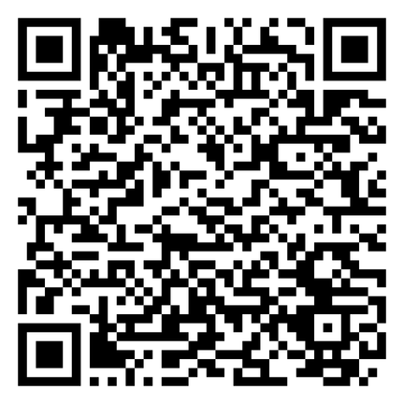
2.2 Digital Health Literacy
Practical activity 2
Let's play the TV game show
Take your tablet or PC,
answer all 10 questions correctly to rise to the top
and become a health millionaire.

Slide 18
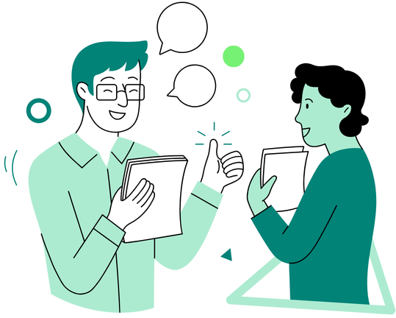
2.2 Digital Health Literacy
Conclusions
  Do you think you have a good level of digital literacy?
  Do you apply these digital skills for your health?
  Do you believe that it can improve your autonomy and quality of life?
Icon: Canva

Slide 19
2.2 Digital Health Literacy
Self-Evaluation Quiz 1/2
1. What is digital health literacy?
a) Knowing how to find, understand, and use digital health information | b) Watching videos about sports
2. Why is digital health literacy important?
a) Because more and more health information is online | b) Because doctors do not work anymore
3. Where can you find good health information?
a) On social media posts without sources | b) On websites of official organisations or hospitals
Notes:
1) A correct; 2) A correct; 3) B correct

Slide 20
2.2 Digital Health Literacy
Self-Evaluation Quiz 2/2
4. What can health apps help you do?
a) Make phone calls for you | b) Track your activity like counting steps and remind you to take medicine
5. What can you learn about online with digital health literacy?
a) Nutrition, exercise, finding a doctor, medicine and treatments | b) How to play video games better
Notes:
4) B correct; 5) A correct

Slide 21
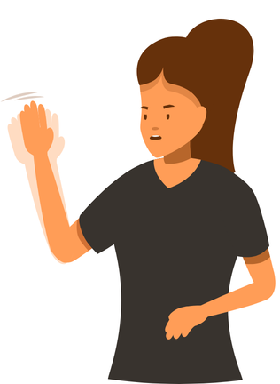
2.2 Digital Health Literacy
And that’s all for today !!!
  Thanks for the great energy
  and for sharing your ideas.
  See you in the next one.
Icon: Canva

