Slide 1



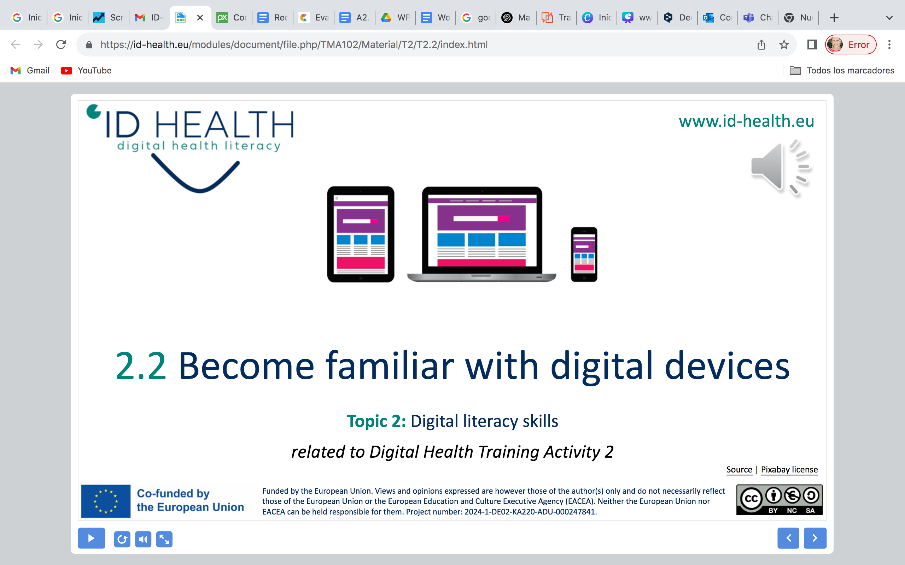
www.id-health.eu
3. Health Literacy

Slide 2








www.id-health.eu
Partners

Slide 3
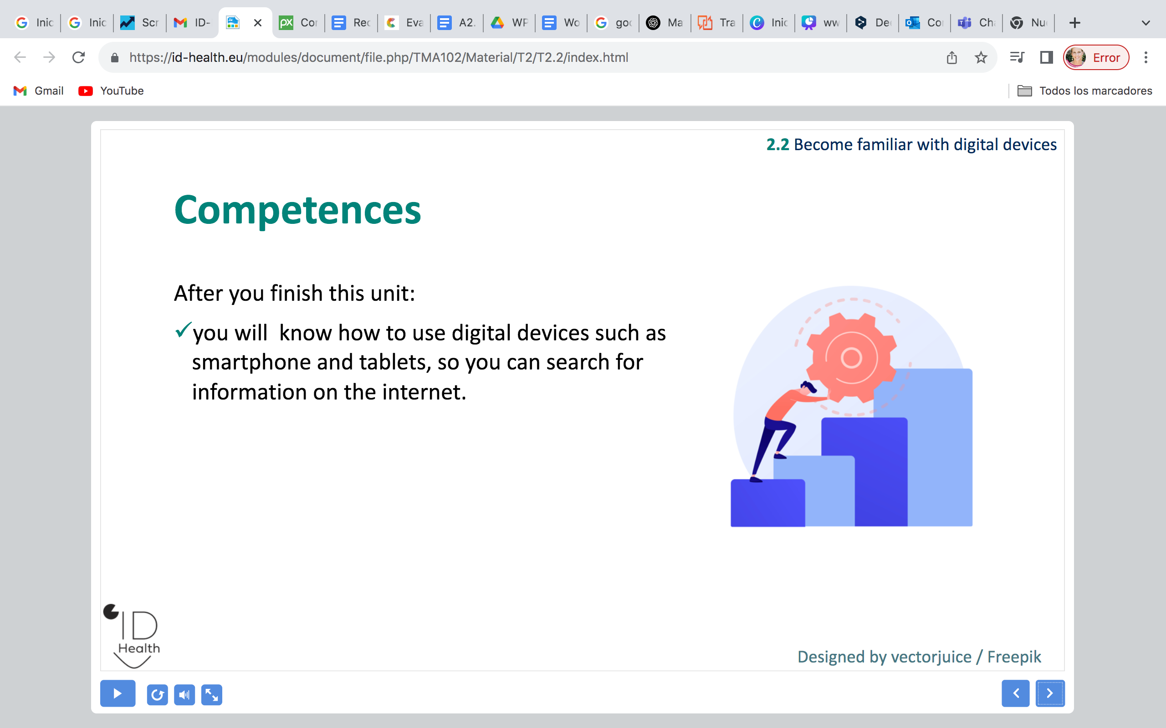
3.1 Health Literacy
TOPIC Nº3 : List of units
3.1 Health Literacy
3.2 Digital Health Literacy

Slide 4
3 Health Literacy
Competences
After you finish this unit:
  You can read and understand health information
  You can see if health information is good or not
  You can ask when something is not clear
  You can use health information in your life
  You can share easy health information with others

Slide 5
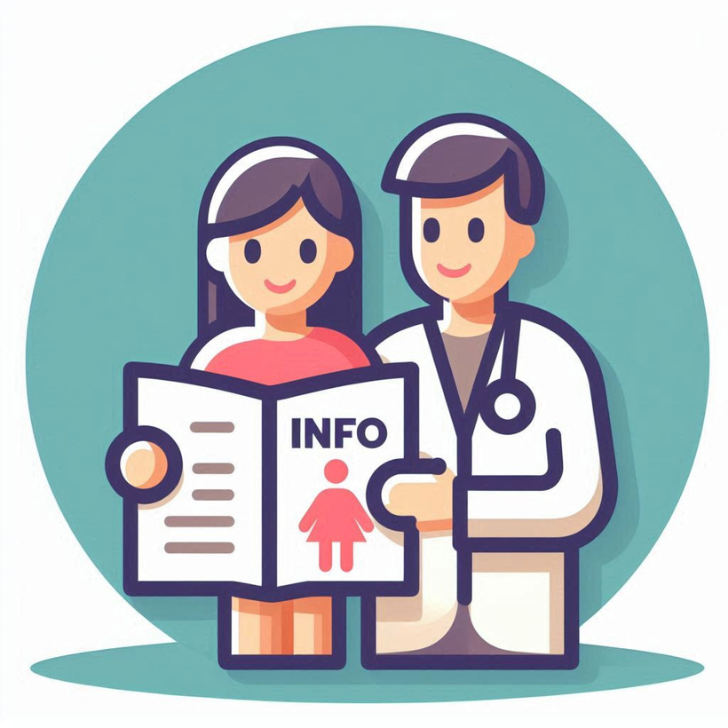
1.1 Health Literacy
What is Health Literacy?
  Health Literacy = understanding health information
  Knowing how to use health information for everyday choices
Image made by AI from Microsoft Designer

Slide 6


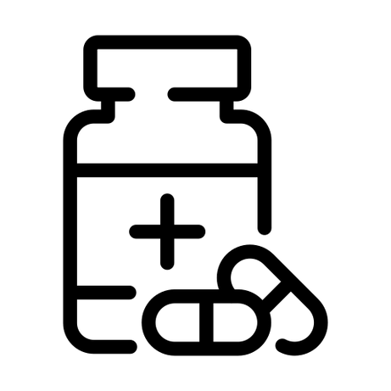
1.1 Health Literacy
Why does this matter to me?
Lets you understand medicines and how to use them
Helps you make choices about your body and health
Makes visits to the doctor easier
Icon made by juicy_fish from Flaticon
Icon made by andinur from Flaticon
Icon made by ghost_icon from Flaticon

Slide 7
1.1 Health Literacy
Why is Health Literacy important?
  Not only when we are sick, but also to stay healthy
  Helps us prevent illness (healthy food, exercise, vaccinations)
  Supports good choices in daily life

Slide 8
1.1 Health Literacy
What skills do we need?
  Find information (leaflets, doctors, internet)
  Check information (is it reliable?)
  Use information (follow advice in daily life)

Slide 9
1.1 Health Literacy
Questions to ask myself
  Do I understand the information I got?
  Can I explain it to another person?
  Do I know what my next step is?

Slide 10

1.1 Health Literacy
How can we improve health literacy to gain more autonomy?
  Ask simple questions:
    “What is this for?”
    “How do I use it?”
  Ask for plain language or pictures
  Practice reading short health messages with a friend
Icon made by Good Ware from Flaticon

Slide 11
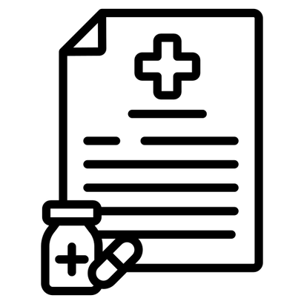

1.1 Health Literacy
Everyday examples
Understanding simple health advice (drink water when hot)
Reading a medicine label correctly
Knowing when to see a doctor or use home remedies
Icon made by andinur from Flaticon
Icon made by Iconjam from Flaticon
Icon made by Graphix’s Art from Flaticon

Slide 12
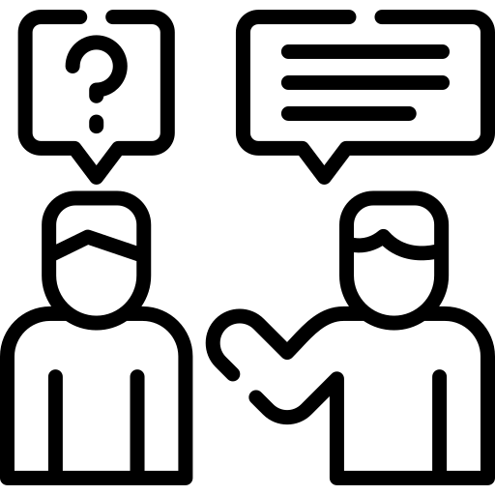
1.1 Health Literacy
Helping myself and others with health literacy
  Share easy words and pictures with family or friends
  Support each other: practice asking questions
  Use trusted sources (doctor, nurse, official leaflets)
Icon made by Freepik from Flaticon

