Slide 1







Let's see how much you have learned!
Image by zinkevych on Freepik
Funded by the European Union. Views and opinions expressed are however those of the author(s) only and do not necessarily reflect those of the European Union or the ANPCDEFP. Neither the European Union nor ANPCDEFP can be held responsible for them.
Notes:
[Narration block 1 (Statement)]
Please do the quizzes.
!! Each quiz has one sentence.
!! If you agree, click the green circle.
!! If you disagree, click the red circle. Let’s start!
[Narration block (correct)]
[Narration block (wrong)]
[Narration block 4 (future)]

Slide 2


1. I know why it is important to learn how to use technology.
Correct
Wrong
I agree
I don’t agree
That is great!
Notes:
[Q=1][A=agree]
[Narration block 1 (Statement)]
1. Learning technology is important. I understand why.
!! Do you agree with what you heard?
!! Or do you disagree?
[Narration block 2 (correct)]
You agree! Great!
[Narration block 3 (wrong)]
Do you disagree?
! Discuss it again with your trainer.
[Narration block 4 (future)]

Slide 3
2. I understand what a digital device is, an apparatus like a phone or computer
Correct
Wrong
I agree
I don’t agree
That is great!
Notes:
[Q=2][A=agree]
[Narration block 1 (Statement)]
2. I understand what a digital device is. It is something like a phone or a computer.
!! Do you agree with what you heard?
!! Or do you disagree?
[Narration block 2 (correct)]
You agree! Great!
[Narration block 3 (wrong)]
Do you disagree?
! Discuss it again with your trainer.
[Narration block 4 (future)]

Slide 4
3. I can tell the difference between a phone, a tablet, and a computer.
Correct
Wrong
I agree
I don’t agree
That is great!
Notes:
[Q=3][A=agree]
[Narration block 1 (Statement)]
3. I know the difference between a phone, a tablet, and a computer.
!! Do you agree with what you heard?
!! Or do you disagree?
[Narration block 2 (correct)]
You agree! Great!
[Narration block 3 (wrong)]
Do you disagree?
! Discuss it again with your trainer.
[Narration block 4 (future)]

Slide 5
4. I know my Smartphone helps me make video calls and send quick messages.
Correct
Wrong
I agree
I don’t agree
That is great!
Notes:
[Q=4][A=agree]
[Narration block 1 (Statement)]
4. My smartphone helps me! I can make video calls! I can send messages!
!! Do you agree with what you heard?
!! Or do you disagree?
[Narration block 2 (correct)]
You agree! Great!
[Narration block 3 (wrong)]
Do you disagree?
! Discuss it again with your trainer.
[Narration block 4 (future)]

Slide 6
5. I know a Computer is better for writing long texts and doing big assignments.
I agree
Wrong
Correct
I don’t agree
That is great!
Notes:
[Q=5][A=agree]
[Narration block 1 (Statement)]
5. A computer is good for long texts. It is good for big assignments.
!! Do you agree with what you heard?
!! Or do you disagree?
[Narration block 2 (correct)]
You agree! Great!
[Narration block 3 (wrong)]
Do you disagree?
! Discuss it again with your trainer.
[Narration block 4 (future)]

Slide 7
6. I understand how I can use my Smartwatch or Smart TV to take care of my health (e.g., exercise or sleep).
Correct
Wrong
I agree
I don’t agree
That is great!
Notes:
[Q=6][A=agree]
[Narration block 1 (Statement)]
6. My smartwatch or smart TV can help my health. They can help with exercise or sleep.
!! Do you agree with what you heard?
!! Or do you disagree?
[Narration block 2 (correct)]
You agree! Great!
[Narration block 3 (wrong)]
Do you disagree?
! Discuss it again with your trainer.
[Narration block 4 (future)]

Slide 8
7. I know that Virtual Reality Glasses can be used to relax me or help with my fears.
Correct
Wrong
I agree
I don’t agree
That is great!
Notes:
[Q=7][A=agree]
[Narration block 1 (Statement)]
7. Virtual reality glasses can help me relax. They can also help with fears.
!! Do you agree with what you heard?
!! Or do you disagree?
[Narration block 2 (correct)]
You agree! Great!
[Narration block 3 (wrong)]
Do you disagree?
! Discuss it again with your trainer.
[Narration block 4 (future)]

Slide 9
8. I know that a smart speaker is used to answer questions: Ask about the weather, the result of a sports match, or interesting facts.
Correct
Wrong
I agree
I don’t agree
That is great!
Notes:
[Q=8][A=agree]
[Narration block 1 (Statement)]
8. A smart speaker answers questions.
You can ask about the weather.
You can ask about sports.
You can ask for facts.
!! Do you agree with what you heard? !! Or do you disagree?
[Narration block 2 (correct)]
You agree! Great!
[Narration block 3 (wrong)]
Do you disagree?
! Discuss it again with your trainer.
[Narration block 4 (future)]

Slide 10
9. I feel more confident in learning about technology.
Correct
Wrong
I agree
I don’t agree
That is great!
Notes:
[Q=9][A=agree]
[Narration block 1 (Statement)]
9. I feel good.
I will keep learning about technology.
!! Do you agree with what you heard?
!! Or do you disagree?
[Narration block 2 (correct)]
You agree! Great!
[Narration block 3 (wrong)]
Do you disagree?
! Discuss it again with your trainer.
[Narration block 4 (future)]

Slide 11
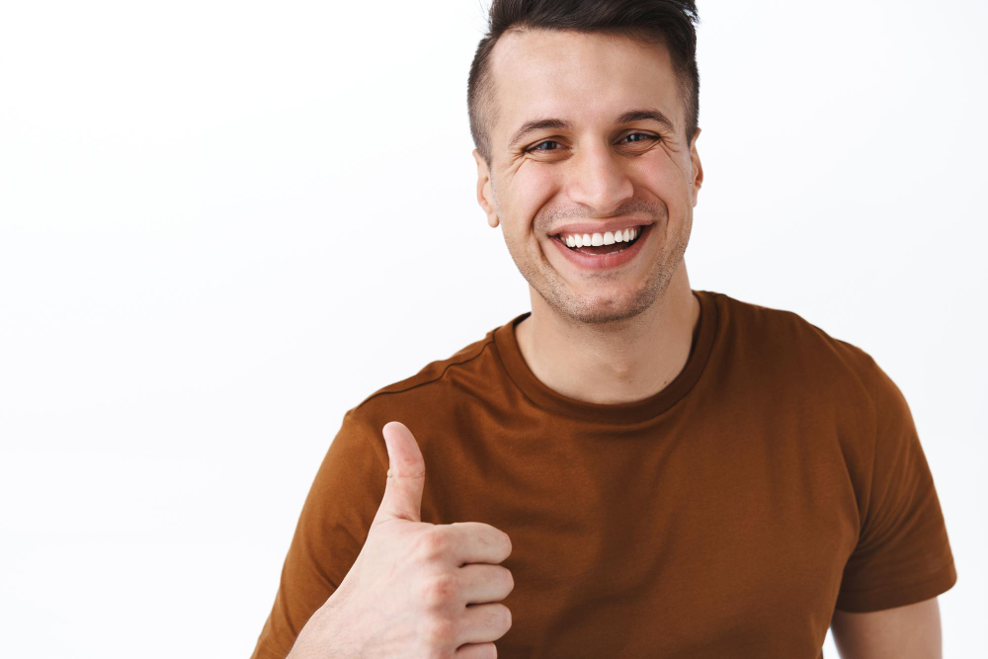

Source | Freepik
You have finished the quizzes!
Funded by the European Union. Views and opinions expressed are however those of the author(s) only and do not necessarily reflect those of the European Union or the ANPCDEFP. Neither the European Union nor ANPCDEFP can be held responsible for them.
Notes:
[Narration block 1 (Statement)]
You have finished the quizzes.
! Did you like them?
[Narration block 2 (start)]
Want to start again?
! Click the green button on the left.
[Narration block 3 (exit)]
To leave, click the grey exit button on the right.
[Narration block 4]

