Slide 1




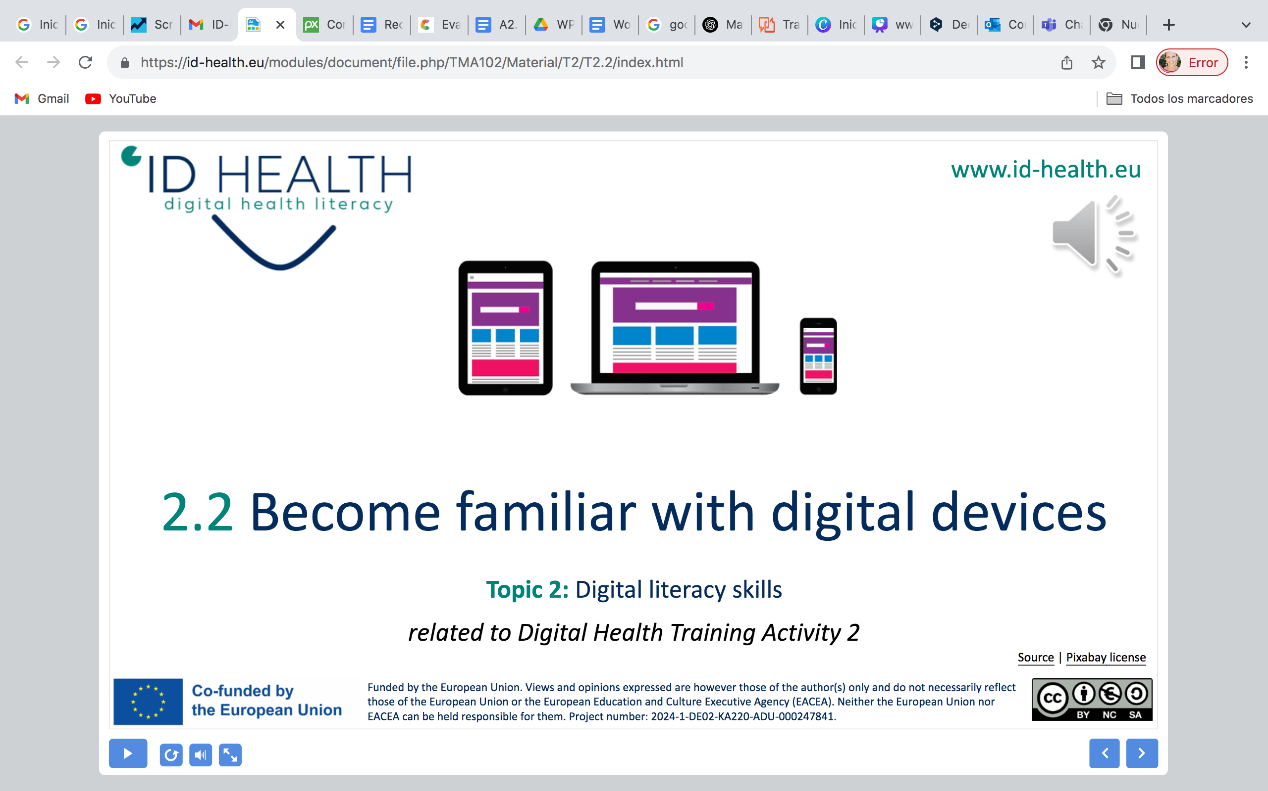
www.id-health.eu
Topic 1: Health management
TRAINING ACTIVITY 2 – SESSION 2
2.2 Digital Health Literacy
Icon created by Freepik - Flaticon

Slide 2


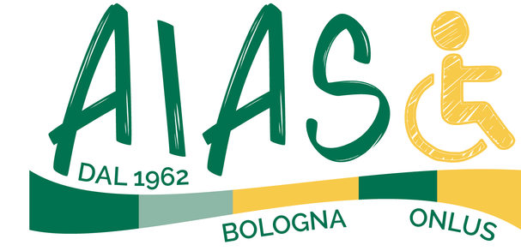

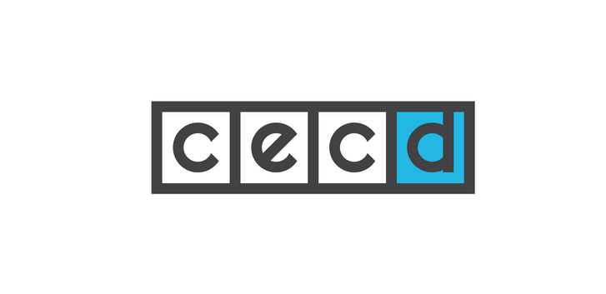



www.id-health.eu
Partners

Slide 3
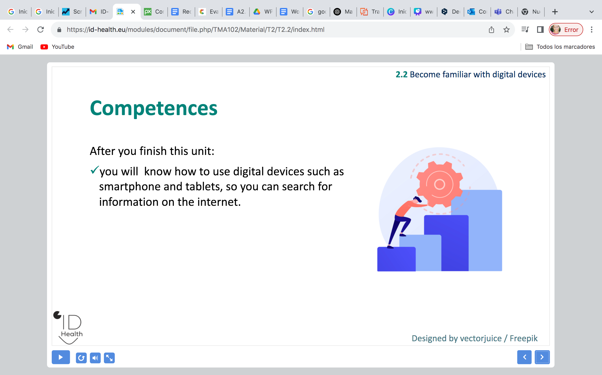
2.2 Digital Health Literacy
TOPIC 1 : Health Management
2.2 Digital Health Literacy
b. How can technologies help me manage my health?
c. Examples of applications or websites for health management
Analyzing
my digital health literacy level

Slide 4
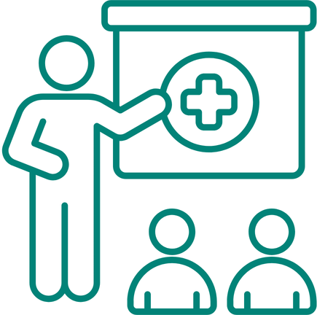
2.2 Digital Health Literacy
Skills
After you finish this unit:
  You know what digital health literacy is.
  You know why digital health literacy is important. .
  You know some first good digital sources of information on health.

Slide 5
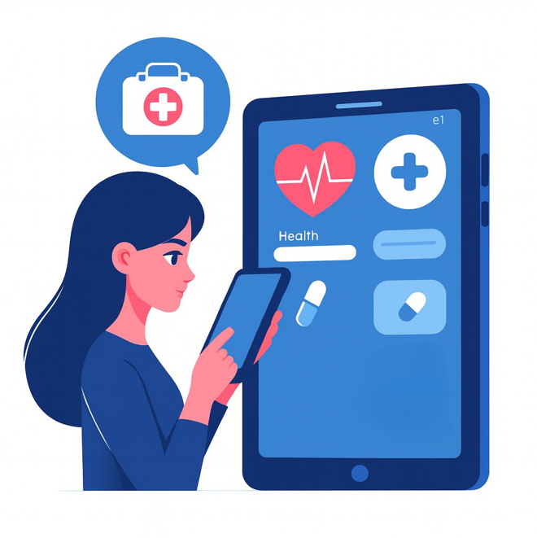
2.2 Digital Health Literacy
What is Digital Health Literacy?
  Digital health literacy means:
  You know how to find, understand,
  and use digital health information.
Image from Microsoft Designer

Slide 6
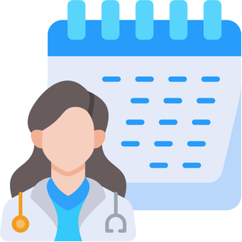
2.2 Digital Health Literacy
Why is digital health literacy important?
  More and more health information is online.
  For example, in apps or on websites.
  It makes everyday life easier.
  For example, to make doctor's appointments or search for information on specific health topics.
Image from Canva

Slide 7
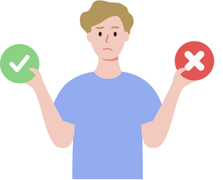
2.2 Digital Health Literacy
What can you use digital health information for in everyday life?
1
  Finding good information
      There is a lot of information about health on the internet.
      Not all of it is accurate.
      With digital health literacy, you will know
      which information is correct and which is incorrect.
Image from Canva

Slide 8
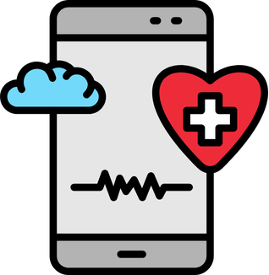
2.2 Digital Health Literacy
What can you use digital health information for in everyday life?
  Using digital services you can:
      Find reliable online information on health
      Find online information on health services
      Use health apps
2
Image from Canva

Slide 9



2.2 Digital Health Literacy
Where can I find health information?
Websites
Health apps on phones or tablets
Videos
about health
Icon made by prettycons from Flaticon
Icon made by Freepik from Flaticon
Icon made by Freepik from Flaticon

Slide 10
Example Health Apps:
How health apps can help you
2.2 Digital Health Literacy
  You can use health apps in everyday life:
  To track your activity.
  For example, counting steps.
  They can remind you to take medicine.
  You can learn more about healthy habits.
  For example, to drink enough water.
Icon made by Freepik from Flaticon

Slide 11


2.2 Digital Health Literacy
Examples of good and bad sources
Good sources are:
Websites of official organisations, for example government organisations.
Websites of hospitals
Bad sources are:
Social media posts without information about where they come from
Advertisements that promise quick cures for illnesses
Image made by Roundicons from Flaticon
Image made by Roundicons from Flaticon

Slide 12



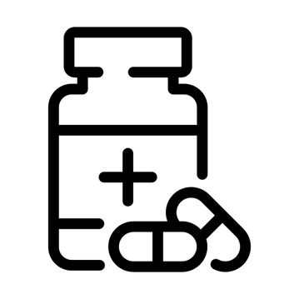
2.2 Digital Health Literacy
Health topics you can learn about online
  For example:
  Nutrition and healthy foods
  Exercise and daily activity
  Finding a doctor or clinic
  Medicine and treatments
Icon made by Smashicons from Flaticon
Icon made by Smashicons from Flaticon
Icon made by ghost_icon from Flaticon
Icon made by joalfa from Flaticon

Slide 13
2.2 Digital Health Literacy
Self-Evaluation Quiz 1/2
1. What is digital health literacy?
a) Knowing how to find, understand, and use digital health information | b) Watching videos about sports
2. Why is digital health literacy important?
a) Because more and more health information is online | b) Because doctors do not work anymore
3. Where can you find good health information?
a) On social media posts without sources | b) On websites of official organisations or hospitals
Notes:
1) A correct; 2) A correct; 3) B correct

Slide 14
2.2 Digital Health Literacy
Self-Evaluation Quiz 2/2
4. What can health apps help you do?
a) Make phone calls for you | b) Track your activity like counting steps and remind you to take medicine
5. What can you learn about online with digital health literacy?
a) Nutrition, exercise, finding a doctor, medicine and treatments | b) How to play video games better
Notes:
4) B correct; 5) A correct

