Slide 1



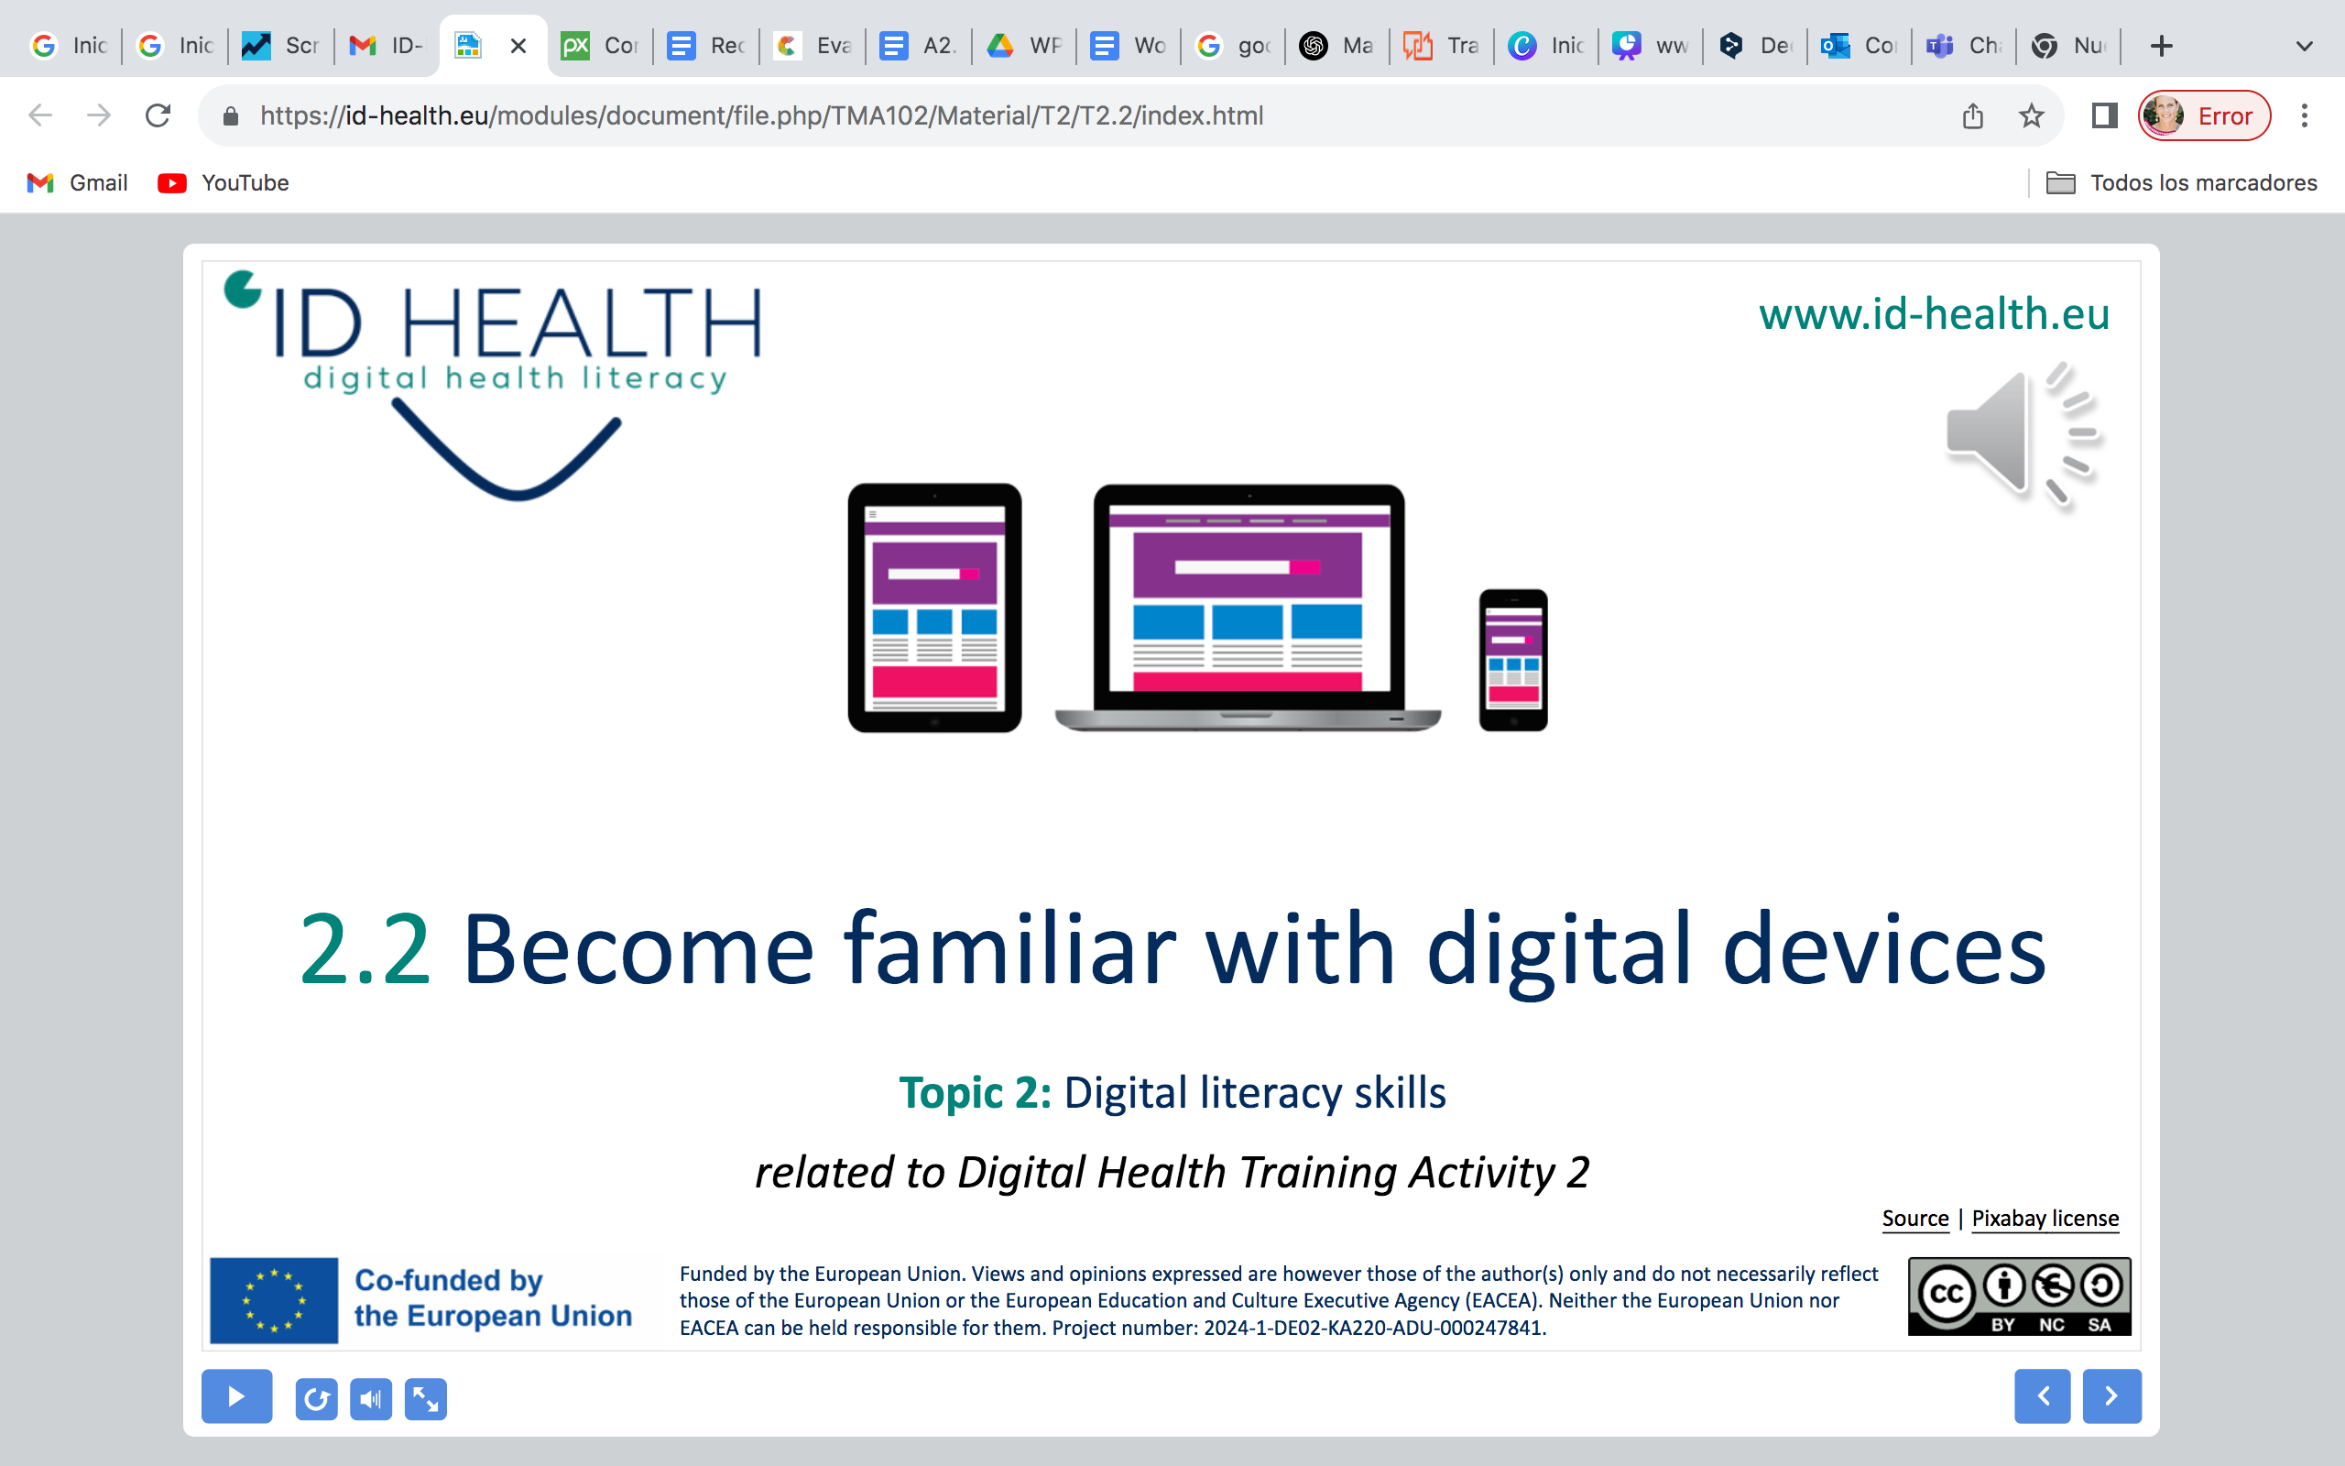
www.id-health.eu
Training on the use of Digital Health Tools for healthier lifestyles
Training Activity 9: Digital Health Media for PID (Session 1)

Slide 2








www.id-health.eu
Partners

Slide 3










www.id-health.eu
TOPIC Nº9: List of units
1.1 Introduction
1.2 What is lifestyle
1.3 Healthy Lifestyle
1.4 What is not a Healthy Lifestyle
1.6 Benefits of
Digital Health Tools
1.5
Digital Health Tools
1.7 Tools
Activities
(Examples)
1.8 Quiz & Feedback
1.5 Digital Health Tools

Slide 4
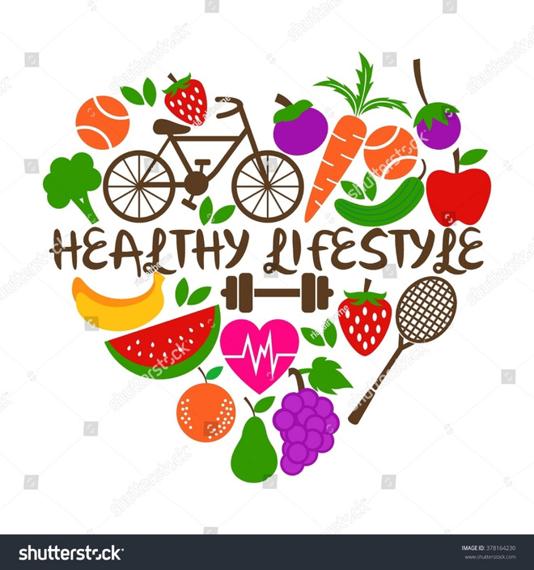
Competences
After you finish this unit: Goals for the Day
You will know how to:
Use your phone for health.
Learn to relax with guided exercises.
Record how you feel.
Set small goals and achieve them.

Slide 5
1.1 Ιntroduction
Introduction
What digital tools do you use?
Digital tools = apps and devices that support health and well-being
They can be used easily on a smartphone, tablet, or smartwatch
Icebreaker
‘’Show one digital tool that helps you today’’

Slide 6
1.2 What is lifestyle?
What is lifestyle?
Lifestyle means the way we live every day.
It is made of our habits, choices, and activities.
Simple Explanation
Lifestyle is like a daily routine.
If you often choose water instead of soda, that is part of your lifestyle.
If you go walking three times a week, that is also your lifestyle.
If you like reading or playing games in the evening, that is lifestyle too.
Why It Matters
Our lifestyle can make us:
Healthy or unhealthy.
Happy or stressed.
Active or tired.

Slide 7
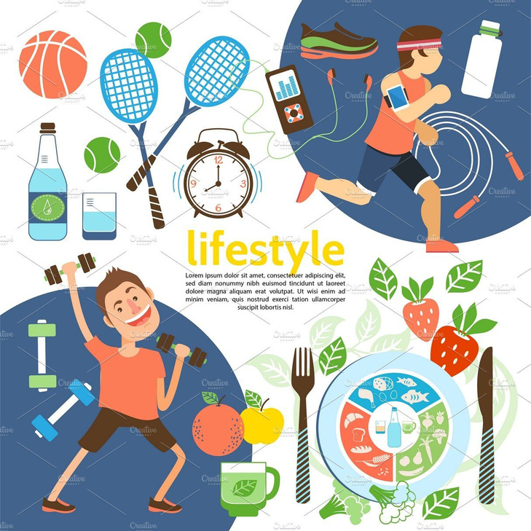
1.2 What is lifestyle? (Cont.)
What is lifestyle?
Examples:
  What we eat and drink.
  How much we move or exercise.
  How well we sleep and rest.
  How we spend time with friends, family, or alone.
  How we use technology (phone, games, internet).
  How we take care of our feelings and stress.
Walking 20 minutes every day = healthy habit.
Sleeping well = the body rests and we feel better.
Lifestyle is like a puzzle: small daily actions together form the picture of our life.

Slide 8
1.3 Healthy Lifestyle
Healthy Lifestyle
A healthy lifestyle does not mean a “perfect lifestyle.”
It means making small daily choices that help us feel better physically and emotionally.
Main Ideas
Nutrition
    Eat more fruits and vegetables.
    Drink enough water.
    Limit sodas and sweets.
    Example: An apple instead of chocolate in the afternoon.

Slide 9
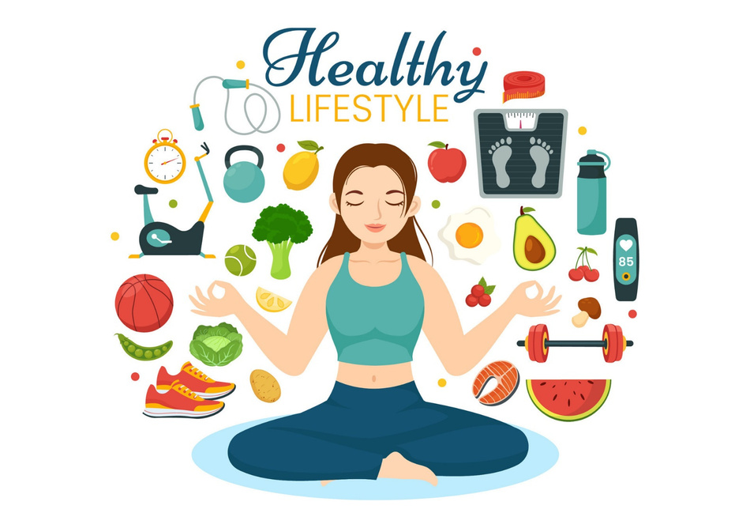
1.3 Healthy Lifestyle
Healthy Lifestyle
A healthy lifestyle does not mean a “perfect lifestyle.”
It means making small daily choices that help us feel better physically and emotionally.
Main Ideas
Physical Activity
    Move every day, according to your ability.
    No gym needed – walking, dancing, or playing is enough.
    Example: 15 minutes walking in the neighborhood or
    5 minutes of dancing at home.

Slide 10
1.3 Healthy Lifestyle (cont.)
Healthy Lifestyle
Sleep and Rest
    Go to bed at a regular time.
    Try to rest without phone or TV before sleep.
    Example: Set a phone reminder to get ready for bed at 10 p.m.
Relationships and Social Life
    Spend time talking or meeting friends/family.
    Social connections make us happier and reduce stress.
    Example: A short call to a friend on a day you feel lonely.

Slide 11
1.3 Healthy Lifestyle (cont.)
Healthy Lifestyle
Stress Management
  Learn ways to calm down (breathing, music, relaxation apps).
Example: When feeling angry, take 3 deep breaths instead of shouting.
Self-Care and Self-Compassion
    Take care of yourself without guilt.
    Speak kindly to yourself.
Example: If you don’t reach a goal, say “I will try again tomorrow” instead of “I never succeed.”

Slide 12
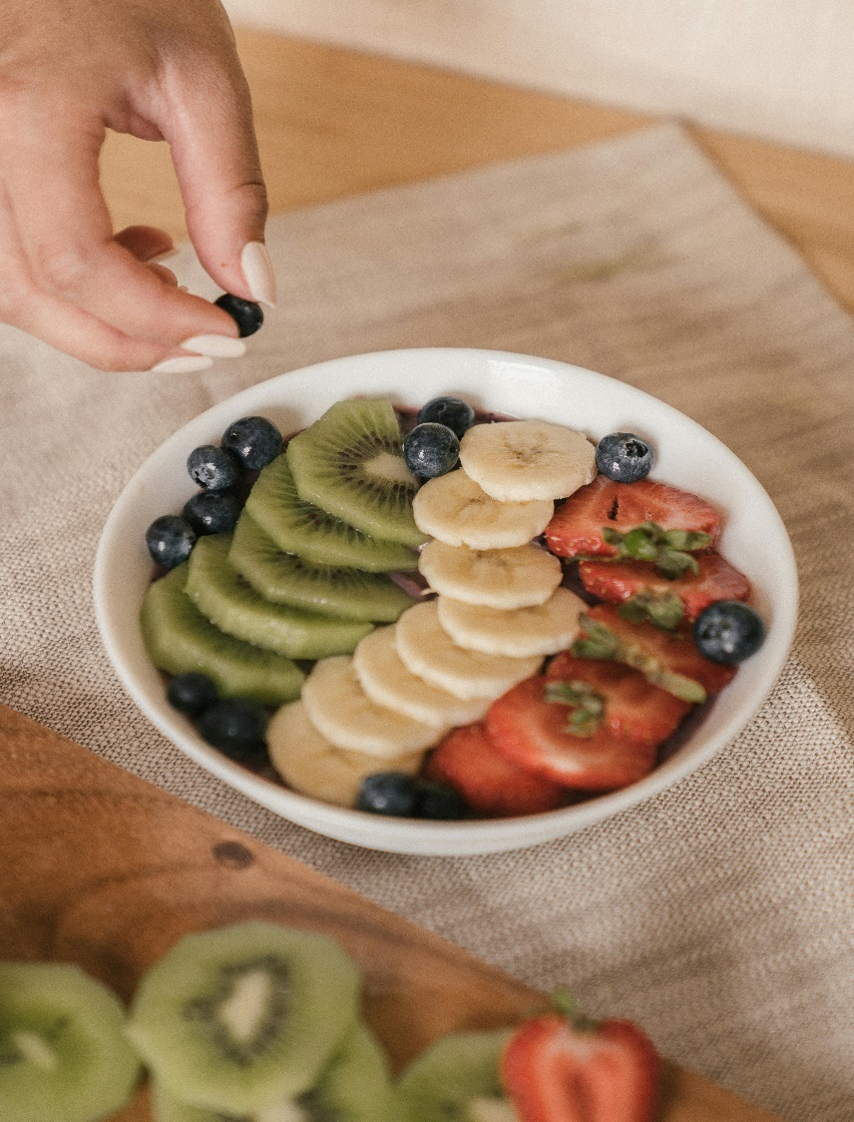
1.3 Healthy Lifestyle
Healthy Lifestyle
Our Body and Our Feelings
  Our body and our feelings work together.
  Good sleep helps us feel calm.
  Stress can make our heart beat fast.
  Small actions help our body feel safe again.
What Helps Us Stay Healthy?
✔️ Drink water
✔️ Eat fruit or simple meals
✔️ Walk or move your body
✔️ Take breaks when you feel tired
✔️ Talk to someone you trust

Slide 13
1.3 Healthy Lifestyle
Healthy Lifestyle
Self-Care
  Self-care helps the body and mind relax.
  Washing your face, brushing teeth, and wearing clean clothes feels good.
  A quiet moment helps your brain feel safe.
  Self-care tells your body: “It is time to rest.”

Slide 14
1.3 Healthy Lifestyle
Healthy Lifestyle
Activity Sheet: My Healthy Day
Morning: One healthy action I can try today.
Afternoon: Food or drink that helps my body.
Movement: How I can move today.
Feelings: Who I can talk to when stressed.
Night: What helps me relax before sleep.

Slide 15
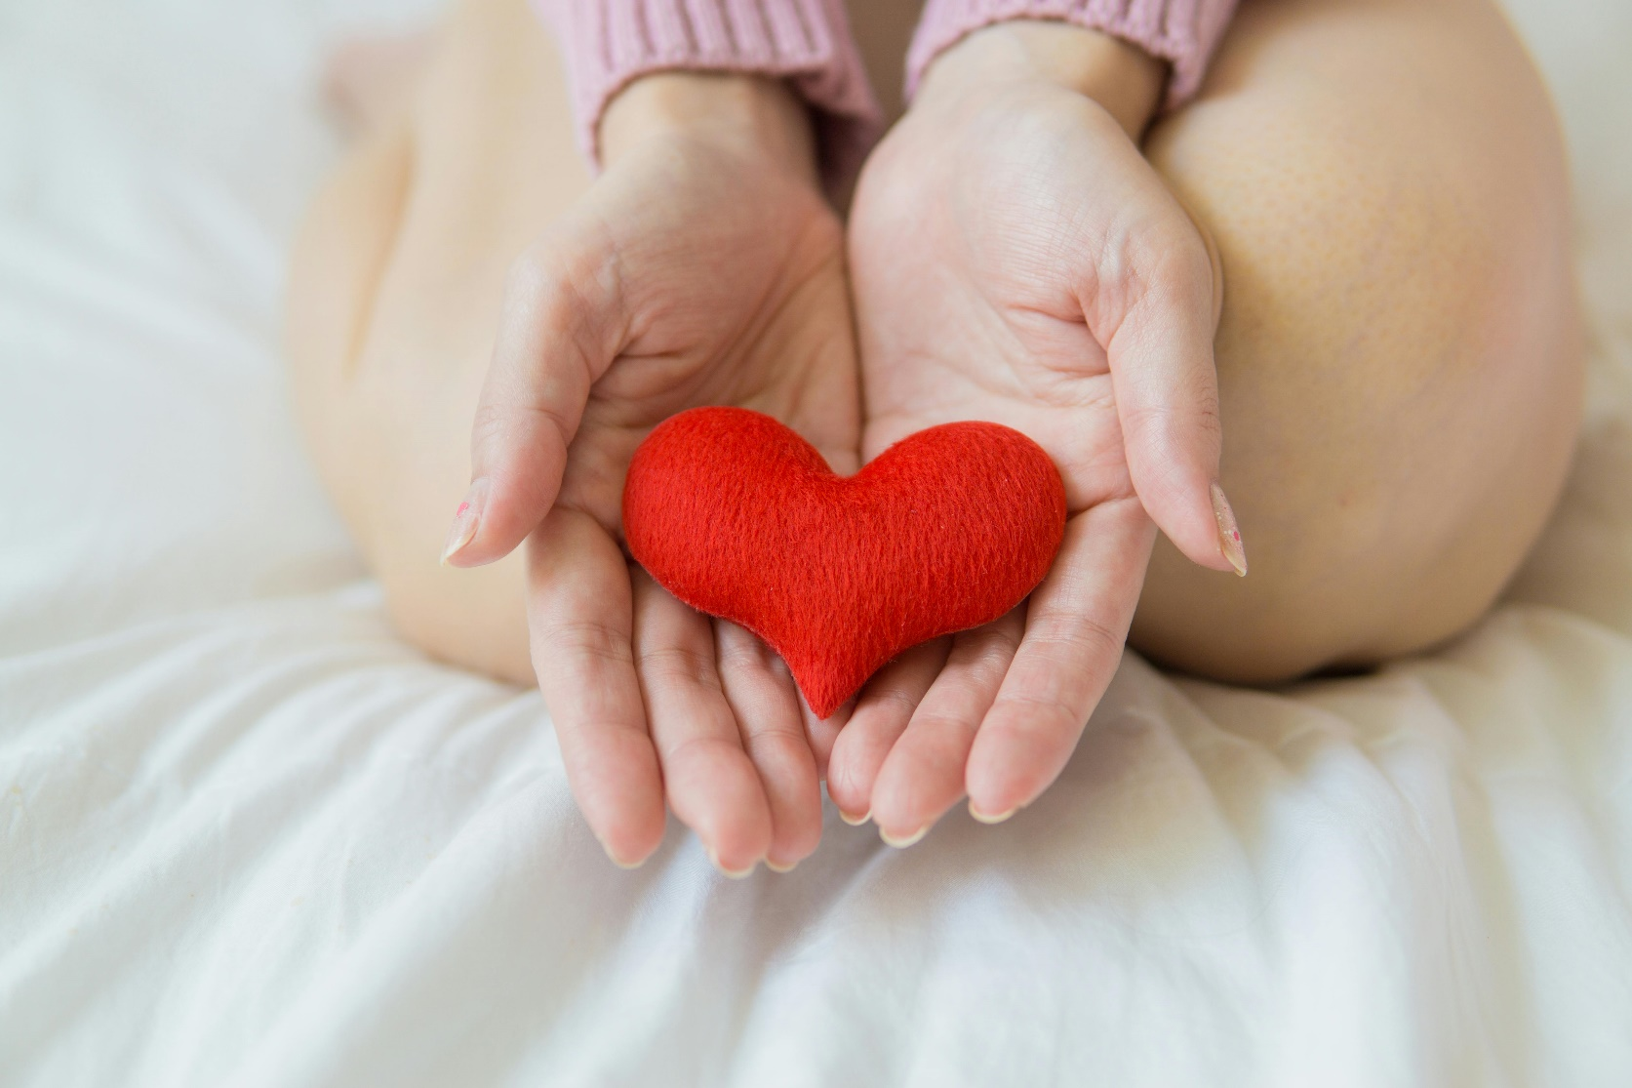
1.4 What is not a Healthy Lifestyle (Cont.)
What is not a Healthy Lifestyle
What Makes Life Harder?
⚠️ Eating too many sweets
⚠️ Drinking alcohol
⚠️ Smoking
⚠️ Drugs
⚠️ No sleep or too much stress

Slide 16
1.4 What is not a Healthy Lifestyle (Cont.)
What is not a Healthy Lifestyle
Smoking
  Smoking makes the heart beat faster.
  It makes the lungs tired.
  It makes stress stronger, not smaller.
  It can make you feel sad or tired later.

Slide 17
1.4 What is not a Healthy Lifestyle (Cont.)
What is not a Healthy Lifestyle
Eating Sweets
  Sweets taste good, but only for a moment.
  Too many sweets can make the body tired.
  They can make the stomach feel heavy.
  A small sweet is okay, but not too often.

Slide 18
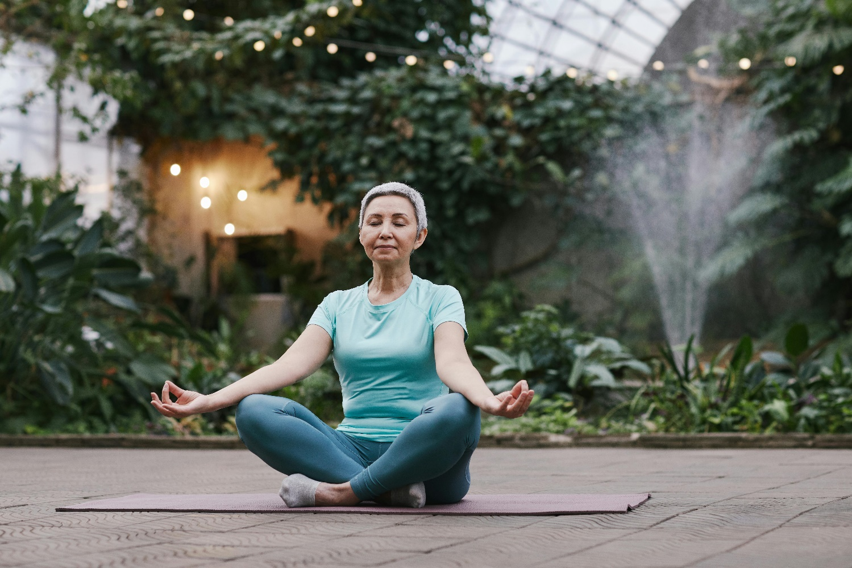
1.4 What is not a Healthy Lifestyle (Cont.)
What is not a Healthy Lifestyle
Overeating
  Eating too much can make the body slow.
  It can make sleep harder.
  Too much food at night can make the stomach hurt.
  Listening to your body helps you know when to stop.

Slide 19
1.4 What is not a Healthy Lifestyle (Cont.)
What is not a Healthy Lifestyle
What Is Cortisol?
The Body’s Stress Helper
  Cortisol is a hormone your body makes.
  It helps you wake up, think fast, or run if you are in danger.
  When you feel stress, cortisol goes up.
  When you rest, breathe slowly, or feel safe, cortisol goes down.
  Too much cortisol can make your stomach hurt, your heart beat fast, or your body feel tired.

Slide 20
1.4 What is not a Healthy Lifestyle (Cont.)
What is not a Healthy Lifestyle
Alcohol and Stress (Cortisol)
  Alcohol may feel relaxing for a moment.
  But alcohol makes the body produce more cortisol (the stress hormone)
  More cortisol makes the body feel tense, nervous, or sad later.
  Alcohol can make feelings stronger, not better.
  It can make sleep worse and the heart beat faster.
  Small healthy choices help the brain feel safe without alcohol.

Slide 21
1.4 What is not a Healthy Lifestyle (Cont.)
What is not a Healthy Lifestyle
Why Alcohol Does Not Help With Stress
  Alcohol slows the brain down at first.
  Then the brain must work harder later.
  This makes stress stronger, not smaller.
Alcohol can:
    Make sleep worse
    Increase tired or sad feelings
    Make the heart beat fast
    Make thinking and decisions harder
  The brain feels safer with healthy habits, not alcohol.

Slide 22
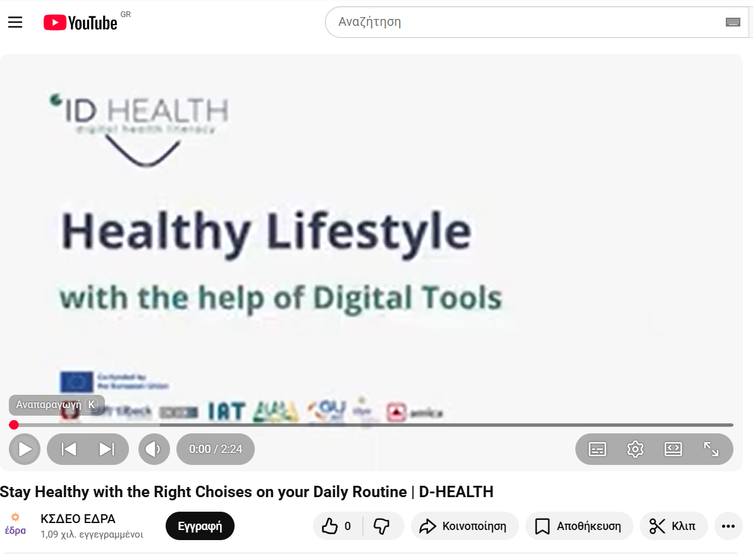
1.4 What is not a Healthy Lifestyle (Cont.)
What is not a Healthy Lifestyle
See You Tube video
Stay Healthy with the Right Choises on your Daily Routine | D-HEALTH
‘’A Day with Healthy Habits, John’s and Mary’s story’’
Who Are John and Maria?
John and Maria are people just like us.
Sometimes they feel happy.
Sometimes they feel stressed or tired.
They try their best every day and that is enough.

Slide 23
1.5 Digital Health Tools
Digital Health Tools
Moodtrackers
App where you choose your emotion (😀 happy, 😐 neutral, 😢 sad).
Example: John records his feelings every night. On Sunday, he sees he was happier when he went for a walk.

Slide 24
1.5 Digital Health Tools
Digital Health Tools
Meditation Apps
Guided exercises with sounds or voices for breathing and relaxation.
Example: Mary uses a 5-minute app with nature sounds before bed to calm down stress.

Slide 25
1.5 Digital Health Tools
Digital Health Tools
Fitness Devices
Watch or app that counts steps and sleep.
Example: Chris sees he walked 3,000 steps on Monday. His goal is 4,000, and the app celebrates when he reaches it.

Slide 26
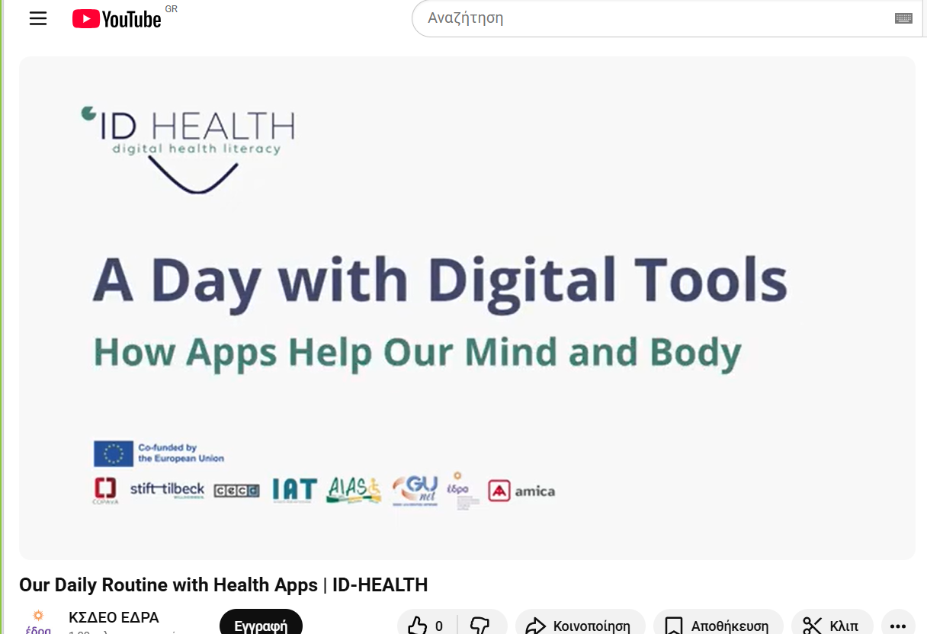
1.5 Digital Health Tools
Digital Health Tools
See You Tube video 2
Our Daily Routine with Health Apps | ID-HEALTH
‘’A Day with Digital Tools, John’s and Mary’s story’’

Slide 27
1.6 Benefits of Digital Health Tools
Benefits of Digital Health Tools
Autonomy=Being more independent
Digital tools give reminders (drink water, take medicine, go for a walk).
You don’t always need to ask someone else to remind you.
Example: A phone alarm says “Time to drink water!”
Self-Confidence=Feeling proud of yourself
When you reach a small goal, the app celebrates with you.
You can say: “I did it!”
Example: You wanted to walk 4,000 steps. You walked 4,200 steps. The app says: “Great job!”

Slide 28
1.6 Benefits of Digital Health Tools
Benefits of Digital Health Tools
Feedback=Seeing your progress
The phone, watch, or app shows what you have done.
Example: A sleep app shows you slept better last night than the night before. A mood app shows that you felt happy more times this week than last week.
Stress Management=Feeling calm
Relaxation apps help you calm down when stressed.
They guide you with breathing, music, or calming sounds.
Example: Before bed, you listen to soft music from an app and relax.

Slide 29
1.6 Benefits of Digital Health Tools (cont.)
Benefits of Digital Health Tools
  Motivation = Wanting to keep going
Digital tools show that every small action is important.
Example: A fitness app says: “You are only 200 steps away from your goal. Keep going!”
  Learning New Skills
Apps can teach us healthy habits.
Example: A food app can remind us to drink water or eat more vegetables.
  Sharing with Others
  Some apps let us share progress with friends or family.
Example: You send your walking steps to a friend, and they clap for you.

Slide 30
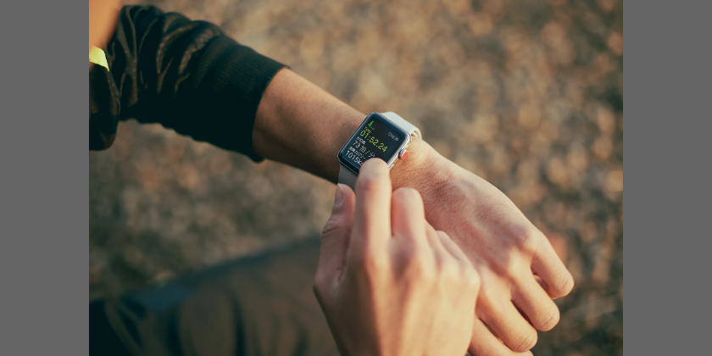
1.6 Benefits of Digital Health Tools (cont.)
Benefits of Digital Health Tools
Digital tools are like helpful friends:
They remind you.
They support you.
They encourage you.
They celebrate with you.

Slide 31
1.7 Activities (Examples)
Activities Examples
Activities (Examples)
Activity 1 (Moodtracker):
Record your mood every night for one week. At the end, check which day you were happiest and why.
Activity 2 (Meditation app):
Listen to a 3-minute breathing exercise. Afterward, say how you felt: calmer, more relaxed, or the same.
Activity 3 (Fitness device):
Count your steps in one day. Goal: +100 steps the next day.
Activity 4 (VR Guided exercise)
Use VR to create interactive experiences such as virtual nature walks, yoga classes, or simple movement exercises.

Slide 32
Activities Examples
1.7 Activities (Examples)
Check Worksheet 1
FACILITATOR’S GUIDELINES
Activity title: My Day with Digital Tools
Duration: 30 minutes
Purpose:
To help participants reflect on how digital tools support healthy routines throughout the day and encourage mindful, balanced use of technology.
Materials:
Worksheet copies, pens/markers, optional digital devices for examples.

Slide 33
Activities Examples
1.7 Activities (Examples)
Check Worksheet 1
FACILITATOR’S GUIDELINES
Steps:
Morning: Discuss how devices remind us to start the day (alarms, water reminders).
Midday: Explore healthy prompts (hydration, meal reminders, step counters).
Afternoon: Identify movement or exercise tracking tools.
Evening: Introduce relaxation or mindfulness apps.
Night: Reflect on feelings; use emojis or short sentences to describe mood.
Discuss:
Which digital tools help you most?
How can you use technology to stay balanced and calm?
What’s one digital habit you’d like to keep or change?

Slide 34
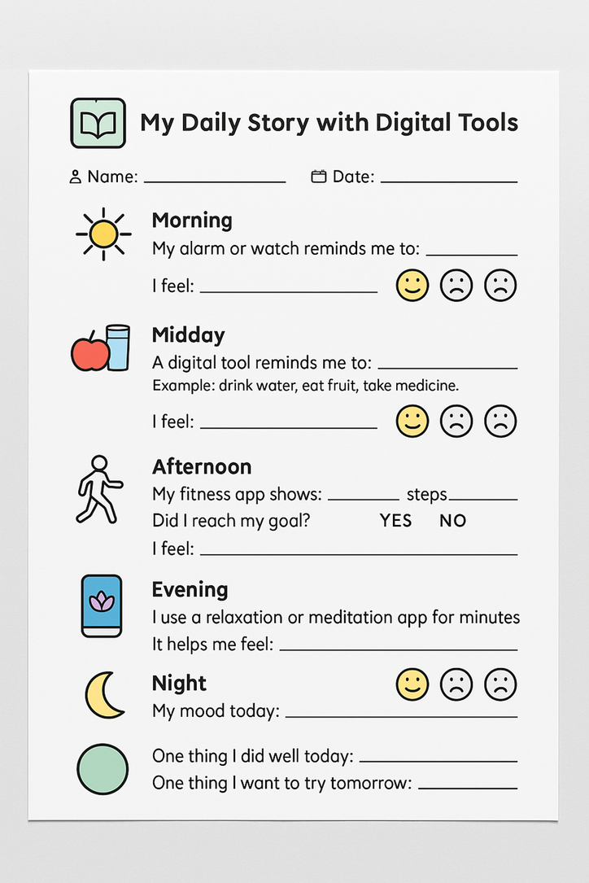
Activities Examples
1.7 Activities (Examples) (Cont.)
Morning
My alarm or watch reminds me to: ___________________________
I feel: 😊 😐 😢 (circle one)
Midday
A digital tool reminds me to: ___________________________
Example: drink water, eat fruit, take medicine.
I feel: 😊 😐 😢 (circle one)
Afternoon
My fitness app shows: ___________________________ steps.
My goal is: ___________________________ steps.
Did I reach my goal? YES / NO
I feel: 😊 😐 😢 (circle one)

Slide 35
Activities Examples
1.7 Activities (Examples) (Cont.)
Evening
I use a relaxation or meditation app for: __________ minutes.
It helps me feel: ___________________________
Night
My mood today: 😊 😐 😢 (circle one)
I am proud because: ___________________________
Reflection
One thing I did well today: ___________________________
One thing I want to try tomorrow: ___________________________

Slide 36
Activities Examples
1.7 Activities (Examples) (Cont.)
CATALOGUE SHEET
Health Swap
  Created by Down’s Syndrome Association in the UK to support healthier eating & exercise for people with Down Syndrome (who have intellectual disability) through an app with large images, simple navigation, weekly meal plan ideas and a shopping-list generator. Able Magazine
  Strengths: Good example of accessible design for ID/IDD (e.g., large fonts/images, simplified navigation), focused on nutrition + exercise.
IDHEApp
  An accessible mobile application developed with involvement of people with ID/IDD, offering personalised content for improving lifestyle (health behaviours) within the project context. ceipes.org
  Strengths: Co-designed with target users, hence more likely to be user-friendly; focuses on healthy lifestyle behaviours (not only exercise).

Slide 37
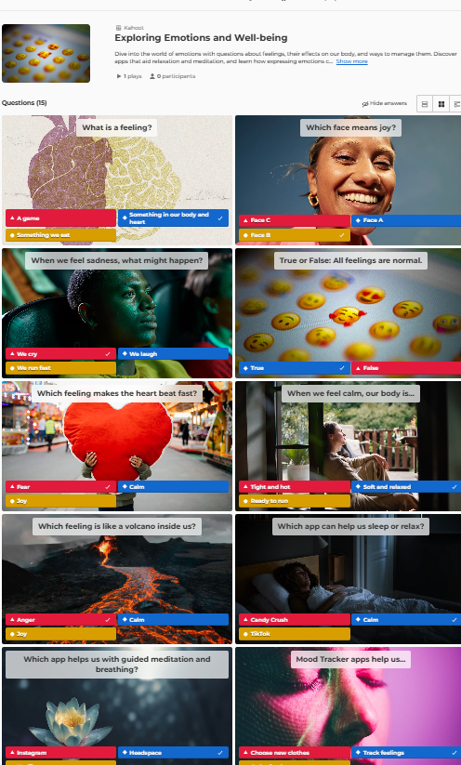
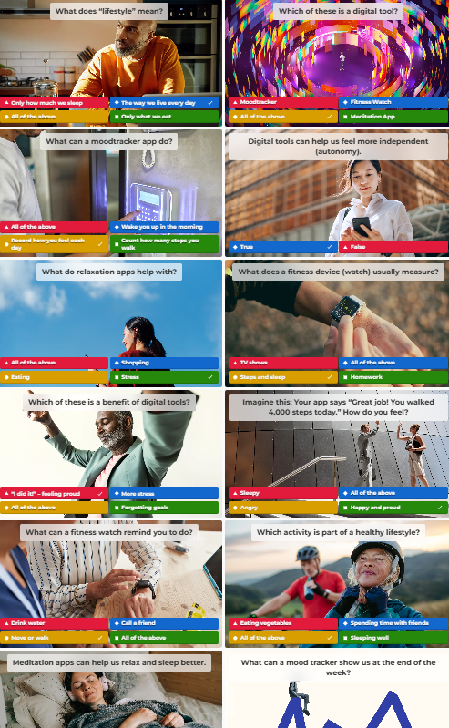
1.8 Quiz & Feedback
What did we learn today?
  Use my phone for health.
  Learn to relax with guided exercises.
  Record how I feel.
  Set small goals and achieve them.
  Quiz and your opinion
  We are taking a quiz: How do I feel now? “Happy Apps, Healthy You!”

